Slide 1
Sanity Checks for Saliency Maps

Slide 2
Overview
Feature Attribution / Saliency Maps Setup
Overview of Sanity Checks for Saliency Maps
Follow-up work
Parting thoughts / Q&A

Slide 3
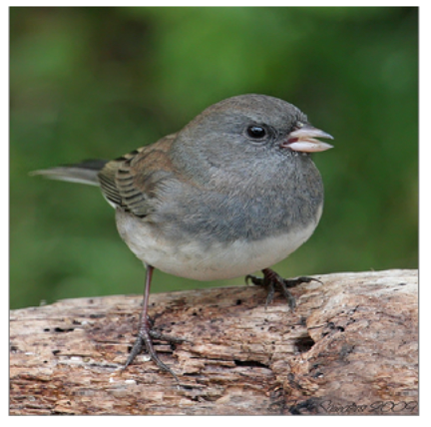
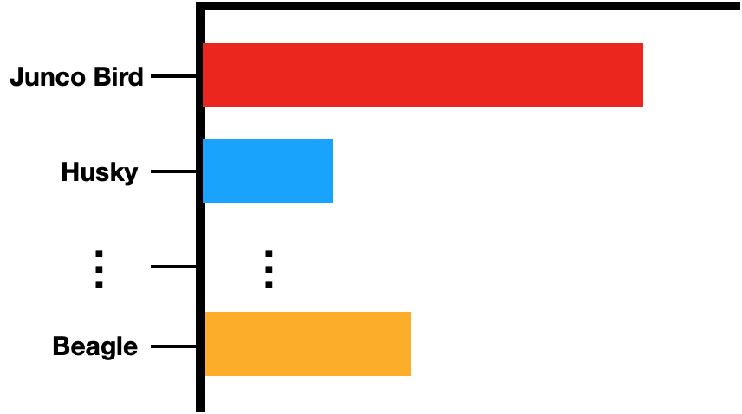
Feature Attributions / Saliency Maps
Input
Model
Prediction
What parts of the input are ‘most important’ for the model prediction Junco Bird?

Slide 4
Feature Attributions / Saliency Maps
Input
Model
Prediction
What parts of the input are ‘most important’ for the model prediction Junco Bird?
Feature Attribution / Saliency Map

Slide 5
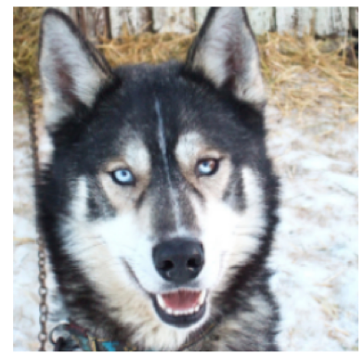
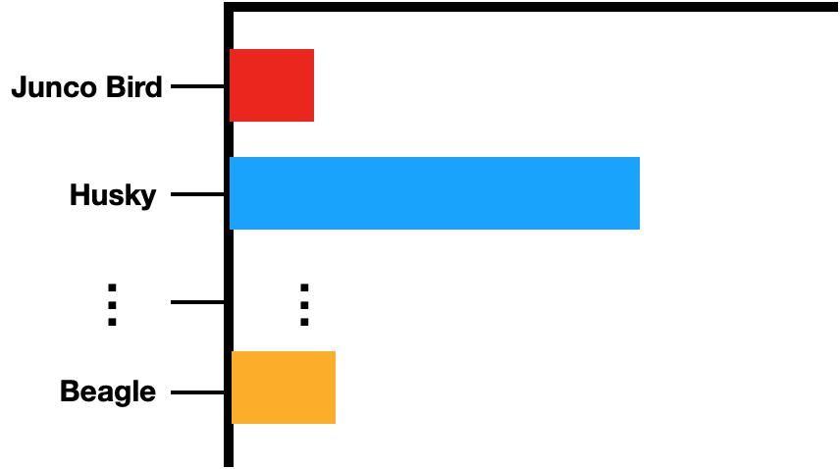
Identifying Shortcuts
Input
Model
Prediction
What parts of the input are ‘most important’ for the model prediction Husky?

Slide 6
Identifying Shortcuts
Input
Model
Prediction
What parts of the input are ‘most important’ for the model prediction Husky?

Slide 7
Identifying Shortcuts
Input
Model
Prediction
What parts of the input are ‘most important’ for the model prediction Husky?
Collect additional data to fix the bug.
Model relying on snow to identify Huskies.

Slide 8
Feature Attributions / Saliency Maps
Input
Model
Prediction
Feature attribution method: assigns an output ‘relevance’ score to each dimension of the input.

Slide 9
Feature Attributions / Saliency Maps
Input
Model
Prediction
Feature attribution method: assigns an output ‘relevance’ score to each dimension of the input.
Model
class specific logit

Slide 10
Input-Gradient / Saliency / Gradient
Model
Input

Slide 11
Input-Gradient / Saliency / Gradient
Model
Input
Input-Gradient
Same dimension as the input.
Logit
Input
Baehrens et. al. 2010; Simonyan et. al. 2014

Slide 12
Input-Gradient / Saliency / Gradient
Model
Input

Slide 13
Integrated Gradients
Model
Input
Path integral: ‘sum’ of interpolated gradients
Baseline input
Sundararajan et. al. 2017

Slide 14
Integrated Gradients
Model
Input
Sundararajan et. al. 2017

Slide 15
SmoothGrad
Model
Input
Gaussian noise

Slide 16
Guided Backprop: “Modified Backprop”
Model
Input

Slide 17
Guided Backprop
Model
Input

Slide 18
Guided Backprop
Model
Input

Slide 19
Recap
Model
Input

Slide 20
Recap
Model
Input

Slide 21
Recap
Class Activation Mapping (Zhou et. al. 2016).
Meaningful Perturbation (Fong et. al. 2017).
RISE (Petsuik et. al. 2018).
Extremal Perturbations (Fong & Patrick 2019).
DeepLift (Shrikumar et. al. 2018).
Expected Gradients (Erion et. al. 2019)
Excitation Backprop (Zhang et. al. 2016)
GradCAM (Selvaraju et. al. 2016)
Guided GradCAM (Selvaraju et. al. 2016)
Occlusion (Zeiler et. al. 2014).
Prediction Difference Analysis (Gu. et. al. 2019).
Internal Influence (Leino et. al. 2018).
See for additional methods: Samek & Montavon et. al. 2020

Slide 22
Recap: which method should you use?
Model
Input

Slide 23
‘Sanity Checks’
Intuitive ‘principles’ that an attribution method should satisfy.
‘Model’ Faithfulness: is the ‘explanation’ sensitive to model parameters?
Test: change the model weights and measure corresponding change in explanation.
Operationalize by reinitialization of model weights.
Data Faithfulness: is the attribution sensitive to training data?
Test: change training label and measure corresponding change in explanation.
Operationalize by randomization labelling in training data.

Slide 24
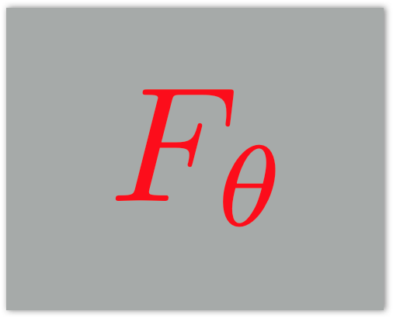
Sensitivity to model parameters
If the parameter settings change of model changes the saliency map should change.
Model 1
Model 2

Slide 25
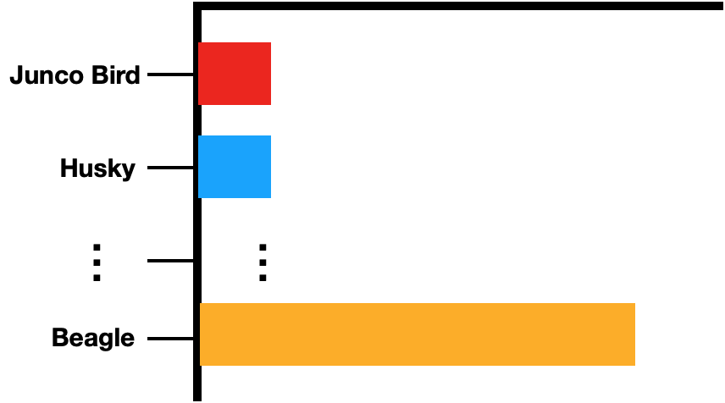
Sensitivity to model parameters
If the parameter settings change of model changes the saliency map should change.
Model 1
Model 2

Slide 26
Sensitivity to model parameters
If the parameter settings change of model changes the saliency map should change.
Model 1
Saliency Map 1
Model 2
Saliency Map 2

Slide 27
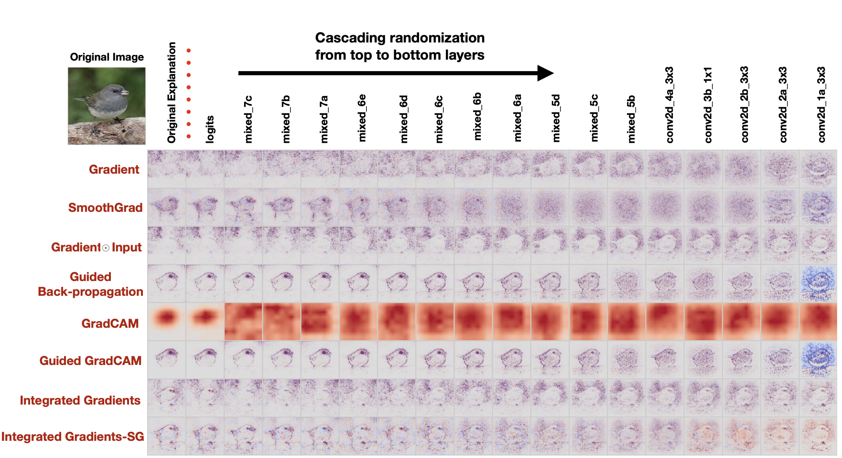
Sensitivity to model parameters

Slide 28
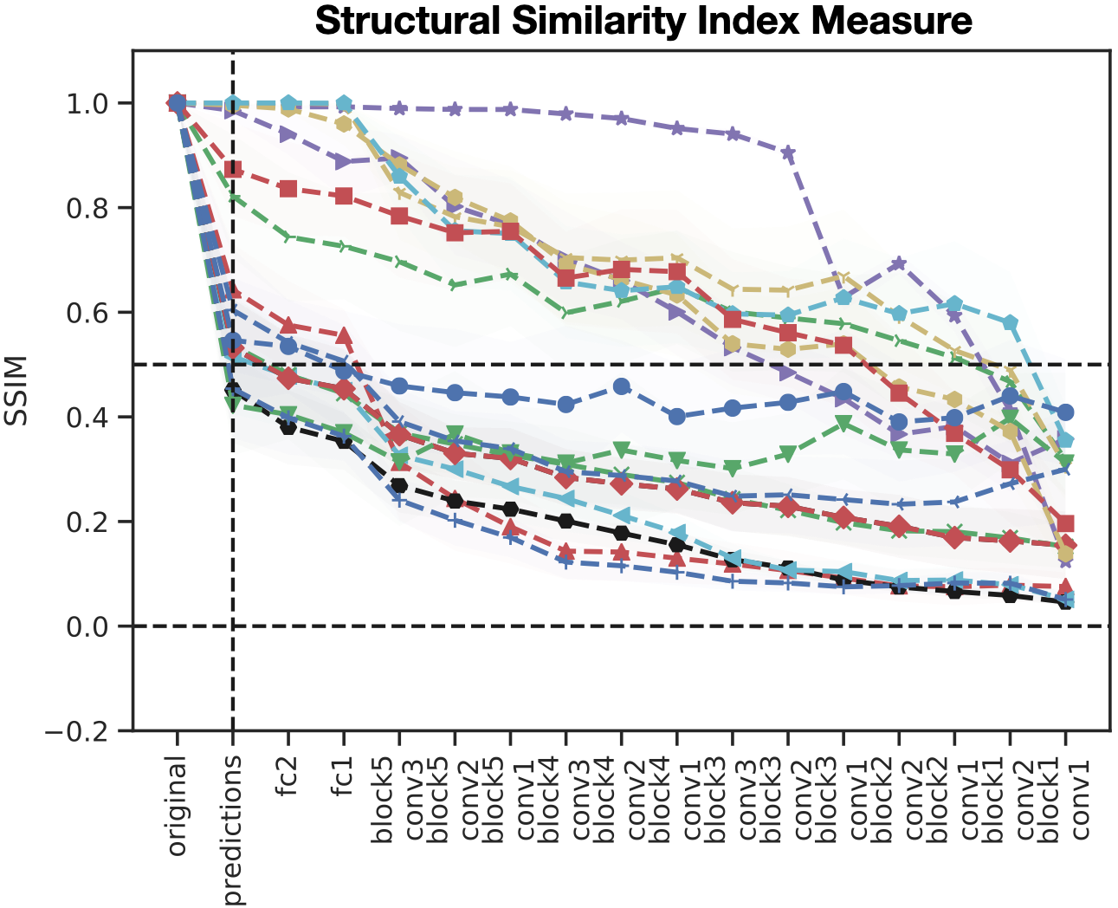
Sensitivity to model parameters

Slide 29
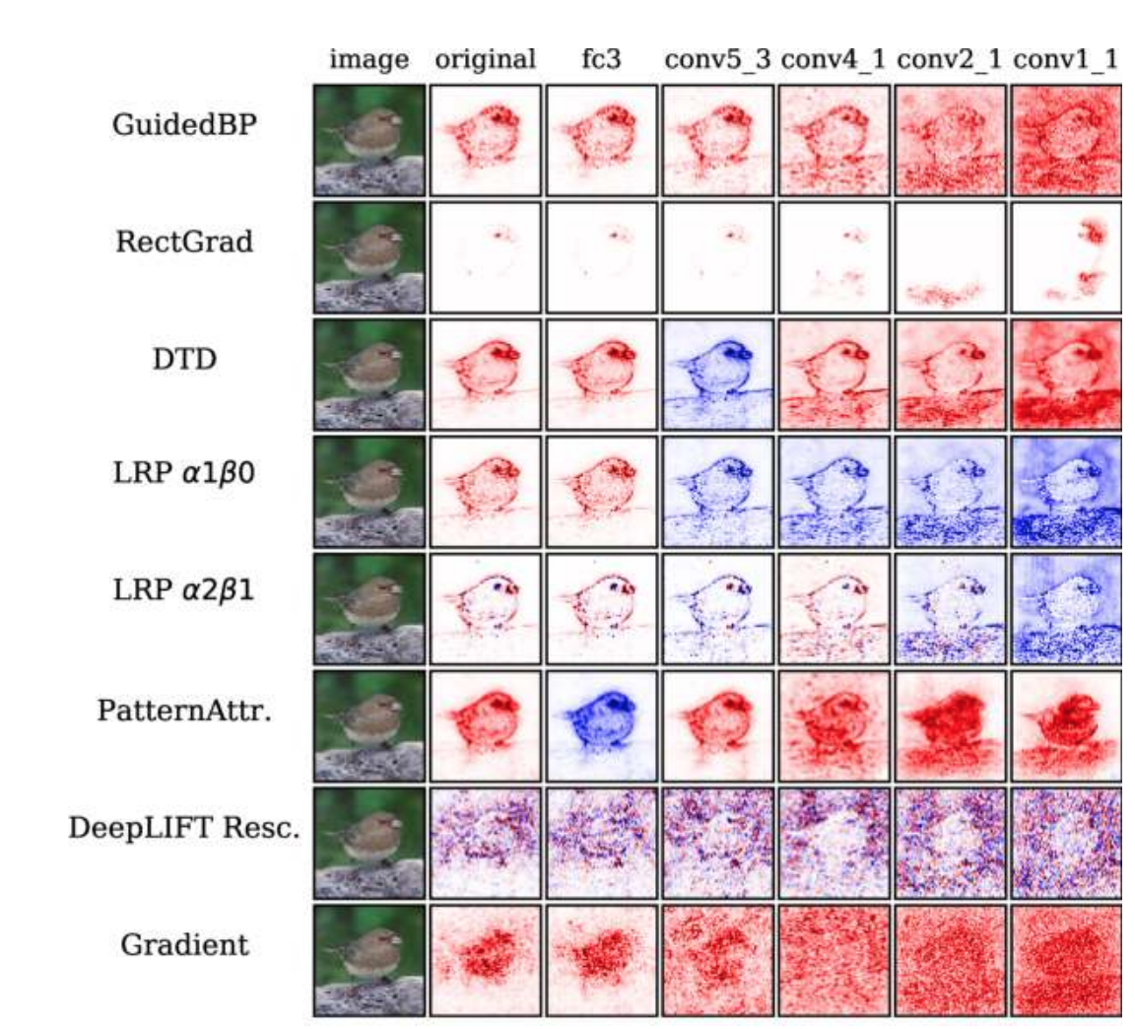
Modified BackProp Approaches
These modified backprop methods converge to a rank-1 matrix! This is because the product of a sequence of non-negative matrices (non-orthogonal columns) converges to a rank-1 matrix (Theorem 1 in Sixt et. al. 2020).

Slide 30
Recap: which method should you use?
Model
Input

Slide 31
Some Takeaways
Identified certain classes of feature attribution methods that are invariant to higher layer weights.
‘Sanity Checks’ are actually ‘weak’ requirements, i.e., does not tell you whether a method is effective.

Slide 32
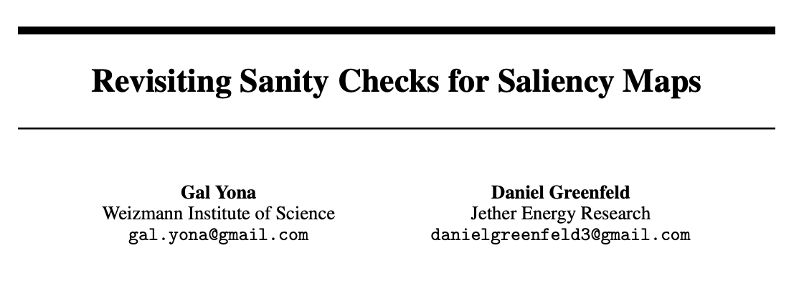
Some objections
Causal reframing suggests that sanity checks results might be task specific.

Slide 33
Some objections
Where you choose to perform randomization matters, and perhaps the weight randomization is not the best approach.

Slide 34
More recent observations: Spurious
Beyond faithfulness, it is unclear whether these feature attribution methods are effective for model debugging.

Slide 35
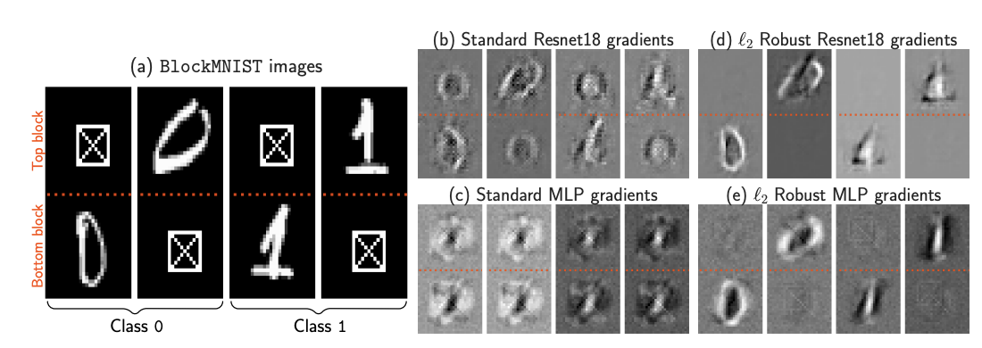
More recent observations

Slide 36
Parting Thoughts
Feature attribution is still important for applications, however, additional is needed to characterize the properties of DNN model training that will result in ‘gradients’ that capture discriminative signals.

