Slide 1
Attention is not Explanation
Authors: Sarthak Jain, Byron C. Wallace
Presenters: Nikhil Nayak, Sree Harsha Tanneru, Hongjin Lin
2023/03/06

Slide 2
Attention Mechanism is a “recent” breakthrough in NLP
2015: birth of attention mechanism in NLP
“Neural machine translation by jointly learning to align and translate” Bahdanau et al. 2015
2017: birth of transformers based on self attention mechanism
“Attention is all you need” Vaswani et al. 2017
Source: Galassi et al. 2021
Notes:
Attention is proposed as a solution to the limitation of the Encoder-Decoder model which encodes the input sequence to one fixed length vector from which to decode the output at each time step. This issue is believed to a problem when decoding long sequences because it make difficult for the neural network to cope with long sentences, especially those that are longer than the sentences in the training corpus.
The basic idea in Attention is that each time the model tries to predict an output word, it only uses parts of an input where the most relevant information is concentrated instead of an entire sentence i.e it tries to give more importance to the few input words.

Slide 3
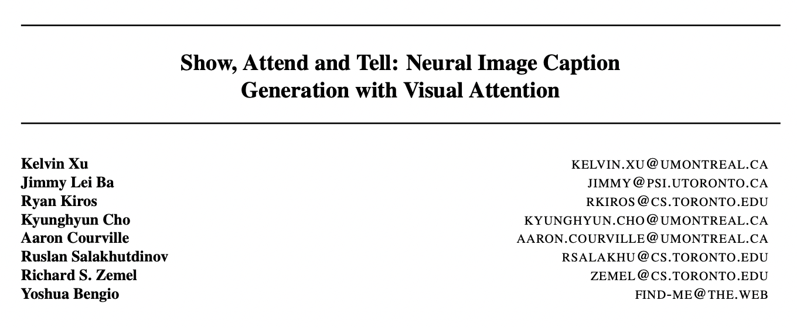
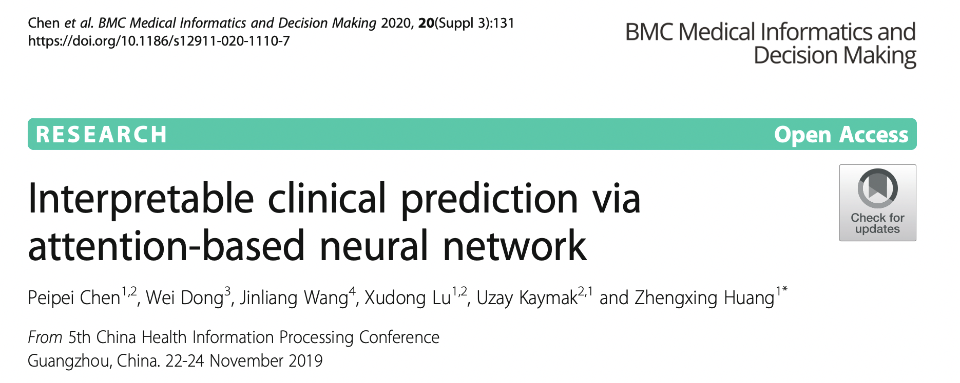
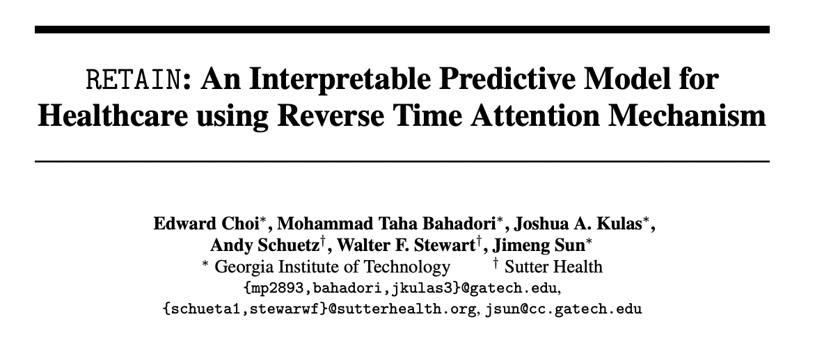
Many use attention as an explanation mechanism

Slide 4
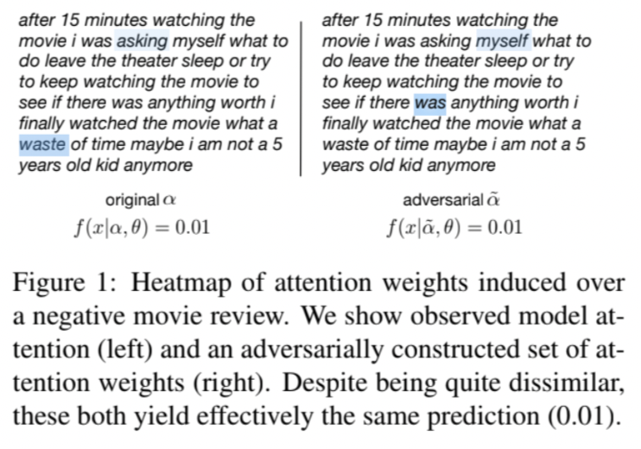
But does attention necessarily provide faithful explanation?
What do you think?

Slide 5
Research Questions
What is the degree to which attention weights provide meaningful “explanations" for predictions?
Consistency: To what extent do induced attention weights correlate with measures of feature importance – specifically, those resulting from gradients and leave-one-out (LOO) methods?
Counterfactual attention weights: Would alternative attention weights (and hence distinct heatmaps/“explanations”) necessarily yield different predictions?

Slide 6
Contributions and main findings
Standard attention modules do not provide meaningful explanations and should not be treated as though they do.
Learned attention weights are frequently uncorrelated with gradient-based measures of feature importance.
One can identify very different attention distributions that nonetheless yield equivalent predictions.

Slide 7
Experimental setup
Binary Text Classification
Question Answering
Natural Language Inference
1 - Correlation between attention and feature importance
2 - Counterfactual attention weights
Notes:
Add more summary here to open it up for Nikil and Hasha

Slide 8
Correlation between Attention and Feature Importance
To what extent do induced attention weights correlate with measures of feature importance?
Specifically two methods are considered:
Feature gradient methods
Leave-One-Out (LOO) method

Slide 9
Gradient based Feature Importance
To use the feature gradient method, we compute the gradient of the output with respect to each input feature.
This tells us how much changing each feature would affect the output.
We can visualize this by highlighting the input features that have the highest absolute gradient values.
Notes:
For example, if we are using a neural network to classify images of cats and dogs, we might find that the network is paying more attention to the shape of the ears than the color of the fur.

Slide 10
Feature Erasure/LOO
To use the LOO method, we remove one input feature at a time and observe how the output changes.
This allows us to measure the impact of each feature on the output.
We can visualize this by highlighting the input feature that is removed and showing the change in the output.
Notes:
For example, if we are using a neural network to classify images of cats and dogs, we might find that erasing the shape of the ears has a bigger impact on the output than erasing the color of the fur.

Slide 11
Distribution Change Measure for Experiments
Total Variation Distance (TVD), Kendall's τ coefficient

Slide 12
Algorithm for Feature Importance Computations

Slide 13
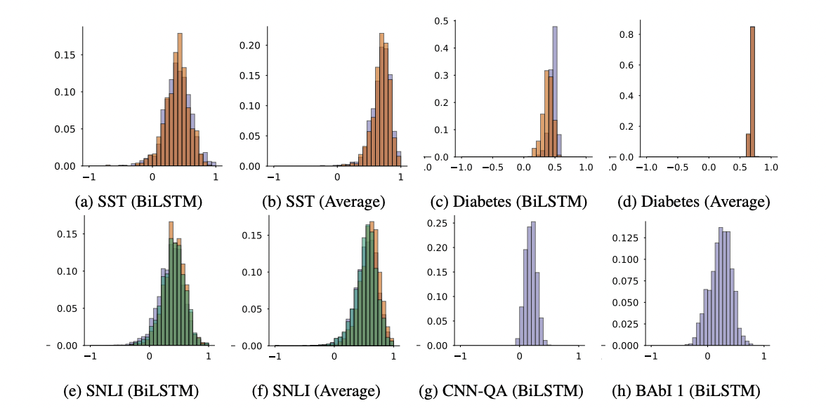
Feature Gradients Results
Histogram of Kendall correlation between attention and gradients.

Slide 14
Correlation Comparison - Attention, Gradients, LOO
Mean difference in correlation.
Fig 1 - LOO, Gradients V/S Attention, LOO. Fig 2 - LOO, Gradients V/S Attention, Gradients.

Slide 15
Possible Limitations in Experiment Results
Potential issues with Kendall T correlation measure - Many irrelevant features may add noise to the correlation measures.
Alternative measures of feature importance, such as gradients and LOO, may not necessarily be considered ideal or deemed as the 'ground truth' for comparison purposes.
Notes:
However we might expect such noise to depress the LOO and gradient correlations to the same extent as they do the correlation between attention and feature importance scores.
While such measures do enjoy a clear intrinsic (to the model) semantics, their interpretation in the context of nonlinear neural networks can nonetheless be difficult for humans

Slide 16
Counterfactual Attention Weights
What is the degree to which attention weights provide meaningful “explanations" for predictions?
Consistency i.e; correlation with other measures of feature importance
Counterfactual attention distributions should yield corresponding changes in predictions.
Notes:
Look back at the original question
Why is the second property desirable ? If not, they’re equally plausible explanations. If there are multiple explanations, we cannot conclude that model made a particular prediction because it attended to inputs in a specific way.
We’ve seen that attention-based explanations lack consistency. So, the first property doesn’t hold well
Now we test the second property i.e; would alternative attention distributions yield different predictions ?

Slide 17
Counterfactual Attention Weights
Would the prediction be different if the model attended to different input features ?
Two experiments
Attention Permutation: Scramble the original attention weights
Adversarial Attention: Generate an adversarial distribution that is maximally distinct from the observed attention weights, whilst simultaneously close to the observed prediction

Slide 18
Attention Permutation - Algorithm
Notes:
Add animation step by step
Intuition - If we scramble attention weights, we attend to different inputs, hence we expect different predictions
Observation - Scrambling the attention makes little difference to the prediction

Slide 19
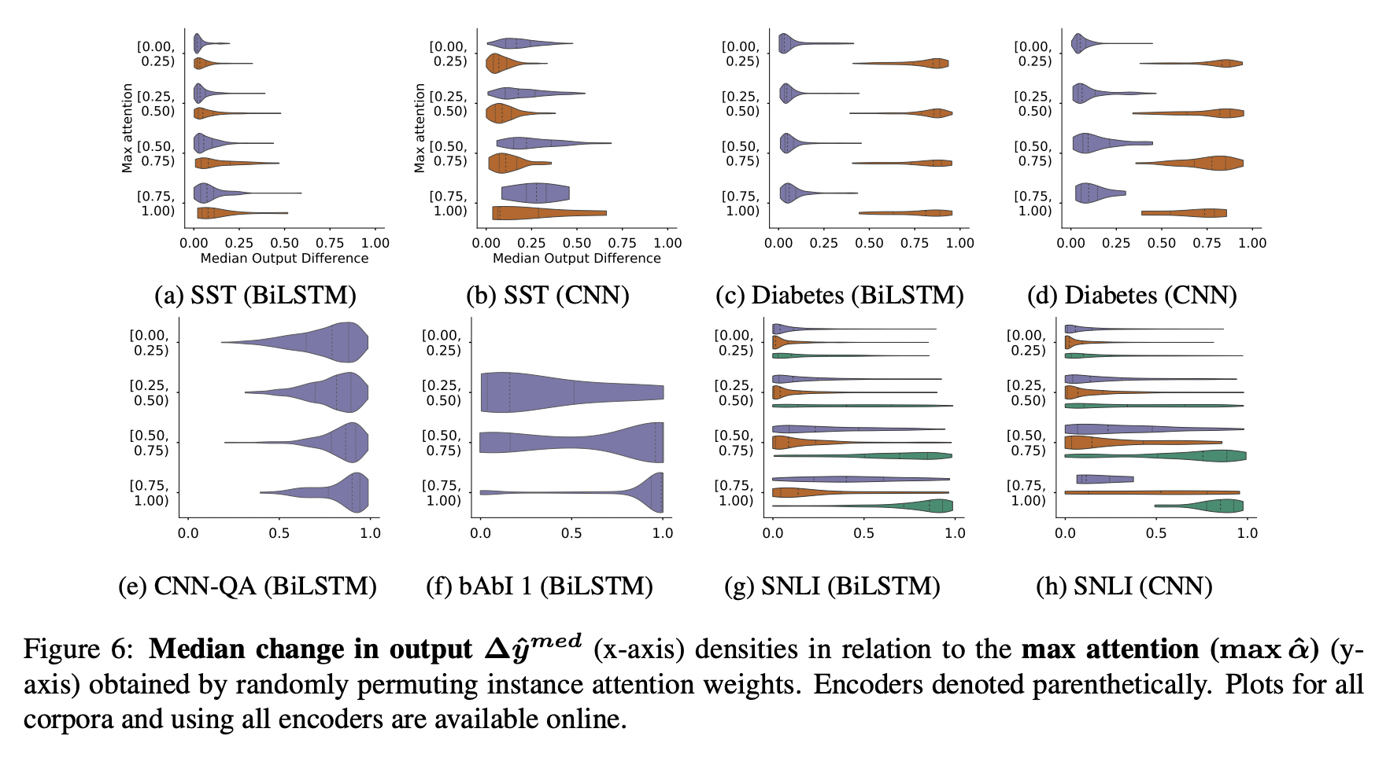
Attention Permutation - Results
Plot Δy at different peak attention values
Notes:
Plot between maximum attention weight and median model output change.
Colors indicate class predictions
High values of maximum attention weight implies model is attending to a small set of features.
Colors again indicate class predictions, as above.
Exception - Predicting ICD codes from notes using the MIMIC dataset, one can see different behavior for the respective classes. For the Diabetes task, e.g., attention behaves intuitively for at least the positive class; perturbing attention in this case causes large changes to the prediction.
How is this plot useful ?
For SST classification task, we see that median output difference is small even at high values of maximum attention weight. Permuting attention weights doesn’t make much difference to prediction.
However, for Diabetes classification, we observe that prediction changes for positive class on permuting attention weights. Probably due to certain keywords being high precision indicators of positive class (this could be a flaw in experiment design). We also noticed that mean difference in correlations is less for Diabetes dataset.
For CNN-QA task, the plot is as expected

Slide 20
Adversarial Attention
Explicitly seek out attention weights that differ as much as possible from observed attention weights, yet leaving prediction almost unchanged.
Why ?
Alternative attention distributions identified for the same output may be viewed as equally plausible explanations for the same output. Is this undesirable ?
Cannot conclude that model made a specific prediction because it attended over inputs in a certain way.
Lack of specificity makes constructing counterfactual explanations hard ?
Makes model less trustworthy ?
Notes:
Hypothesis: Shifting model attention to very different input features should yield corresponding changes in output

Slide 21
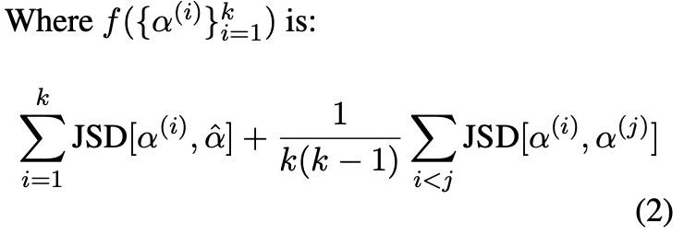
Adversarial Attention - Optimisation
Notes:
Adam optimisation is straightforward
We want to identify a set of new attention distributions that is as far as possible from observed alpha and from each other, whilst keeping the model prediction close to observed prediction.
The first term in objective f is to find maximally distinct attention distribution from observed attention distribution.
The second term in objective f is to maximise our k candidates are distinct from each other too.
We want to find k candidate distributions with maximum distance from alpha, but within epsilon of prediction
KL Divergence isn’t a symmetric measure.
Note that ‘k’ is setup as part of the optimization problem.
Upper bound on JSD

Slide 22
Adversarial Attention - Algorithm
Notes:
Add animation step by step
Out of the k candidate distributions, pick the one with highest JSD from observed attention distribution

Slide 23
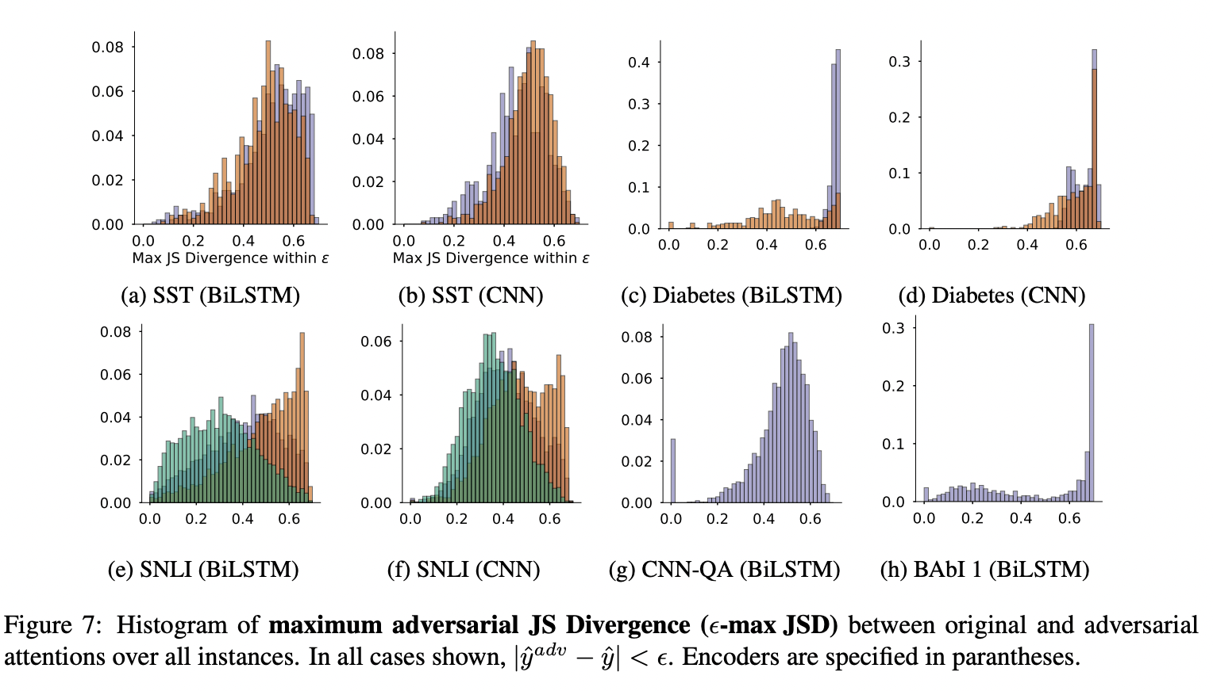
Adversarial Attention - Results
Notes:
High JSD is observed for many classification datasets. Color indicates class.
Low JSD for positive class in Diabetes classification.

Slide 24
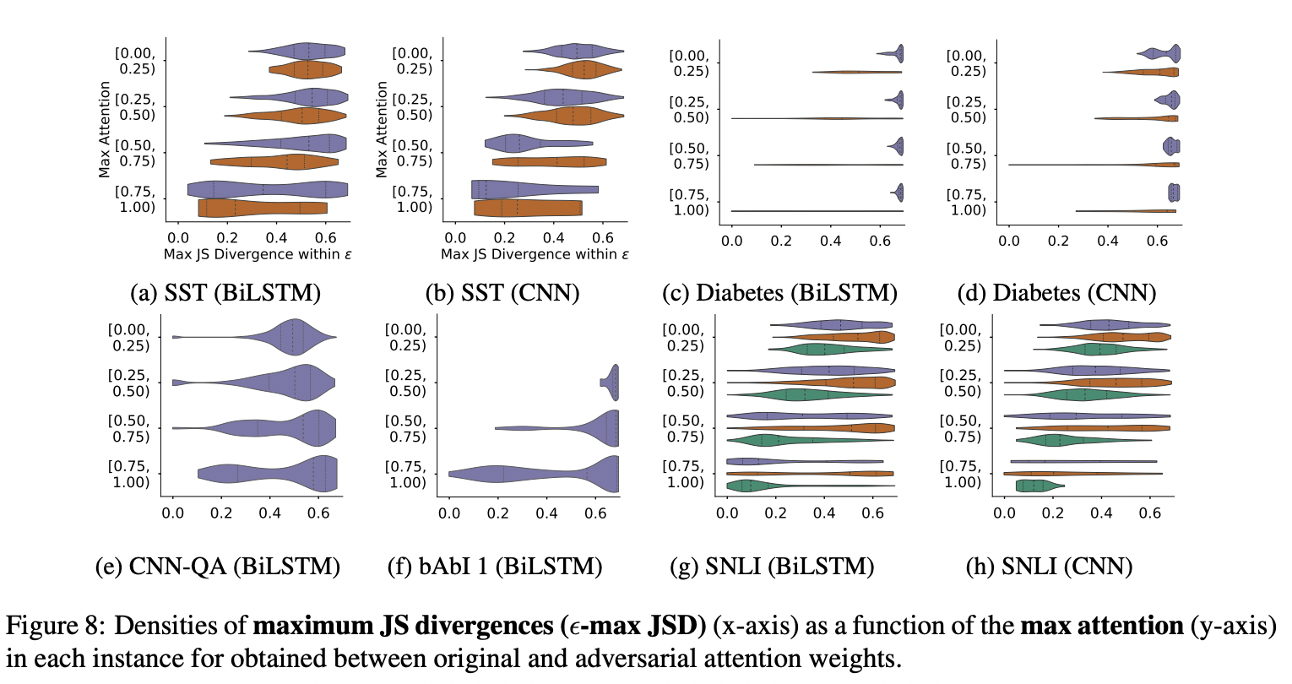
Adversarial Attention - Results
Notes:
We plot the maximum observed attention and JS Divergence of adversary. As peak attention value increases, we expect that it’s harder to find an adversarial distribution. It is reflected in the graph too.
As peak attention increases, JS divergence density is concentrated at lower values. This agrees with our intuition.
However, there are adversarial combinations exist with high JS Divergence, which imply using observed attention distribution as an explanation is misleading.

Slide 25
Counterfactual Attention - Limitations
Adversarial weights may themselves be unlikely under model parameters
There are instances where a single explanation out of multiple plausible explanations is sufficient.
Notes:
Nothing wrong with multiple attention distributions

Slide 26
Overall Limitations
Alternate attention mechanisms are not explored
Limited evaluations to classification, QA, and NPI tasks. seq2seq tasks are not considered.

Slide 27
Critique and Discussion
Wiegreffe, S. & Pinter, Y. (2019). Attention is not not Explanation. In Proceedings of the 2019 Conference on EMNLP-IJCNLP (pp. 11-20).
Attention distribution is not a primitive.
Is attention necessary for prediction ?
Is the variance in attention distributions unusual ? i.e; How adversarial are the adversaries ?
Do you agree with the authors’ conditions of a “faithful explanation”?
Do you think attention constitutes a “sufficient” explanation ?
What other conditions should we consider as a good explanation?
How can experts be brought into evaluate conditions of good explanations?
Notes:
Attention distribution is not a primitive. Computed adversarial weights maybe scored unlikely under the model parameters.
Is attention even needed for prediction ?
If attention mechanism isn’t used in the first place, there’s no point in using their output for explanations.
Is the variance in attention distributions unusual ?
Future work shows that same model when trained with different random weight initialisations yielded similar variance in JS Divergence.
Do you agree with the authors’ conditions of a “faithful explanation”? The paper states that the requisite for attention distributions to be used as explanation is that there must only exist one or a few closely-related correct explanations for a model prediction.
Do you think attention is an explanation ?
Depends on the definition of explanation. If you are looking for a plausible explanation, yes. One true faithful explanation, no.
We should first clarify task-specific explanation needs. Attention mechanisms are a vehicle of partial transparency. They provide insights into the inner workings of the model.

