Slide 1
Explaining by Removing:
A Unified Framework for Model Explanation*
Authors: Ian C. Covert, Scott Lundberg, Su-In Lee
Presenters: Hongjin Lin, Jason Wang, Oam Patel
Monday 03/27/2023
* Journal of Machine Learning Research, 2021

Slide 2
Motivation
There have been an explosion of explainability methods
There is a need for a unifying framework
?
…
Notes:
MIR creates a segmentation of edges and regions and iteratively removes segments from the image (selecting those that least decrease the classification probability) until the remaining image is incorrectly classified.
LIME calculates feature attribution values by fitting a weighted regularized linear model to an interpretable representation of the input.

Slide 3
Contributions
A unified framework that characterizes 26 existing explanation methods → removal-based explanations.
Mathematical tools to represent different approaches for removing features from ML models.
Removal-based explanations are implicitly tied to cooperative game theory → advantages of the Shapley value over alternative allocation strategies.
Feature removal is a simple application of subtractive counterfactual reasoning.

Slide 4
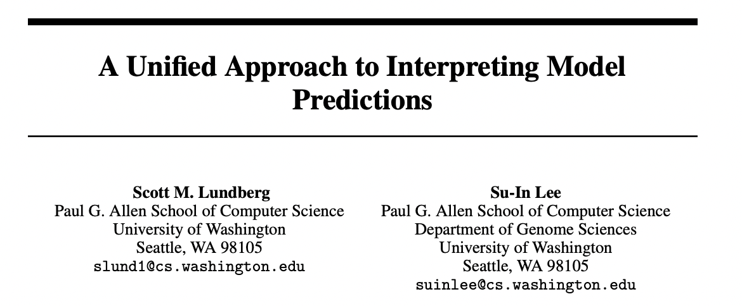
Previous Unifying Efforts
2017
LIME, DeepLIFT, LRP, QII, …
2017
SHAP
Grad * Input, DeepLIFT, LRP and Integrated Gradients
modified gradient back propagations
2020
permutation tests, Shapley Net Effects, feature ablation, SAGE…
additive importance measures
Notes:
SHAP
One innovation that SHAP brings to the table is that the Shapley value explanation is represented as an additive feature attribution method, a linear model. That view connects LIME and Shapley values.
Modified gradient back propagations (talked about in class)
Additive importance measures:
understood as performance gains associated with each feature
Proposed Shapley additive global importance (SAGE), for quantifying a model’s dependence on each feature
Additive model: Any statistical or mathematical model in which an effect can be expressed as a weighted sum of independent variables, so that the portion of the effect contributed by one independent variable does not depend on the value of any other independent variable.

Slide 5
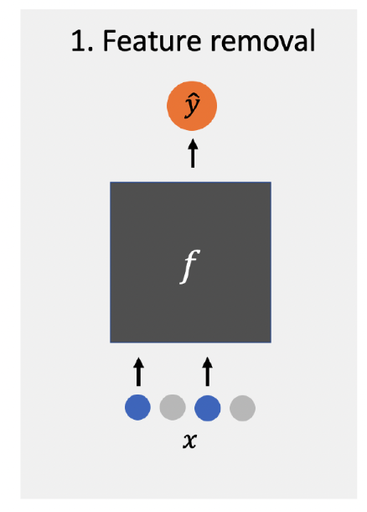
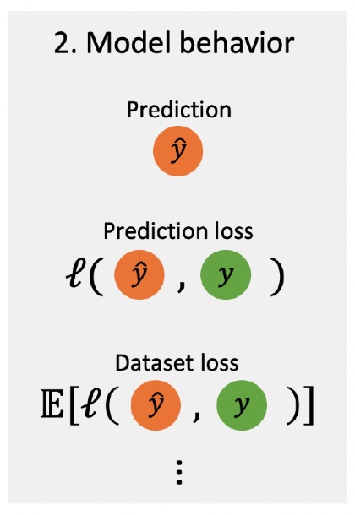
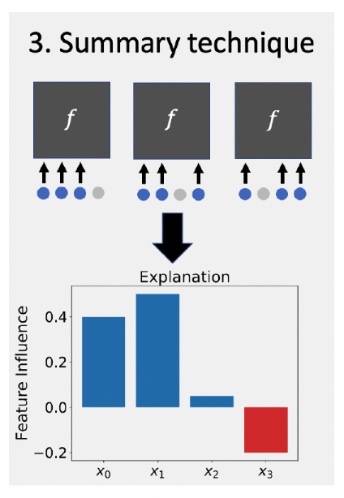
The Removal-based Explanations Framework

Slide 6
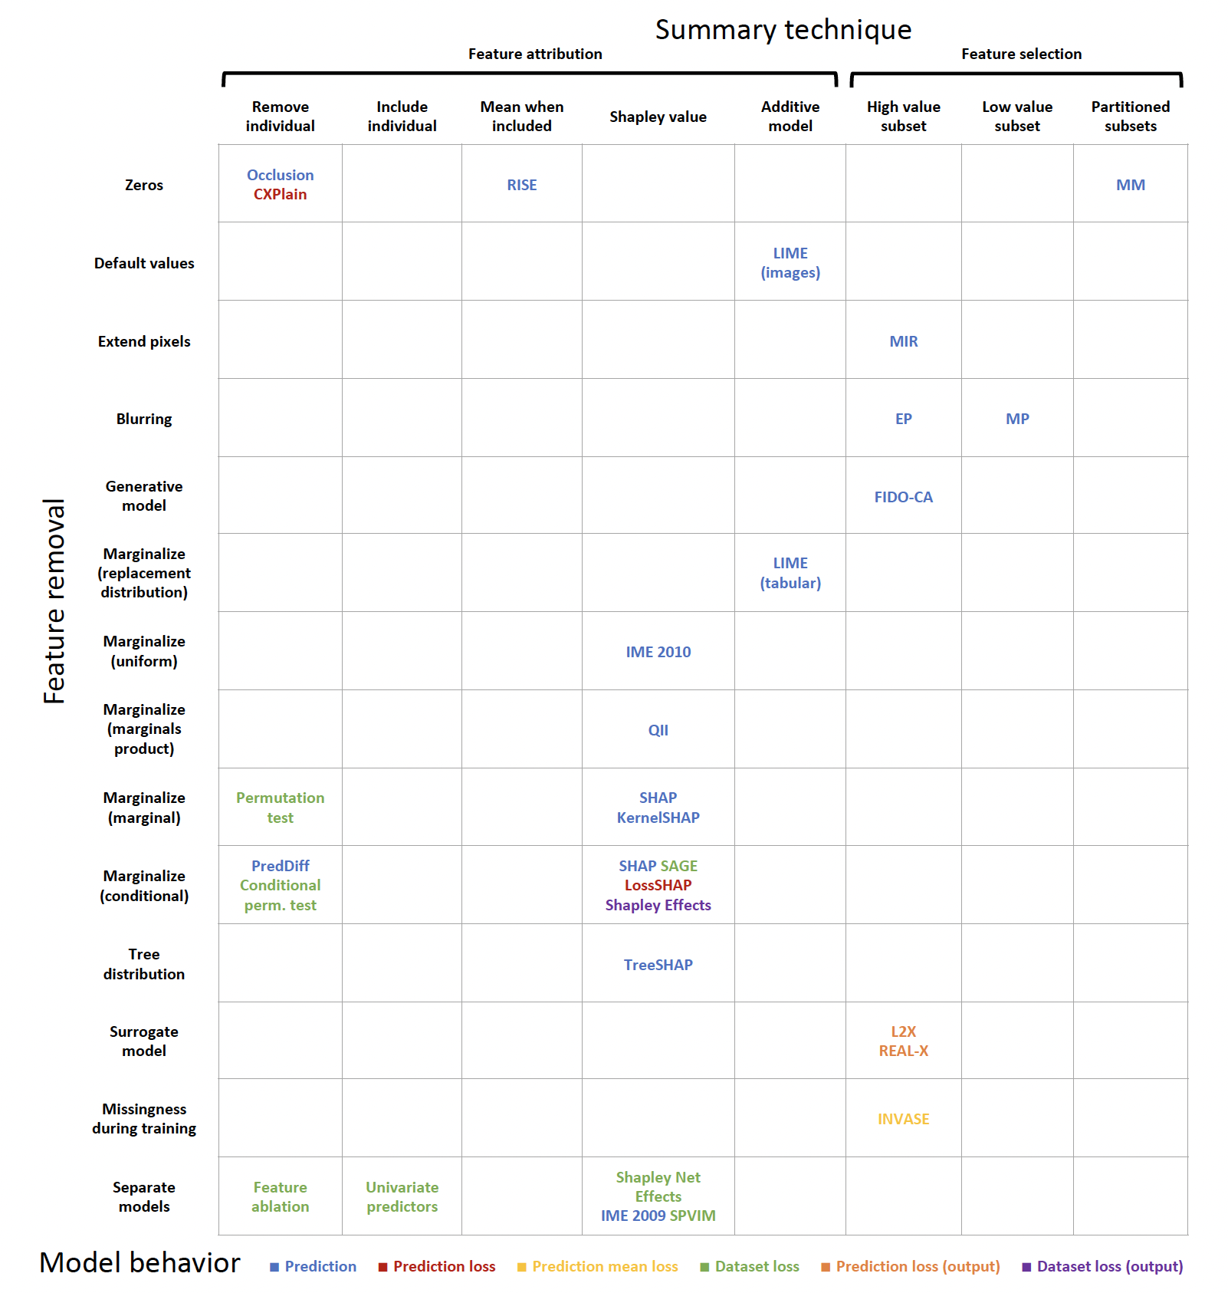
3
Methods Survey
1
Key insights
Common
marginalize out removed features with their conditional distribution
Shapley values
Relatively unique and spatially isolated
RISE; LIME for tabular data; INVASE
Many combinations left unexplored!
2
Notes:
For example, LIME fts a linear model to an interpretable representation of the input (Ribeiro et al., 2016), L2X selects the most informative features for a single example (Chen et al., 2018a), and Shapley Effects examines how much of the model's variance is explained by each feature (Owen, 2014).

Slide 7
Mathematical Formulation

Slide 8
Overview

Slide 9
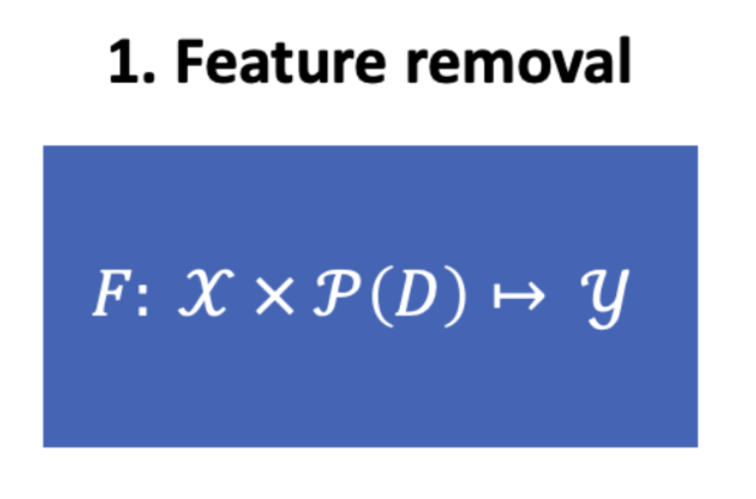
Defining Feature Removal
Zero ablation
Default values
Generative model
Train separate models
Train surrogate models
“Missingness” during training

Slide 10
Defining Feature Removal (cont)
Marginalization
Marginalize with conditional
Tree distribution
Marginalize with marginal
Marginalize with product of marginals
Marginalize with uniform
Marginalize with replacement distributions

Slide 11
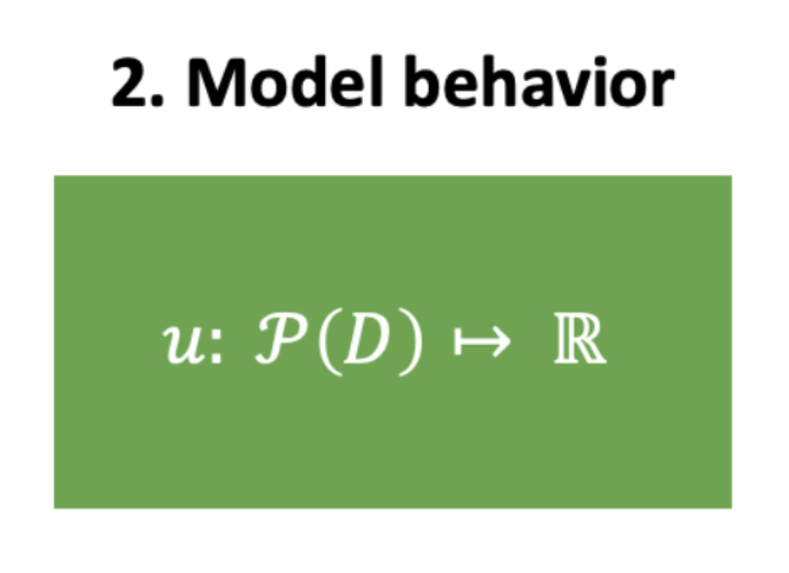
Explaining Model Behaviors
Given the newly defined model F(x_S), we need a metric to assess how important the x_S features are
Options
Prediction*
Prediction loss*
Prediction mean loss
Dataset loss*
Prediction loss w.r.t. output
Dataset loss w.r.t. output
Notes:
Connect model behavior and the functions listed

Slide 12
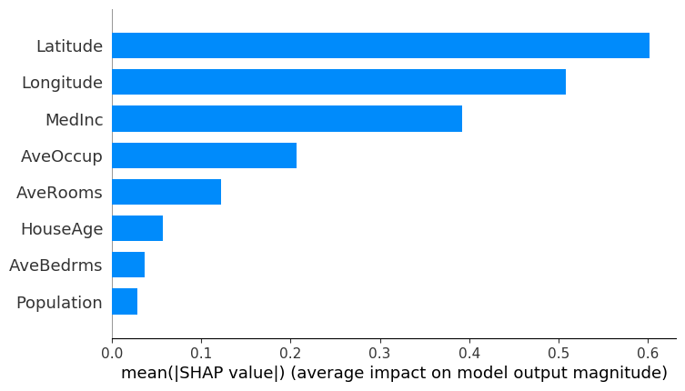
Summarizing Feature Influence
Two related approaches
Map feature to real number value (feature attribution)*
Map dataset to a set of important features (feature selection)
Both are related, often the second is just a threshold applied to the first

Slide 13
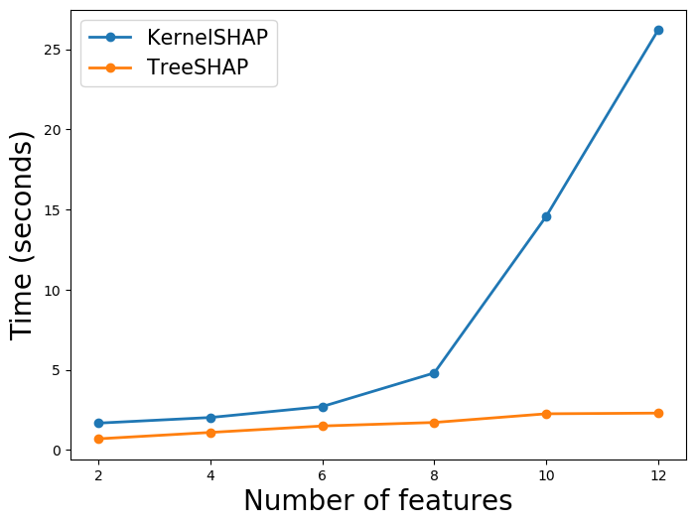
Computational Complexity
How to isolate features?
Consider every subset including the feature in question
Exact solutions are O(2^d / d) in the worst case
SHAP, RISE summarization, LIME additive model, etc
Only consider the subset where you remove the feature
Polynomial in d
Occlusion, PRedDiff, CXPlain, permutation tests, etc
Approximations? (much faster, but lose worst-case guarantees)
Sampling
TreeSHAP (dynamic programming solution for tree models)
Solve a continuous relaxation of the subset problem (i.e. learn a mask)
Greedy search (MIR)
Learn a model to do the explanation task (map from dataset to feature importance vector)

Slide 14
Connections to Other Theoretical Frameworks

Slide 15
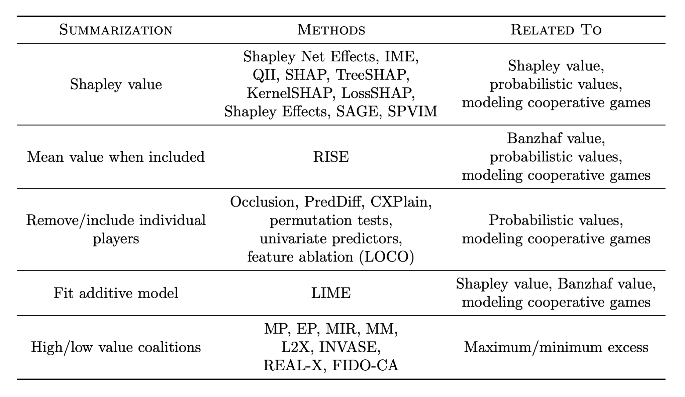
Game Theory
Same setup as what the SHAP people said
Cooperative games where we solve for allocations
Makes SHAP unique; however, other methods can be viewed as fitting (linear, additive) models to cooperative games
Proofs in appendix, not critical

Slide 16
Information Theory
f approximates response variable’s conditional distribution
Classification:
Regression:

Slide 17
Information Theory
f approximates response variable’s conditional distribution
Classification:
Regression:
F can also approximate conditional distribution (over subsets!)
Set of conditional distributions:

Slide 18
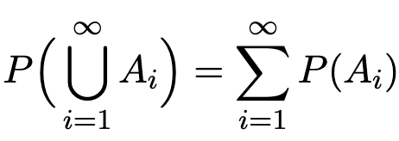
Information Theory
f approximates response variable’s conditional distribution
Classification:
Regression:
F can also approximate conditional distribution (over subsets!)
Set of conditional distributions:
Want this to be probabilistically valid (called consistent)
Countable Additivity:
Bayes’ Rule:
Occurs only when average over conditional distribution
I.e. SHAP

Slide 19
Approximations of SHAP
Intractable!
Conditional Distribution is Intractable!
Assume feature independence
Assume model linearity

Slide 20
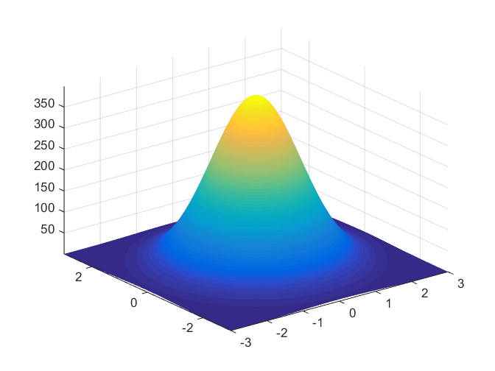
Approximations of SHAP
Intractable!
Conditional Distribution is Intractable!
Assume feature independence
Assume model linearity
Or:
Assume normal

Slide 21
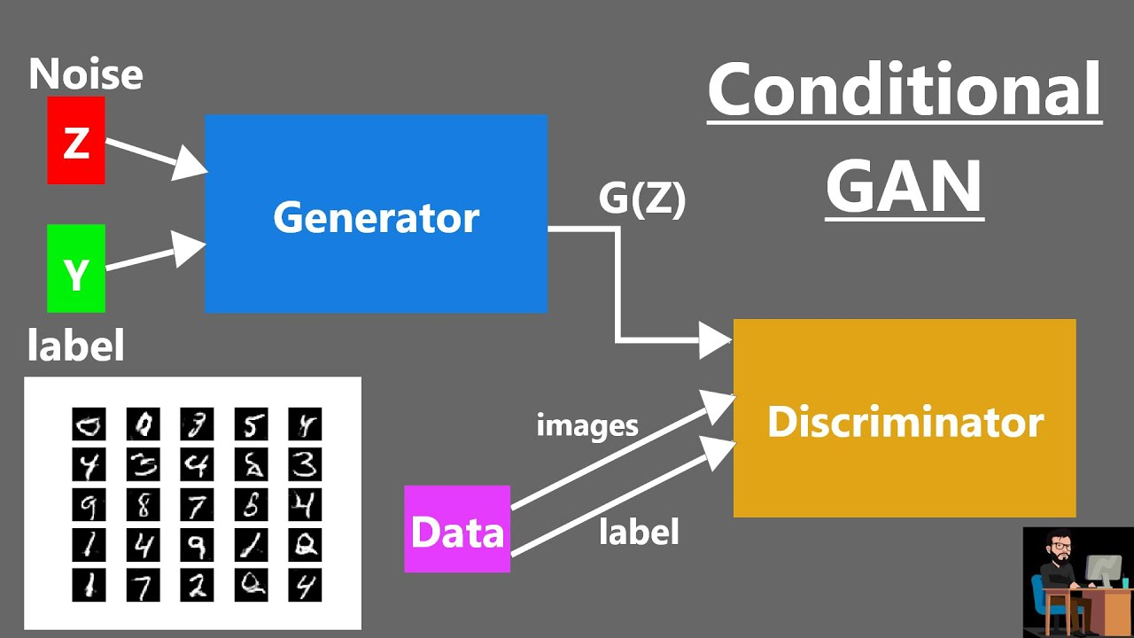
Approximations of SHAP
Generative Model
Draw samples from cGAN
Single-Sample Monte Carlo Approximation

Slide 22
Approximations of SHAP
Generative Model
Draw samples from cGAN
Single-Sample Monte Carlo Approximation
Surrogate Model
Train a model to match model predictions
Objective

Slide 23
Approximations of SHAP
Generative Model
Draw samples from cGAN
Single-Sample Monte Carlo Approximation
Surrogate Model
Train a model to match model predictions
Objective
Training with Missing
Train your original model with missing features
Objective

Slide 24
Approximations of SHAP
Generative Model
Draw samples from cGAN
Single-Sample Monte Carlo Approximation
Surrogate Model
Train a model to match model predictions
Objective
Training with Missing
Train your original model with missing features
Objective
Separate Model
Train separate model for each possible subset

Slide 25
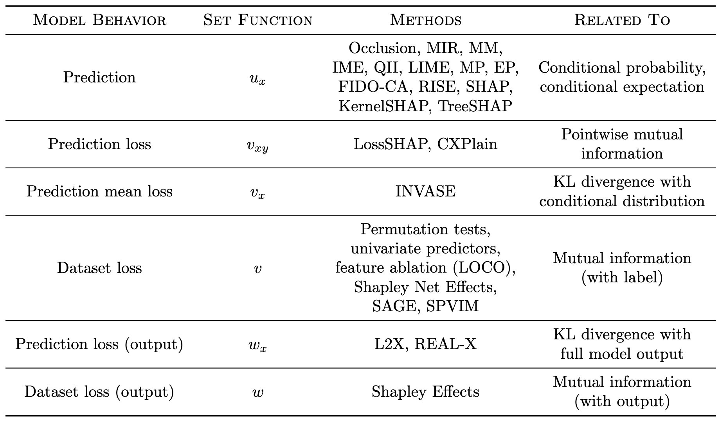
Information Theory Quantities

Slide 26
Cognition Theory
Subtractive Counterfactual (Epstude and Roese, 2008) and Method of Difference (Mill, 1884)
Norm Theory and the downhill rule
Trade-off between simplicity and completeness
Notes:
Norm theory: people assess normality by gathering summary statistics from a set of recalled and simulated representations of a phenomenon (e.g., loan application outcomes for individuals with a set of characteristics): for averaging the model output over a distribution of values for the removed values
Downhill rule: In other words, people are more likely to assign blame to an aspect of a situation if it has a more likely alternative that would change the outcome.

Slide 27
Experiments

Slide 28
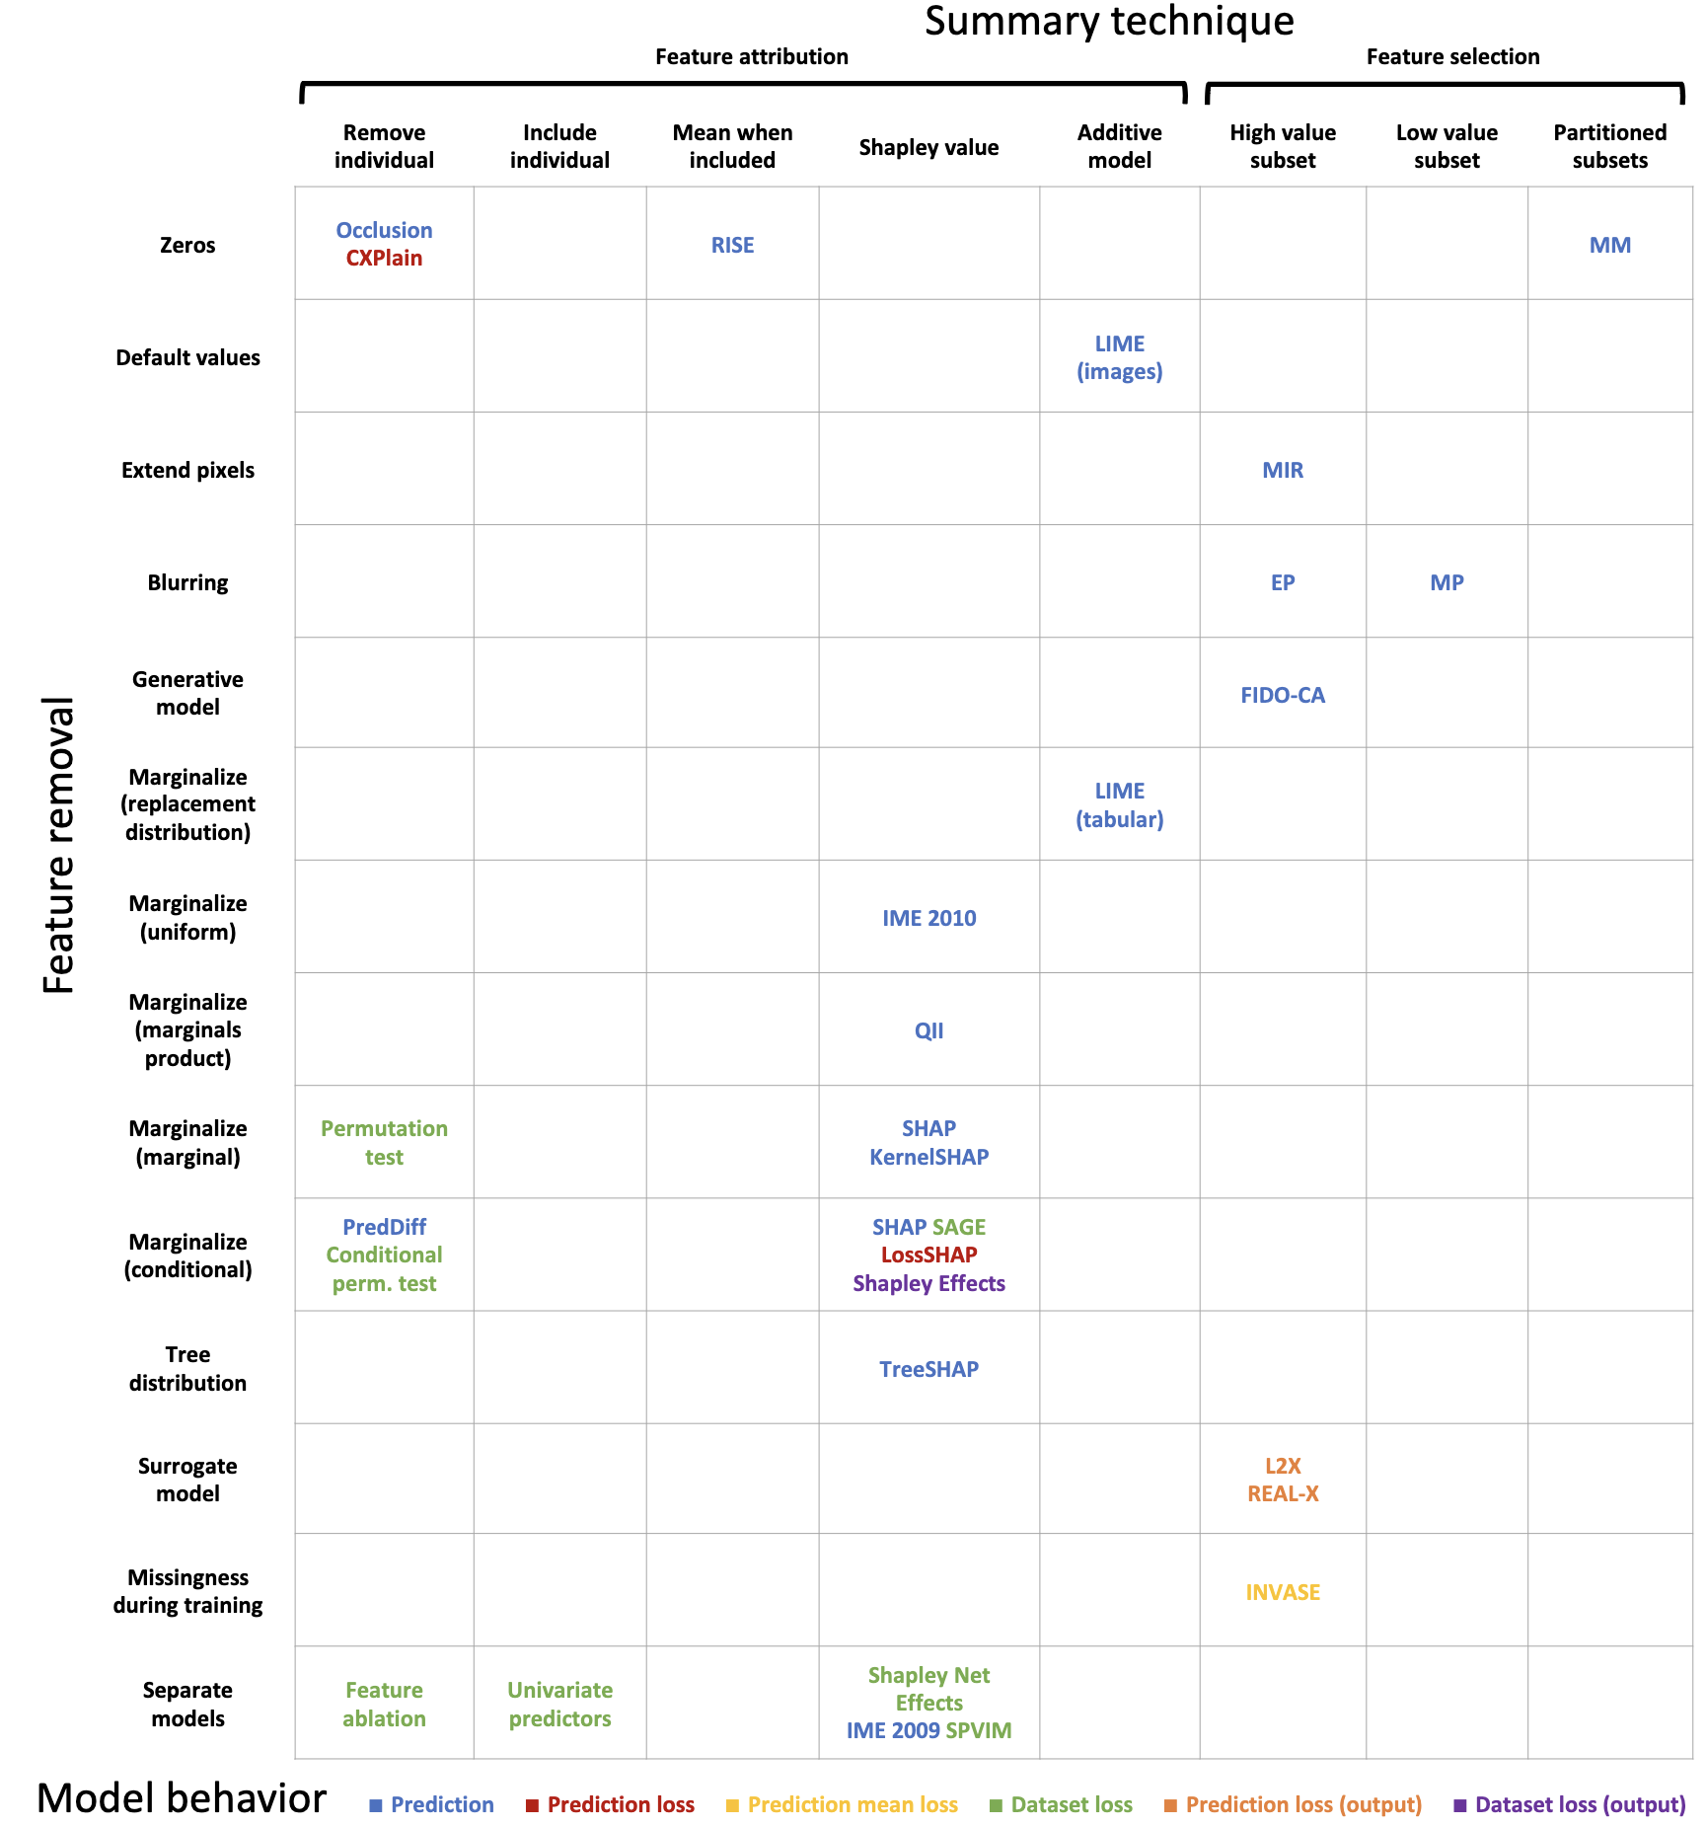

Slide 29
So many unexplored combinations!!!

Slide 30
Experimental Goals
Fill in the gaps of removal-based method combinations

Slide 31
Experimental Goals
Fill in the gaps of removal-based method combinations
Verify that the information-theoretic model works best
Verify other theorized relationships between existing methods
SHAP!

Slide 32
Removal-Based Model Combinations
Feature Removal
Default Values
Marginalization
Uniform
Product
Joint
Model Behavior
Prediction
Prediction Loss
Dataset Loss
Summary Technique
Removing
Including
Mean when Included
Banzhaf
Shapley

Slide 33
Removal-Based Model Combinations
Feature Removal
Default Values
Marginalization
Uniform
Product
Joint
Model Behavior
Prediction
Prediction Loss
Dataset Loss
Summary Technique
Removing
Including
Mean when Included
Banzhaf
Shapley
Over 80 Combinations Tested!

Slide 34
Removal-Based Model Combinations
Feature Removal
Default Values
Marginalization
Uniform
Product
Joint
Model Behavior
Prediction
Prediction Loss
Dataset Loss
Summary Technique
Removing
Including
Mean when Included
Banzhaf
Shapley

Slide 35
Experimental Domains
Census Income
48,842 Individuals
14 Socioeconomic Features, >$50k income or not
Light-GBM (gradient boosted tree)
MNIST
70,000 Handwritten Digits
32x32 Grayscale Pixels
CNN (14 Layers)
Breast Cancer Subtypes
510 Patients
Took a random subset of 100/17,814 genes
Logistic Regression

Slide 36
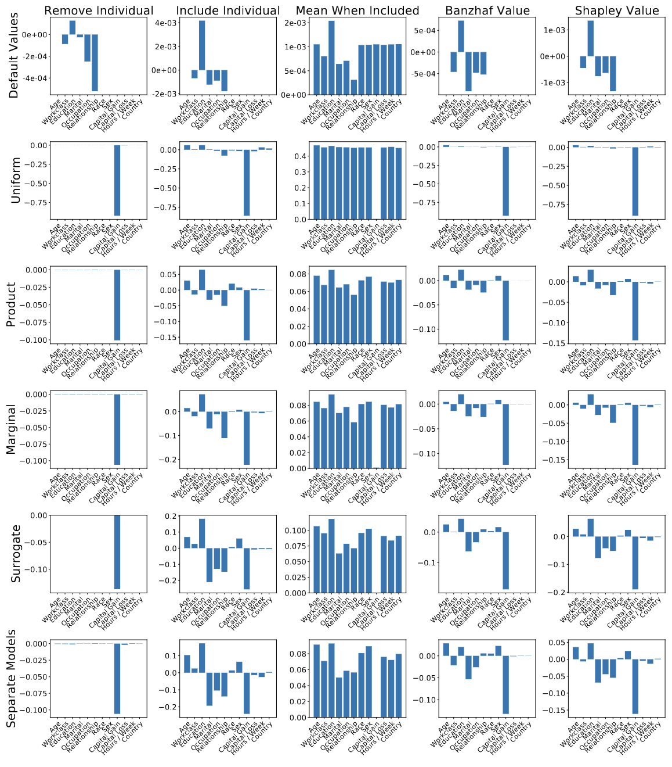
1. Census Income
Qualitatively:
Bottom four the same
Approximate conditional distribution

Slide 37
1. Census Income
Qualitatively:

Slide 38
1. Census Income
Qualitatively:
Bottom four the same
Approximate conditional distribution
Include and Banzhaf/Shapley the same
Similar formulations

Slide 39
1. Census Income
Qualitatively:
Bottom four the same
Approximate conditional distribution
Include and Banzhaf/Shapley the same
Similar formulations
Mean When Included is NOT probabilistic and quite different

Slide 40
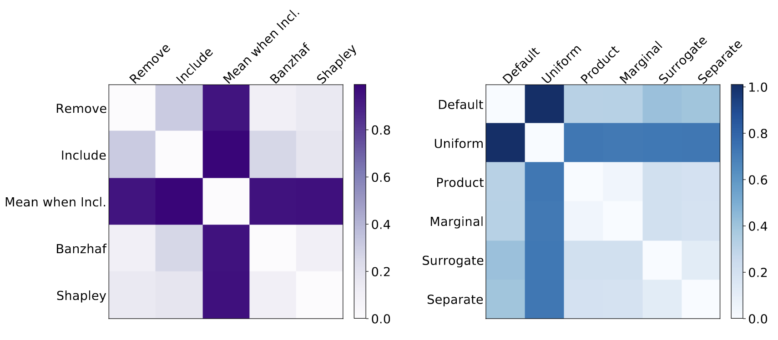
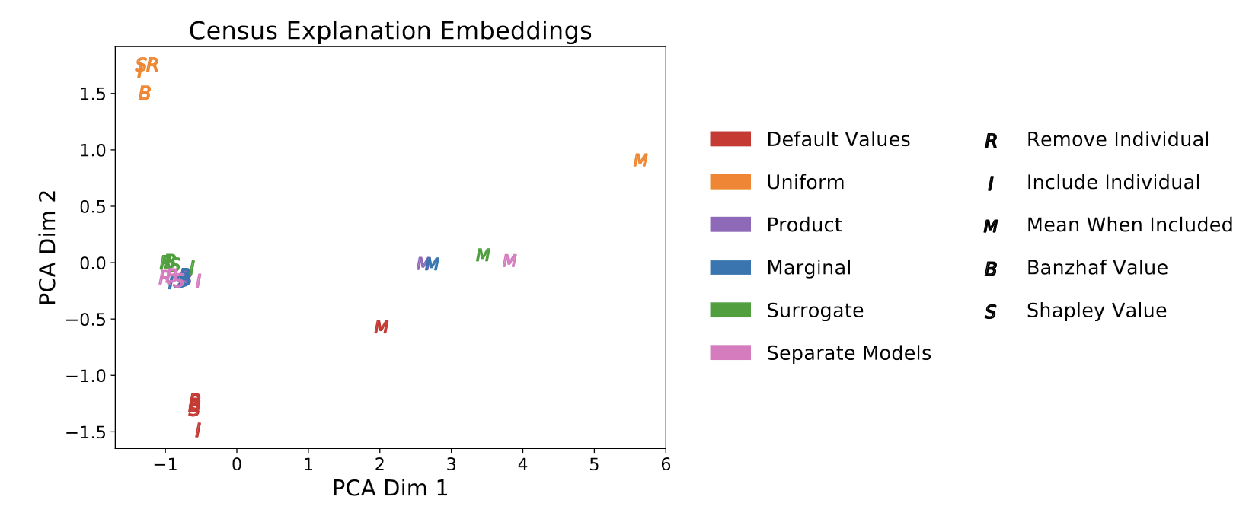
1. Census Income
Mean Distance Between Explanations:
More results:
Mean when Included is unique
Uniform Removal is unique
PCA Plot of Explanations

Slide 41
1. Census Income
Quantitatively:
How good is the conditional distribution approximation?
Intractable, so treat separate models as ground truth
Surrogate Removal Method does best

Slide 42
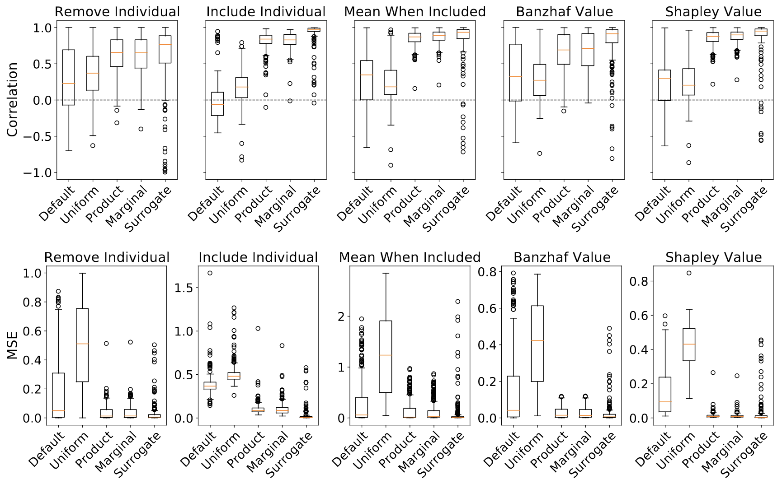

Slide 43
2. MNIST
Qualitatively:

Slide 44
2. MNIST
Qualitatively:
Default Values gives zero attribution to zero-valued features

Slide 45
2. MNIST
Qualitatively:
Default Values gives zero attribution to zero-valued features
Shapley “looks” the best

Slide 46
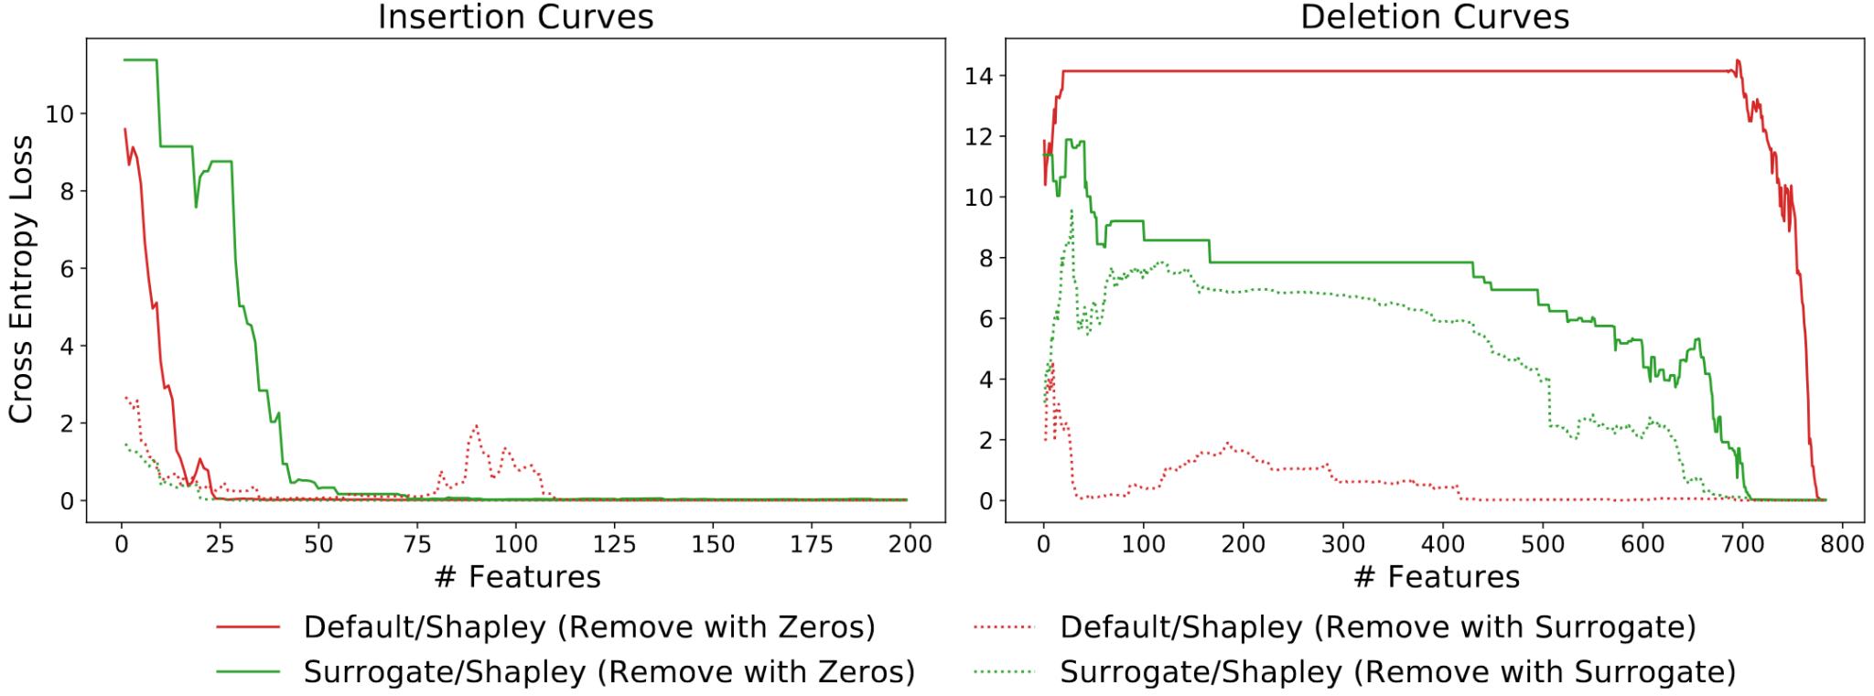
2. MNIST
Quantitative Analysis:
Insertion: Remove the bottom k important features
Deletion: Remove the top k important features
Removing with surrogate is better!

Slide 47
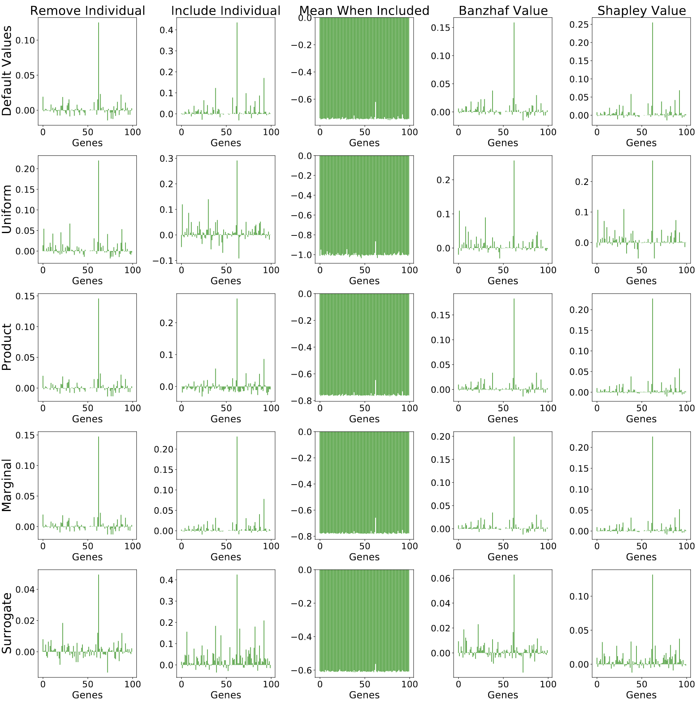
3. Breast Cancer Subtypes
Qualitatively:
ESR1 gene is most important
Hard to compare qualitatively
Verify that “mean when included” is much different from the rest

Slide 48
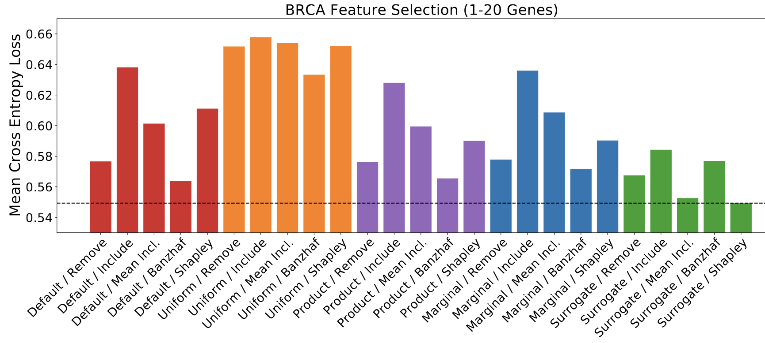
3. Breast Cancer Subtypes
Quantitatively:
Select only 20 most important genes
Surrogate+Shapley best!

Slide 49
Conclusion
SHAP+Surrogate Model is the best
In line with information-theoretic connection
The authors’ unified framework helps us reason abstractly about these techniques
Able to identify and fill so many gaps in the combination of removal-based models

Slide 50
Limitations
No limitations section
No comparisons across model behavior
Quantifying approximation quality with an approximation
Evaluation metrics can be aligned with explanation method
Doesn’t bode well for a universal unbiased metric
Slightly suspect analysis for Breast Cancer dataset

Slide 51
Discussion
Are removal-based the right framework to go in XAI?
How do we reconcile with the fact that removing features may result in out-of-distribution behavior?
What other unifying frameworks can you think of?
Do you agree with the assessment that SHAP provides the best explanation?
What methods do not fall under removal-based methods?
Notes:
TalkToModel, TCAV

