Slide 1
Open Problems in Mechanistic Interpretability: A Whirlwind Tour
Neel Nanda
https://neelnanda.io/whirlwind-slides

Slide 2
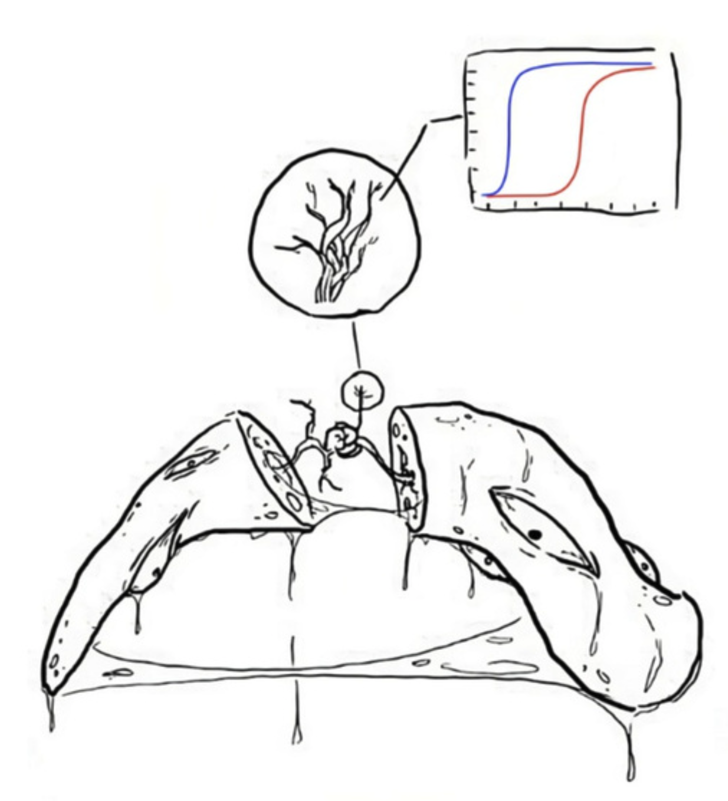
Motivation
Key Q: What should interpretability look like in a post GPT-4 world?
Large, generative language models are a big deal
Models will keep scaling. What work done now will matter in the future?
Emergent capabilities keep arising
Many mundane problems go away
A single massive foundation model

Slide 3
We need to study model internals
Inputs and Outputs Are Not Enough

Slide 4
Goal: Understand Model Cognition
Is it aligned, or telling us what we want to hear?

Slide 5
What is a Transformer?
Input: Sequences of words
Output: Probability distribution over the next word
Residual stream: A sequence of representations
One for each input word, per layer!
Each layer is an incremental update - stream is a running total
Represents the word plus context
Attention: Moves information between words
Made up of heads, each acts independently and in parallel
We try to interpret heads!
MLP: Processes information once it’s been moved to a word
Walkthrough: What is a Transformer + Implementing GPT-2 From Scratch

Slide 6
What is Mechanistic Interpretability?

Slide 7
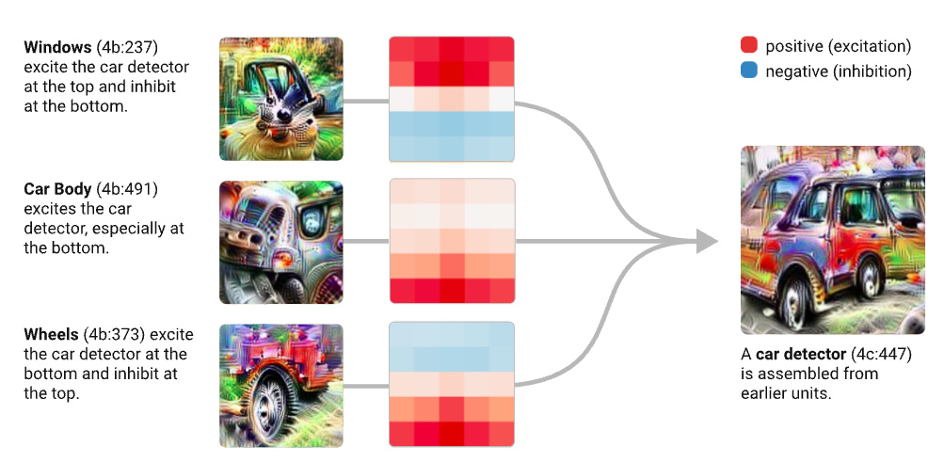
What is Mechanistic Interpretability?
Goal: Reverse engineer neural networks
Like reverse-engineering a compiled program binary to source code
Hypothesis: Models learn human-comprehensible algorithms and can be understood, if we learn how to make it legible
Understanding features - the variables inside the model
Understanding circuits - the algorithms learned to compute features
Key property: Distinguishes between cognition with identical output
A deep knowledge of circuits is crucial to understand, predict and align model behaviour
Interpretability Request for Proposals (Chris Olah)
Notes:
I don’t claim that this is obviously the right thing that works on real LLMs, but I want to present a case that it’s a good bet. That mech interp can find true beliefs about a model, and create a bunch of useful indirect insights that can help things scale. And that you need to ask these questions of any interp agenda!

Slide 8
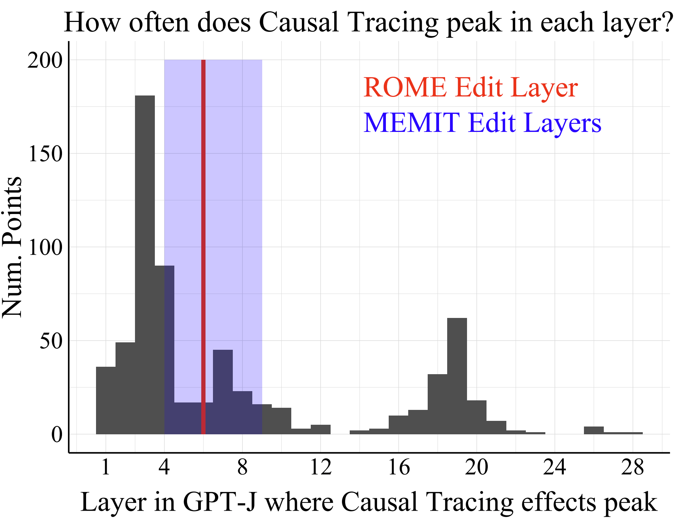
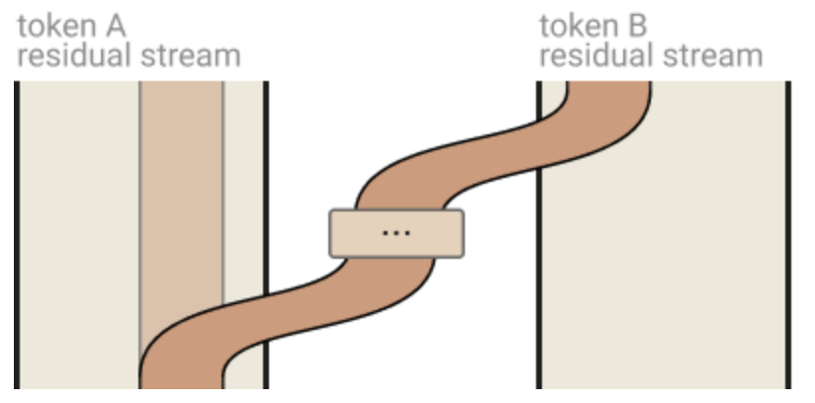
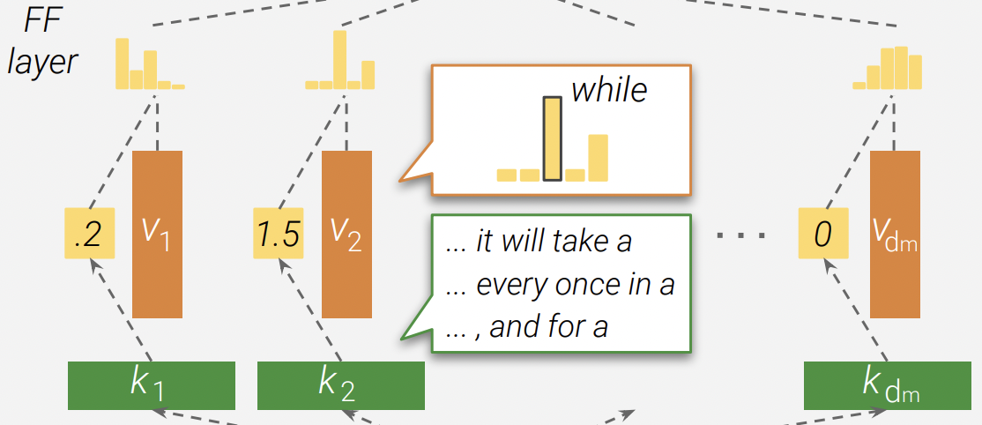
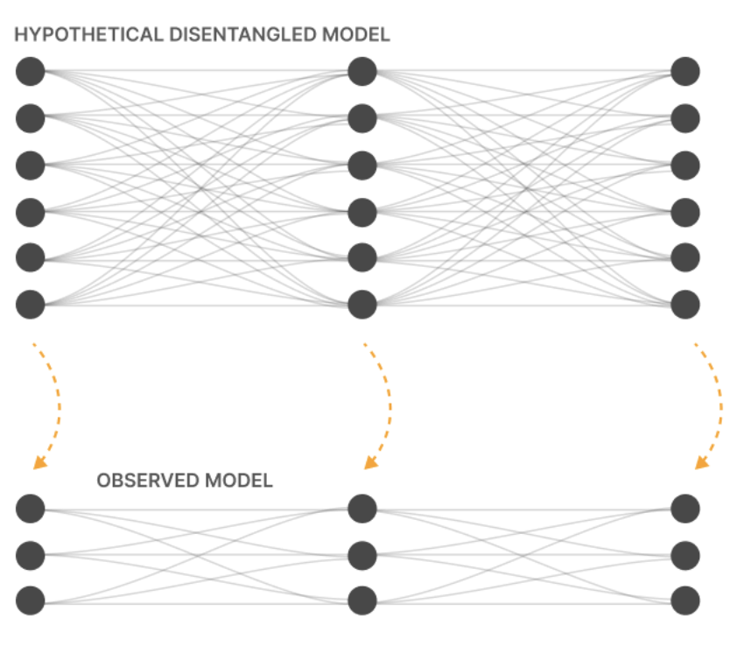
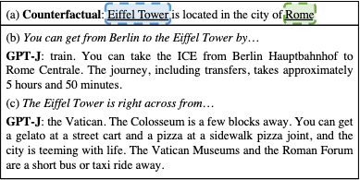
A Growing Area of Research
A Mathematical Framework for Transformer Circuits (Elhage et al, Anthropic 2021)
Transformer Feed-Forward Layers Are Key-Value Memories (Geva et al, EMNLP 2021)
Does Localization Inform Editing? (Hase et al, 2023)
Investigating Gender Bias in Language Models Using Causal Mediation Analysis (Vig et al, NeurIPS 2020)
Toy Models of Superposition (Elhage, Anthropic 2022)
Locating and Editing Factual Associations in GPT (Meng et al, NeurIPS 2022)

Slide 9
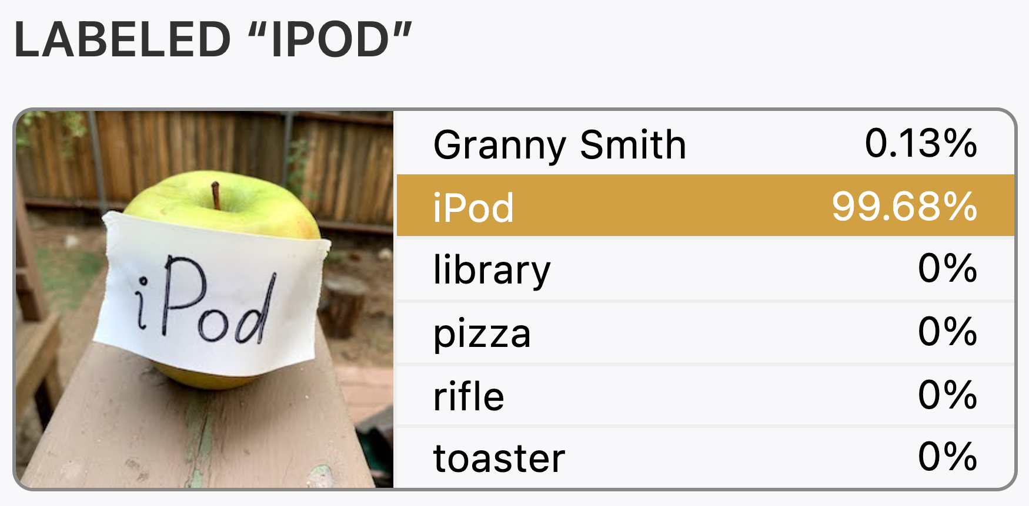
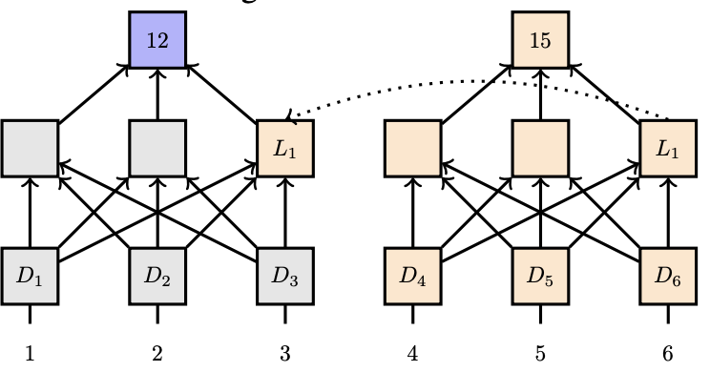
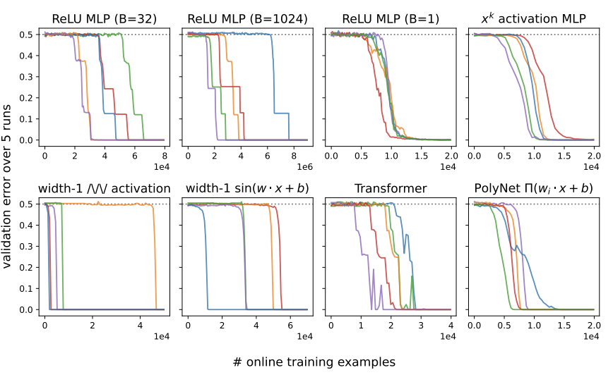
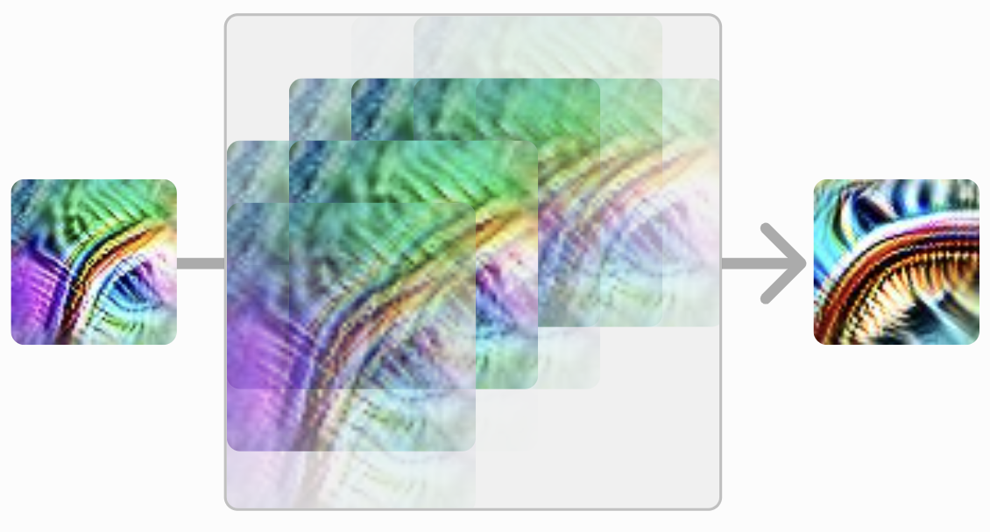
A Growing Area of Research
Multimodal Neurons in Artificial Neural Networks (Goh et al, Distill 2021)
Compositional Explanations of Neurons (Mu and Andreas, NeurIPS 2020)
Causal Abstractions of Neural Networks (Geiger et al, NeurIPS 2021)
SGD Learns Parities Near the Computational Limit (Barak et al, NeurIPS 2022)
Curve Circuits (Cammarata et al, Distill 2020)
The Quantization Model of Neural Scaling (Michaud et al, 2023)

Slide 10
Personal Motivation: Why Mechanistic Interpretability?
Easy to get started + get feedback loops
Very fun!
Vibe is a cross between maths, computer science, natural sciences and truth-seeking
Code early, and code a lot - get contact with reality
https://neelnanda.io/getting-started

Slide 11
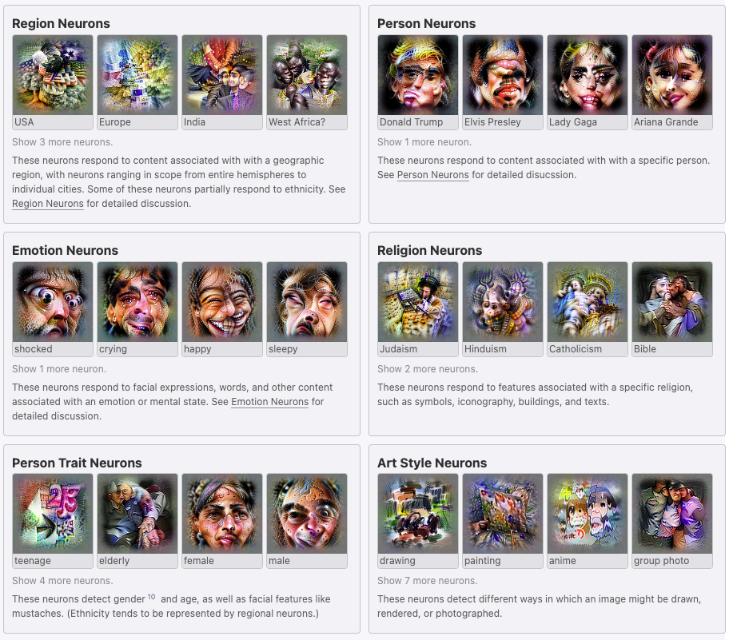
Features = Variables: What does the model know?
Multimodal Neurons (Goh et al)
neuroscope.io

Slide 12
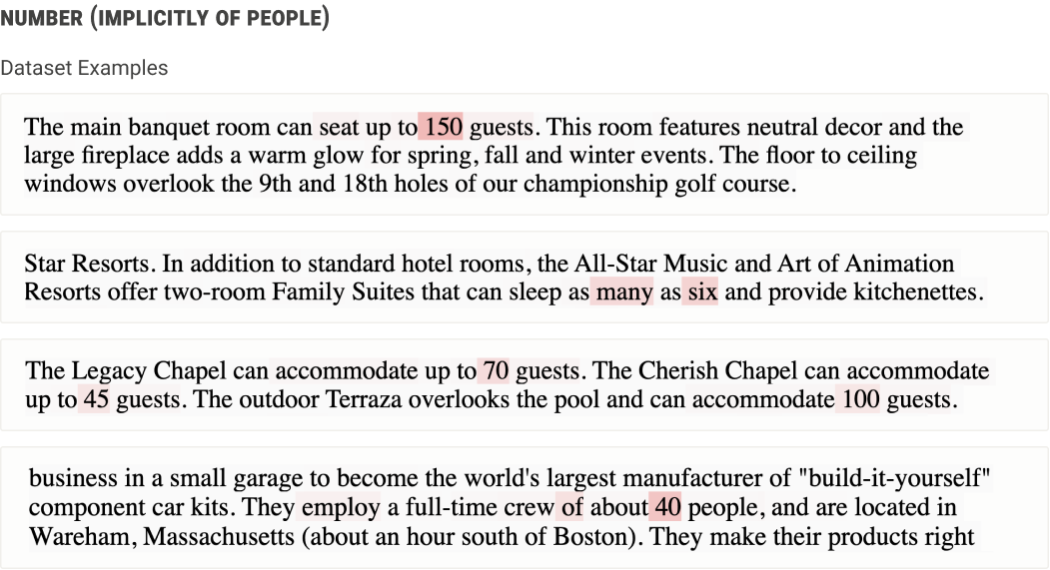
COP: Studying Neurons
Softmax Linear Units (Elhage et al)
neuroscope.io

Slide 13
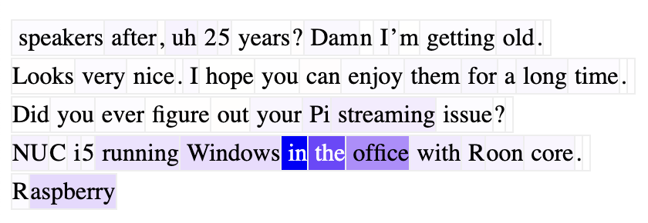
Tool: Neuroscope
https://neuroscope.io
Open Problems: Studying Learned Features
Notes:
Q: Look for abstract neurons in middle layers of larger models

Slide 14
Circuits = Functions: How does the model think?
Induction Heads (2L Attn-Only Models)
A Mathematical Framework (Elhage et al)
Open Problems: Analysing Toy Language Models

Slide 15
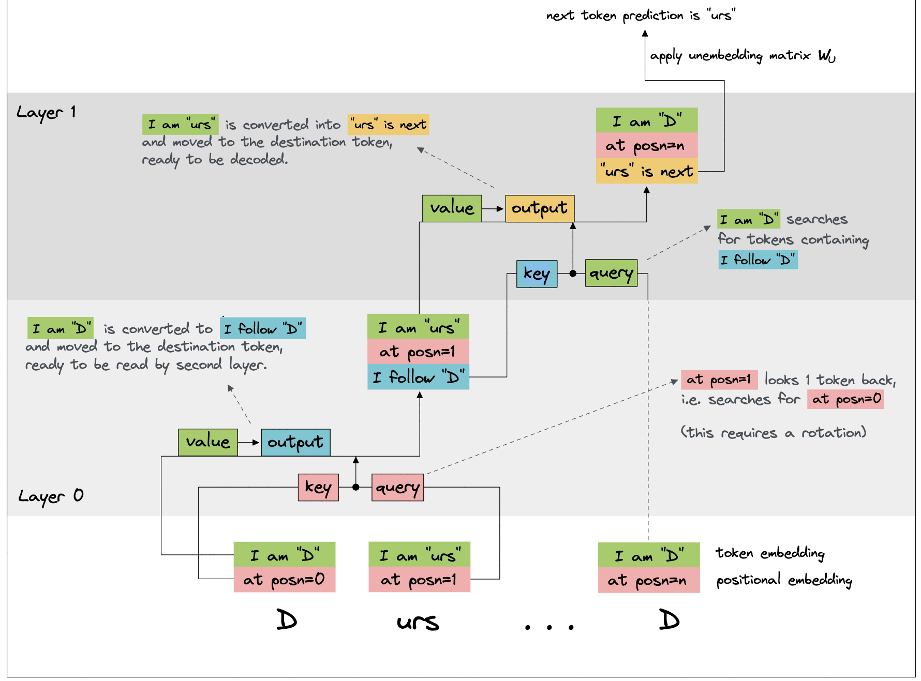
Mechanistic Understanding
Induction Heads Illustrated (Callum McDougall)
Notes:
Q: Try to reverse engineer a trigram neuron, eg ice cream -> sundae

Slide 16
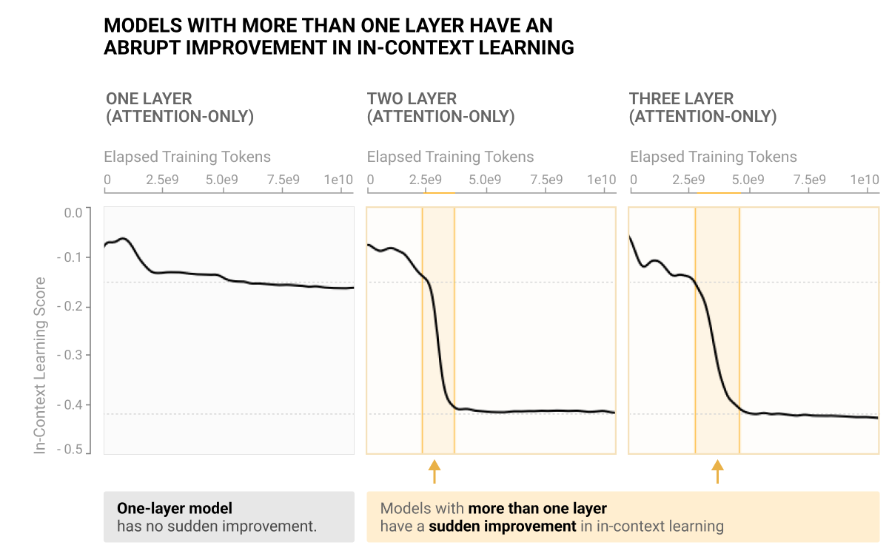
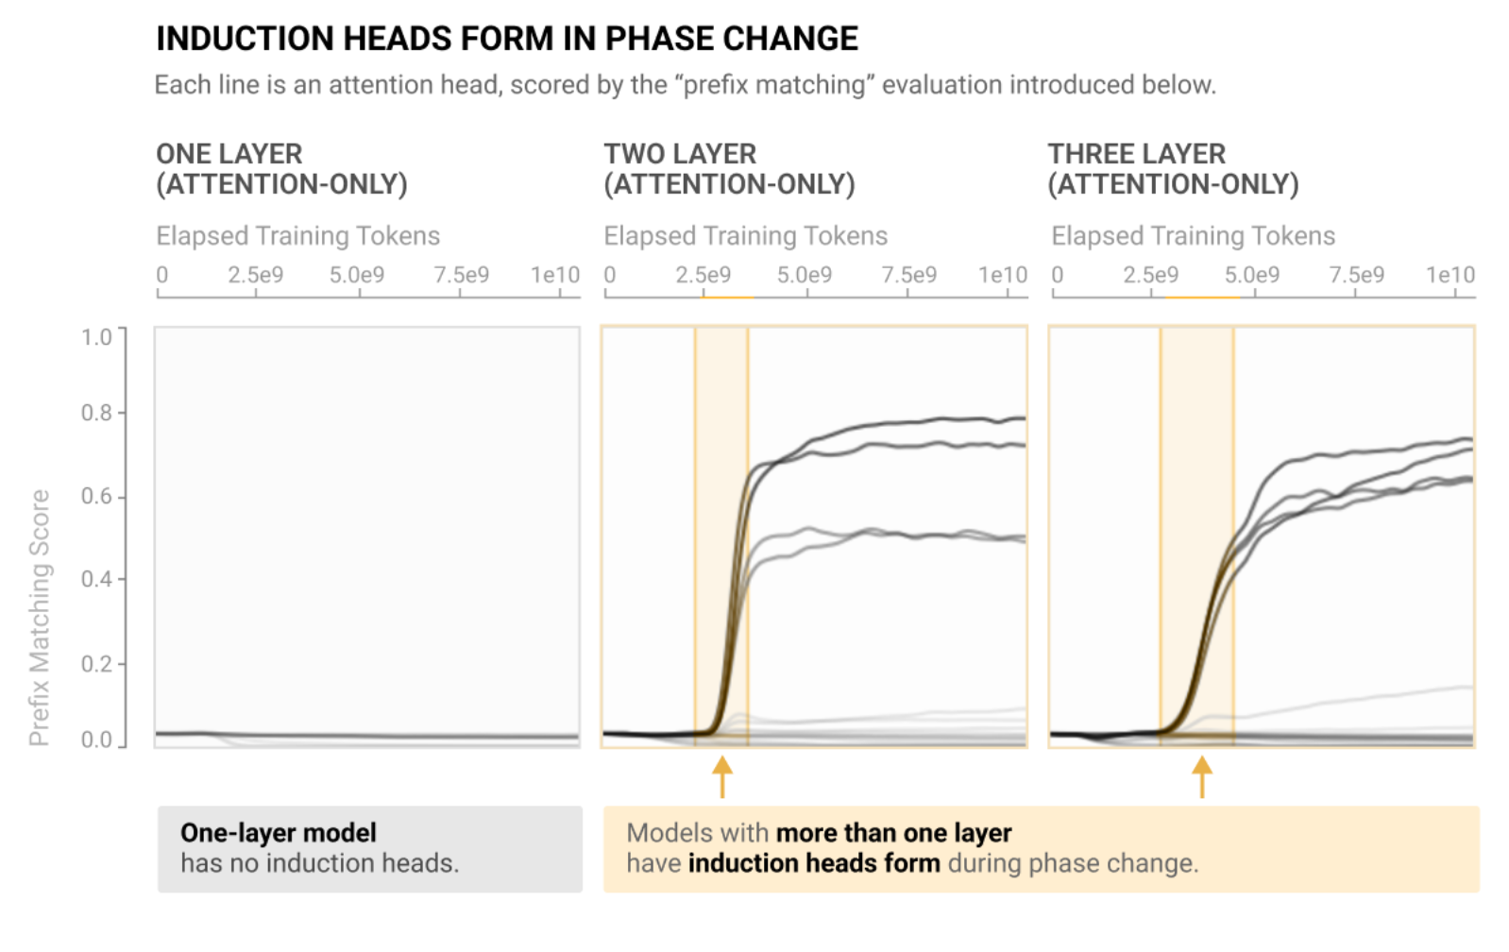
Case Study: Understanding Emergence of In-Context Learning
Induction Heads and In-Context Learning (Olsson et al)
Open Problems: Analysing Training Dynamics
Notes:
Emphasis: Mechanistic Understanding in toy language models allowed progress on real models
Useful to predict emergence, really important
Note difference between mechanistic and behavioural definition, induction is a core mechanism but is more complex. Sophisticated induction and eg involves translation heads

Slide 17
The Mindset of Mechanistic Interpretability
Alien neuroscience: Models are interpretable, but not in our language
If we learn to think like them, mysteries dissolve
Skepticism: It’s extremely easy to trick yourself in interpretability
Zoom In: Rigour and depth over breadth and scalability
Ambition: It is possible to achieve deep and rigorous understanding
A bet that models have underlying principles and structures that generalise

Slide 18
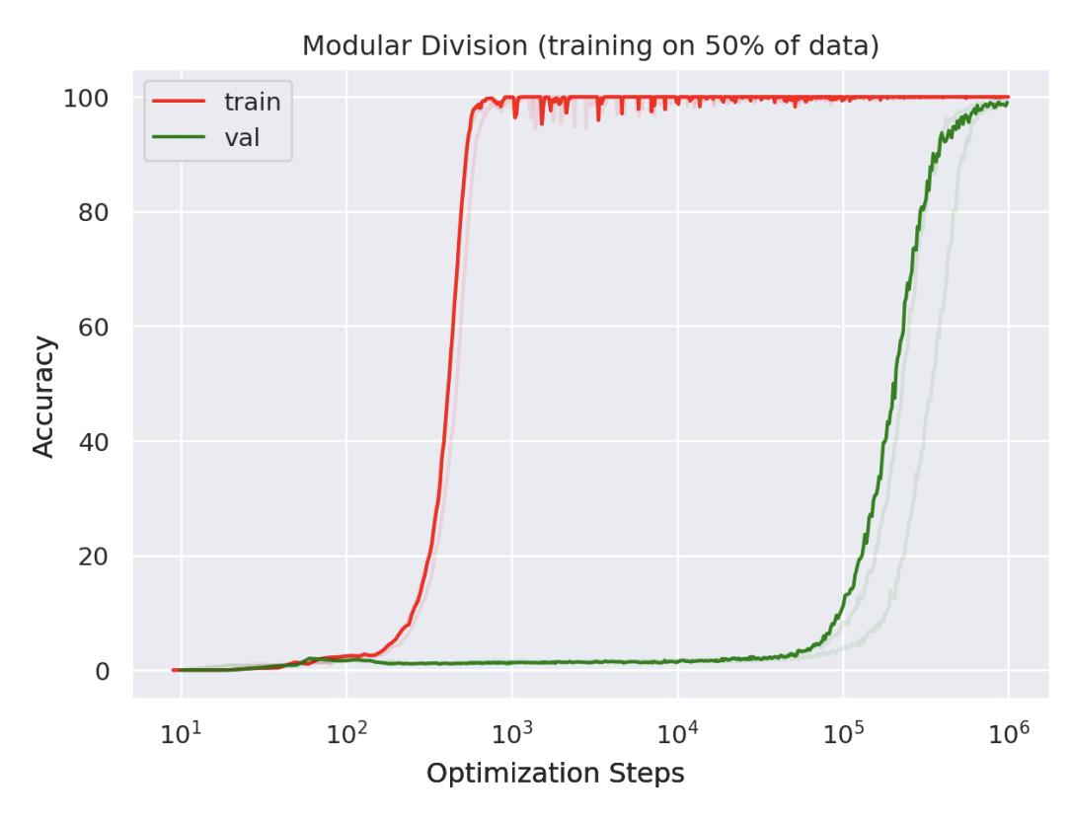
Case Study: Grokking
Mechanistic Understanding can dissolve mysteries in deep learning
Grokking: Generalization Beyond Overfitting (Power et al)

Slide 19
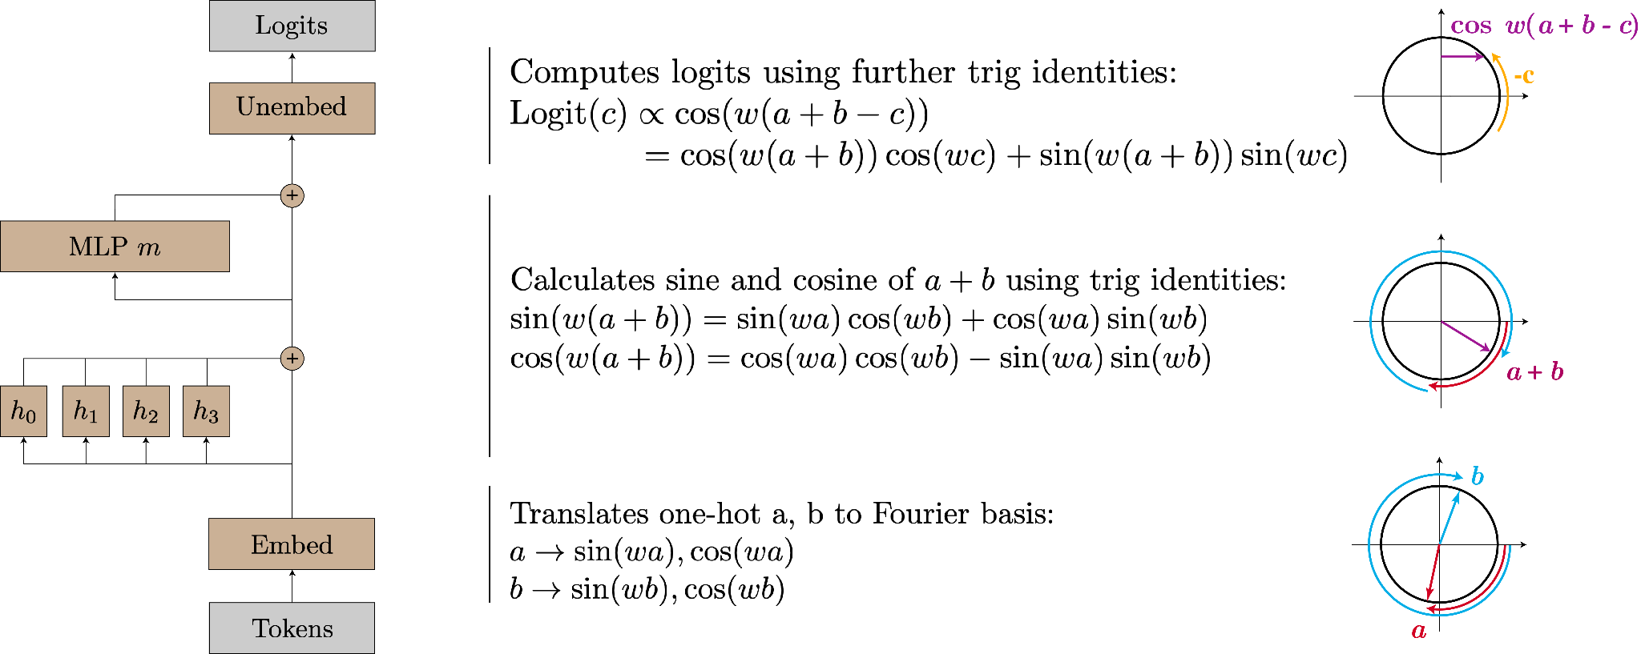
The Modular Addition Circuit
Progress Measures for Grokking via Mechanistic Interpretability (Nanda et al)
Open Problems: Interpreting Algorithmic Models
Notes:
Rigorous understanding is possible!
Alien neuroscience - until you realise it thinks in Fourier space it’s impossible, with that insight it all makes sense

Slide 20
Progress Measures for Grokking via Mechanistic Interpretability (Nanda et al)
Notes:
Q: I showed grokking in a toy model w/ induction heads, can you reverse engineer those properly and look at how this develop during training?

Slide 21
Frontier: Polysemanticity and Superposition
Multimodal Neurons (Goh et al)
Open Problems: Exploring Polysemanticity & Superposition
Notes:
Biggest open problem in the field - how do models represent their thoughts? Seems linear, does not seem always aligned with neurons, what’s up?

Slide 22
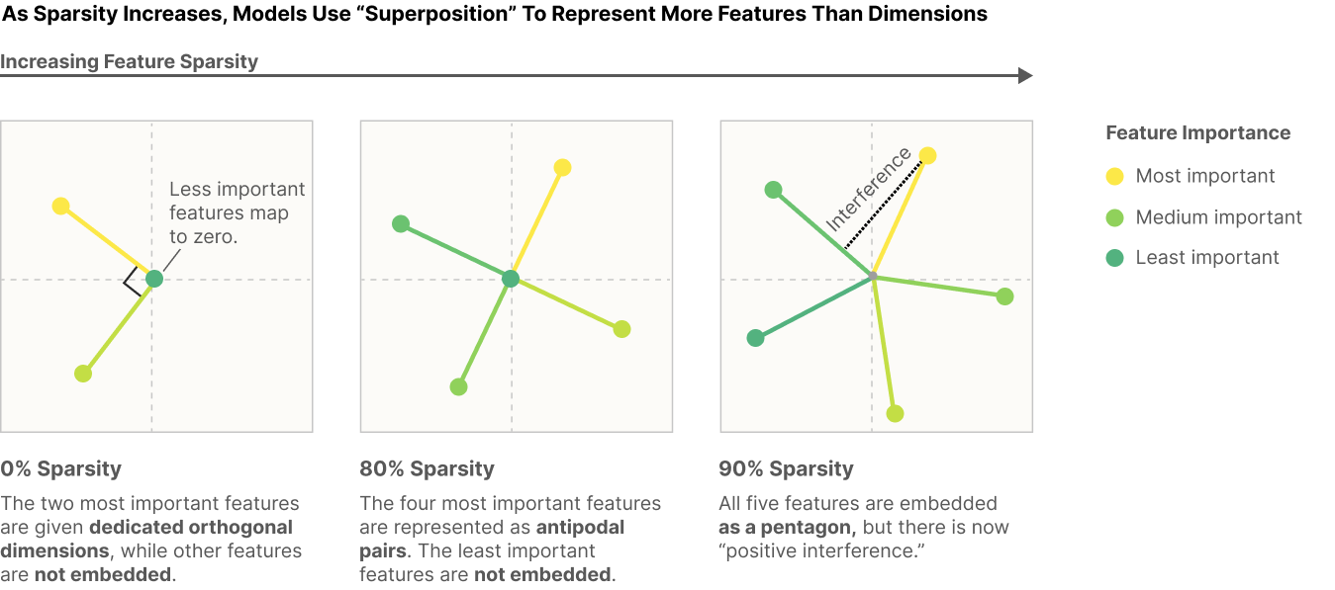
Hypothesis: Polysemanticity is because of Superposition
Toy Models of Superposition (Elhage et al)
Open Problems: Exploring Polysemanticity & Superposition + Analysing Toy Language Models
Notes:
Conceptual framework for thinking about models - superposition
Compression, simulating a much larger model with a small one. Trade off between more features +
We don’t know how to deal with this lol
Q: Exhibiting this in real models! Look at compound works in a one layer model’s neurons, eg ice cream or social security.

Slide 23
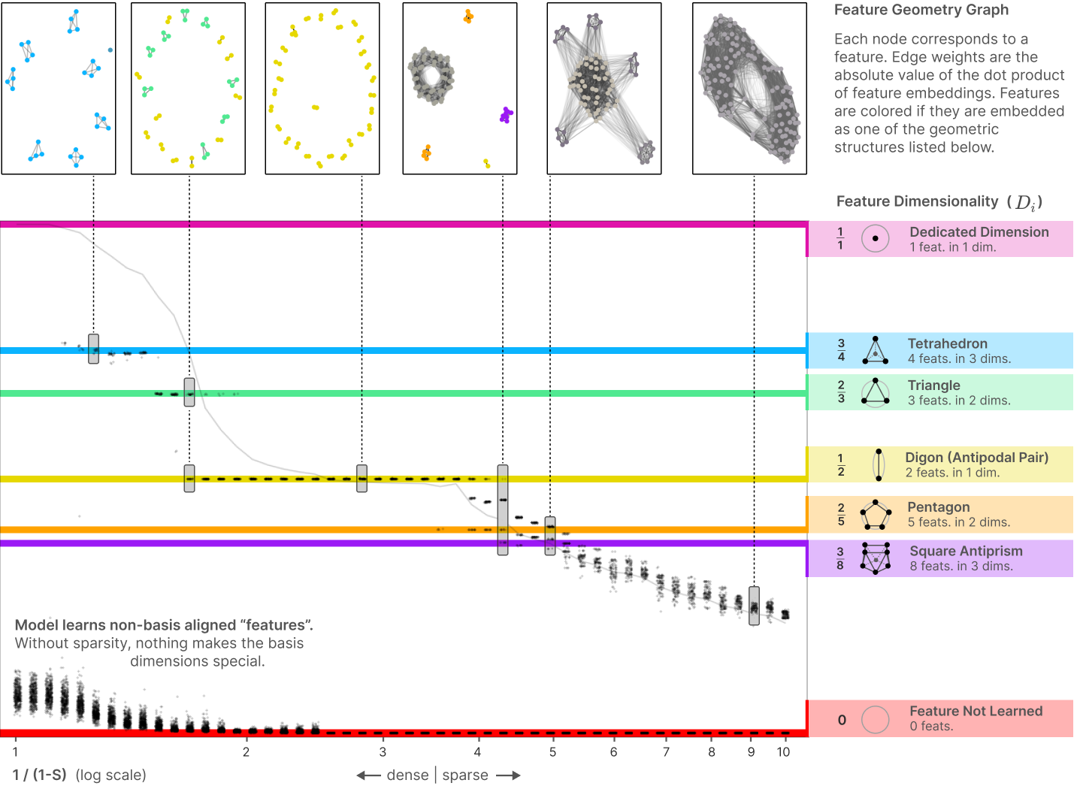
Conceptual Frameworks:
Geometry of Superposition
Toy Models of Superposition (Elhage et al)
Open Problems: Exploring Polysemanticity & Superposition + Analysing Toy Language Models
Notes:
Q: Dig further into neuron superposition, can you find any more patterns or motifs?

Slide 24
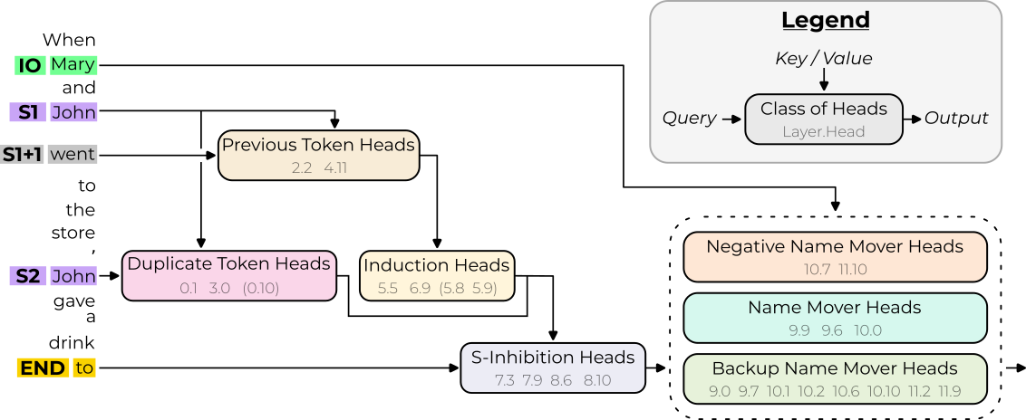
Case Study: Interpretability in the Wild
Seeing what’s out there
When John and Mary went to the store, John gave the bag to -> Mary
Interpretability in the Wild (Wang et al)
Open Problems: Finding circuits in the wild
Notes:
Open problem: Models can count! 1) …\n 2) …\n 3) … etc. How? Induction-y probably.

Slide 25
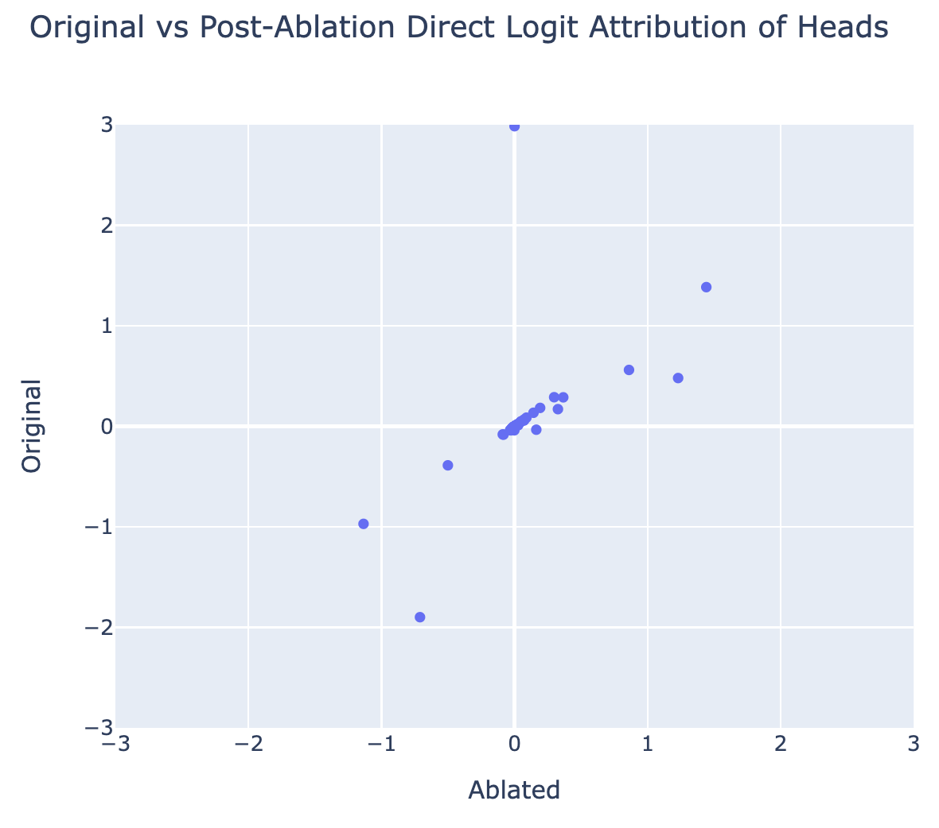
Refining Ablations: Backup Name Movers
Mechanistic Interpretability as a validation set
Backup Head
Negative Backup Head
Open Problems: Techniques, Tooling and Automation
Notes:
We ablate a head, and other heads significantly compensate! Backup circuit! WTF!
Ablation solid technique, unreliable, major issue.
What other illusions exist? Many valuable techniques + domains to explore
Q: Can we find other kinds of backup heads, eg backup induction?
Q: What’s the backup circuit?

Slide 26
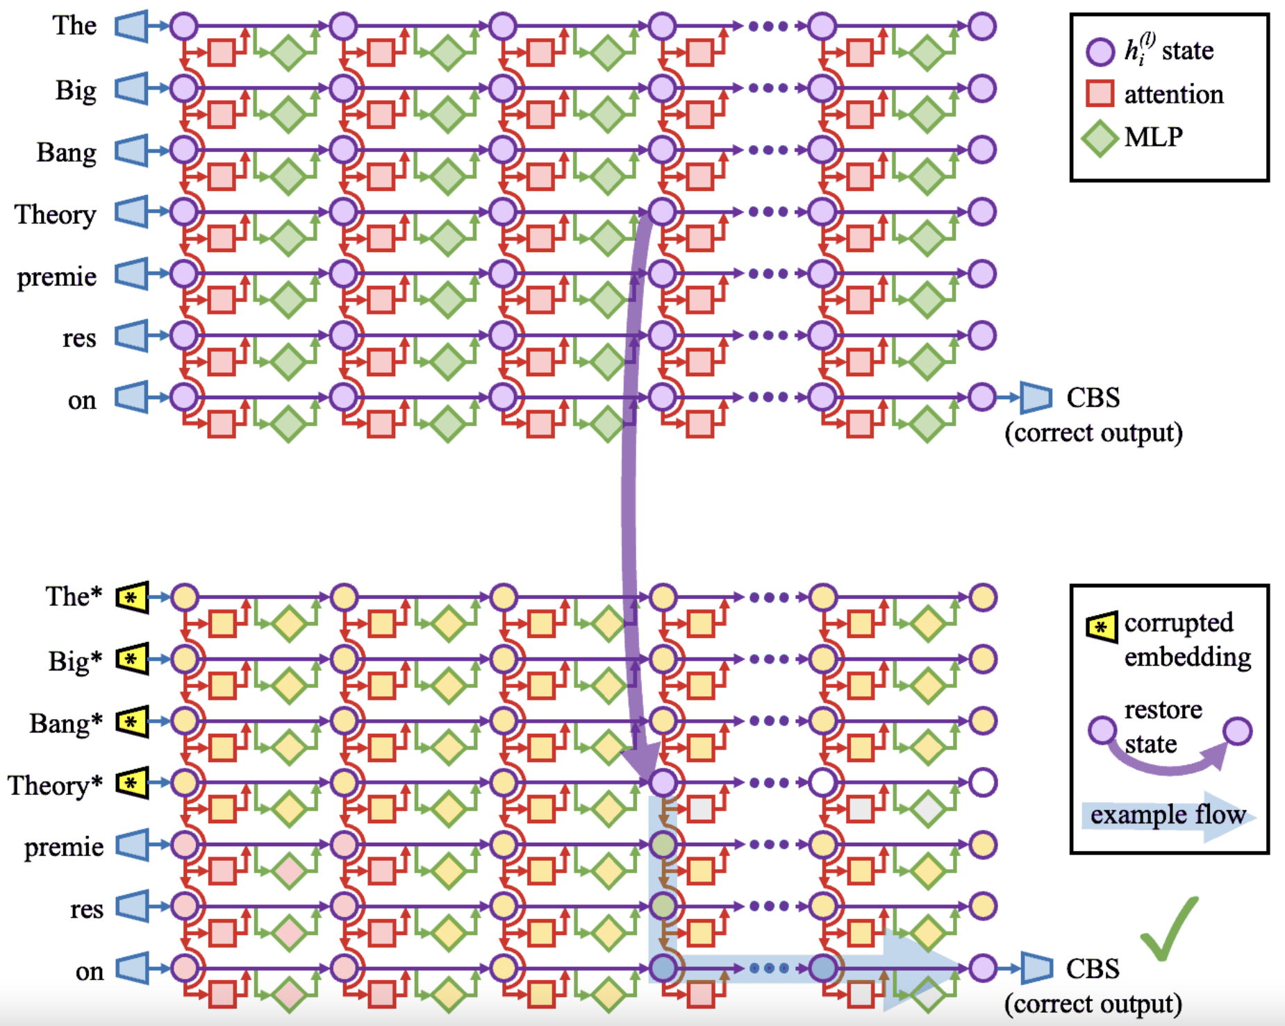
Technique: Activation Patching
Practice finding circuits => develop good techniques
Locating and Editing Factual Associations in GPT (Meng et al)
Open Problems: Techniques, Tooling and Automation
Notes:
Technique, first seen in causal mediation analysis, developed in ROME paper, refined in Interp in the Wild
Causal intervention - sentence where John is IO, one where Mary is IO. Pick some head and patch in the John act to the Mary run, and see if it flips output to John. If so, important!
Very automated, scalable, nice, but also zoomed in and allows higher rigour, IOI made it more sophisticated with path patching, then causal scrubbing, etc.

Slide 27
Demo: Exploratory Analysis Demo
https://neelnanda.io/exploratory-analysis-demo
Notes:
Q: Check for universality of IOI - OPT Small?

Slide 28
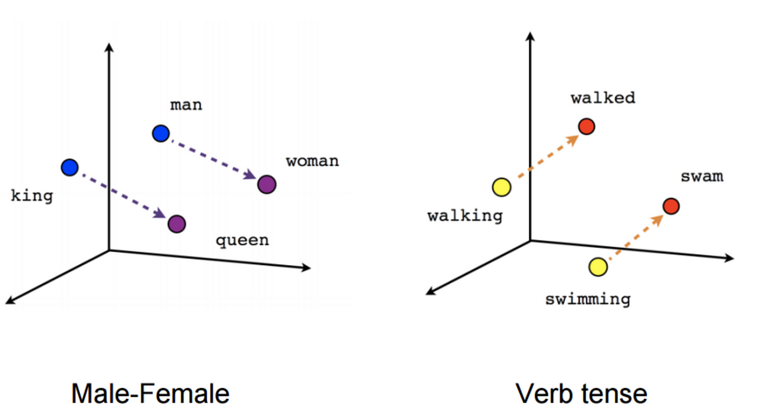
Linear Representation Hypothesis:
Models represent features as directions in space
Models have underlying principles with predictive power
Notes:
A hypothesis about models - activations contain different directions corresponding to features, which can independently vary.
First implied by word2vec, I think, not novel to mech interp. But an example of an empirical claim about a universal principle about how models represent thoughts

Slide 29
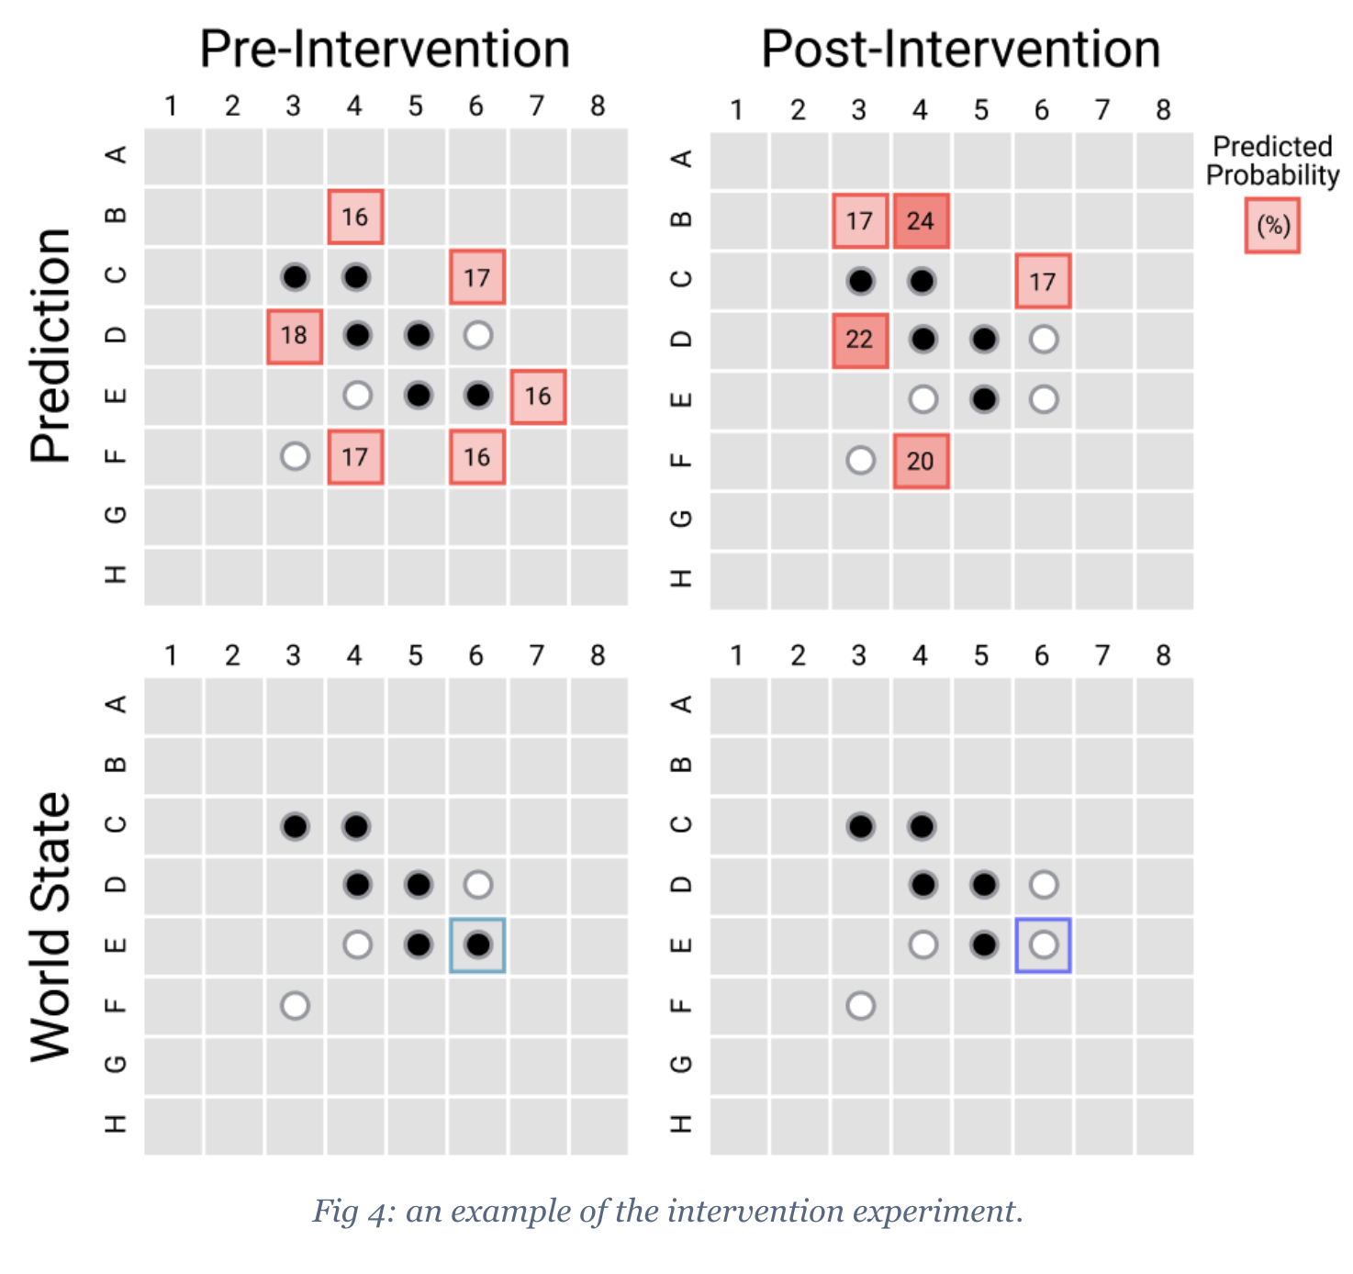
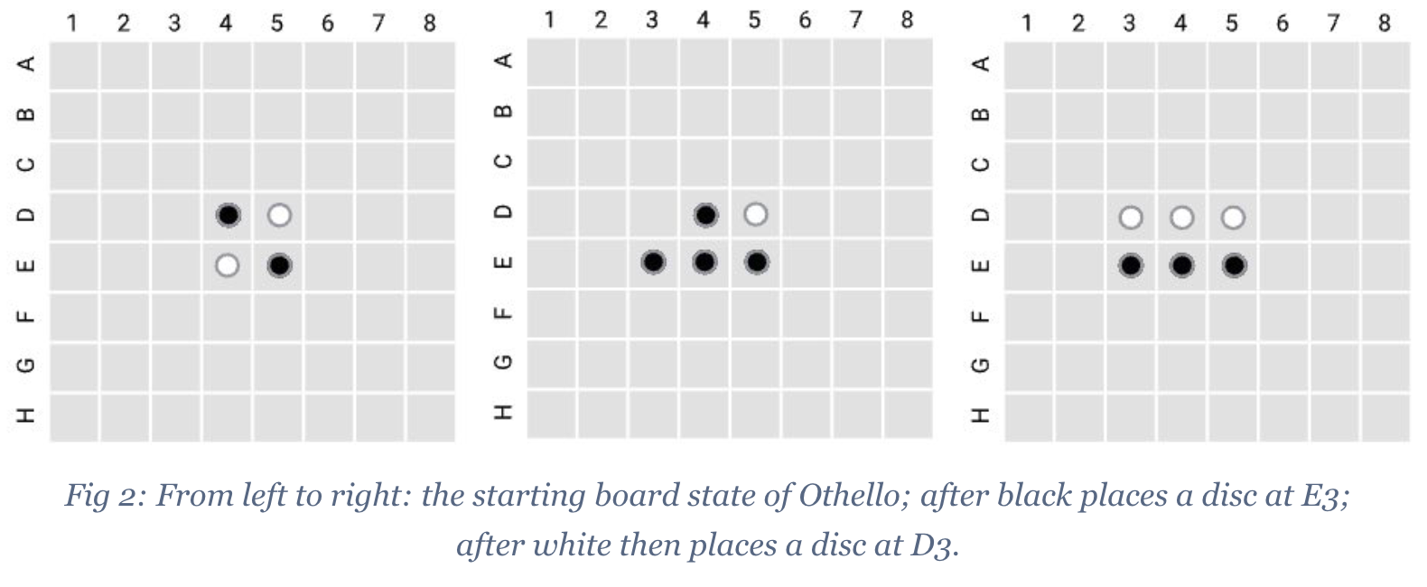
Case Study: Emergent World Representations in Othello-GPT
Networks have real underlying principles with predictive power
Seemingly Non-Linear Representations?!
Emergent World Representations (Li et al)

Slide 30
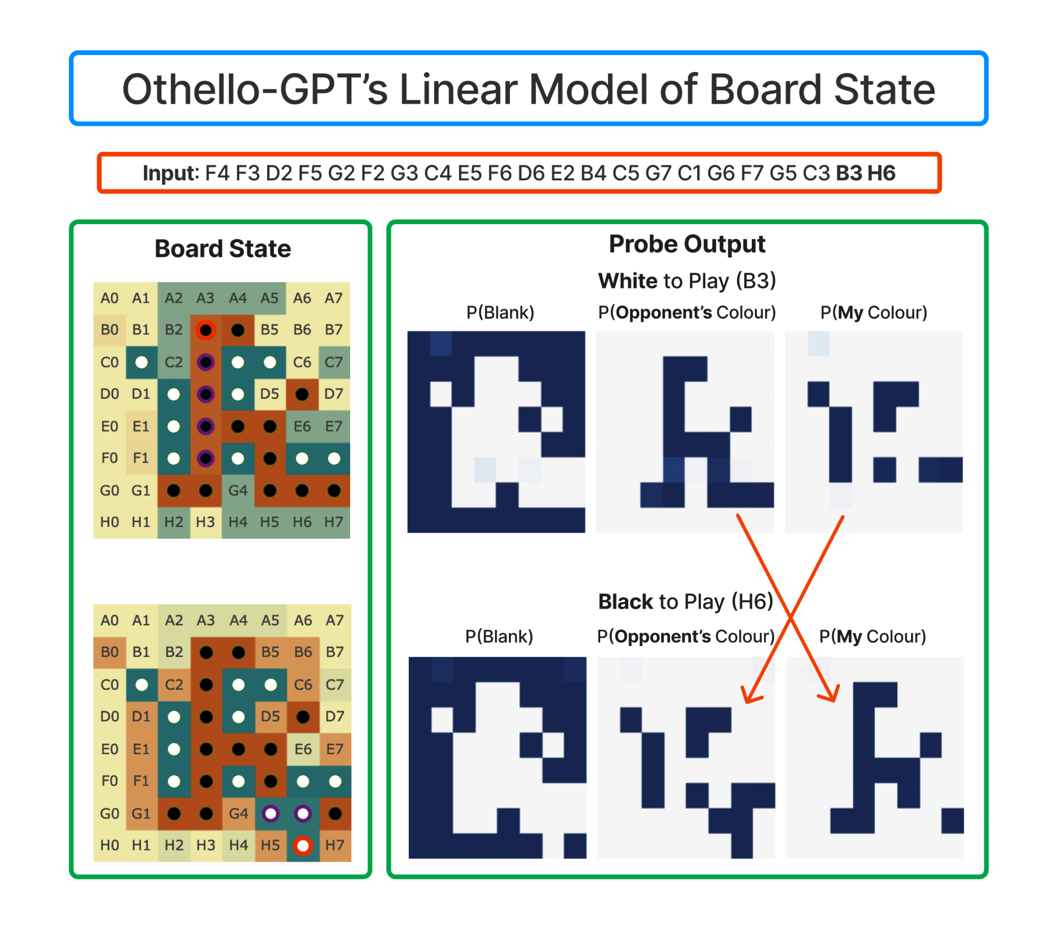
My colour vs their’s
Linear representation hypothesis
Generalises
Survived falsification
Has predictive power
Actually, Othello-GPT Has A Linear Emergent Representation (Neel Nanda)
Open Problems: Future Work on Othello-GPT
Notes:
Q: Can you find interpretable + monosemantic neurons? Complex enough to be interesting, simple enough to be tractable

Slide 31
Learning More
200 Concrete Open Problems in Mechanistic Interpretability
https://neelnanda.io/concrete-open-problems
Getting Started in Mechanistic Interpretability
https://neelnanda.io/getting-started
A Comprehensive Mechanistic Interpretability Explainer
https://neelnanda.io/glossary
TransformerLens
https://github.com/neelnanda-io/TransformerLens

