Slide 1
Can language models learn from explanations in context?
Andrew Lampinen, Ishita Dasgupta, Stephanie Chan, Kory Matthewson, Michael Henry Tessler, Antonia Creswell, James McClelland, Jane Wang, Felix Hill DeepMind, London, UK
Presented by Cynthia Chen, Jason Jabbour, Mark Mazumder
April 17, 2023

Slide 2
Presentation Roadmap
Introduction
Method
Experiments
Discussion

Slide 3
Introduction
Language models (LMs) have been found to be able to perform new tasks by adapting to a few in-context examples
In-context example: an example (question + right answer) for a specific task prompt
“few-shot”: a few examples are given to guide the model
Could including few-shot explanations of the answers in these examples improve LM performance?
Notes:
Training of GANs occurs by alternating between training the generator and discriminator

Slide 4
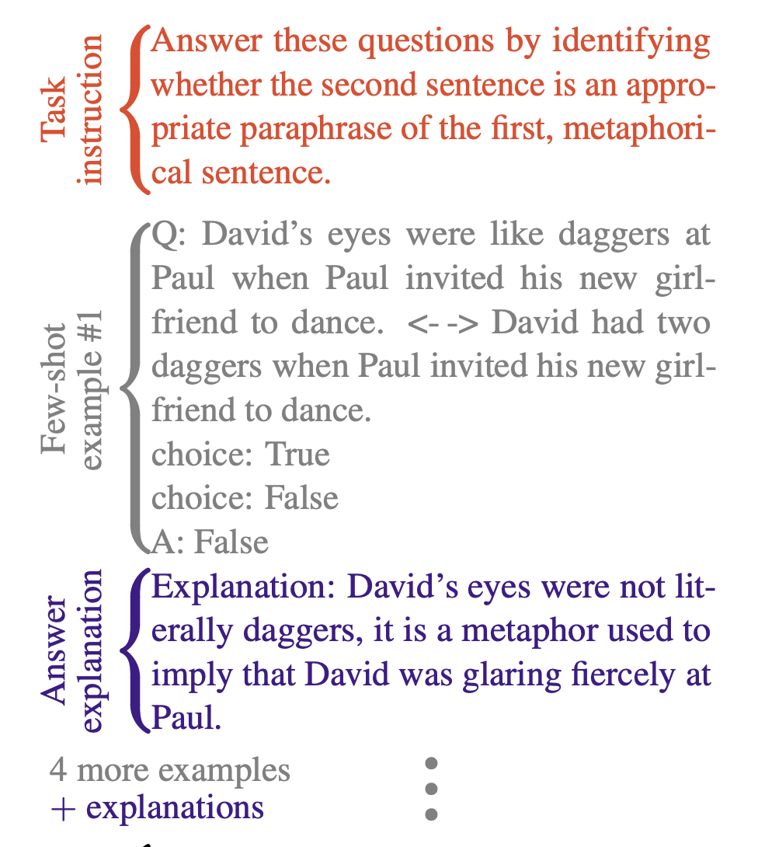
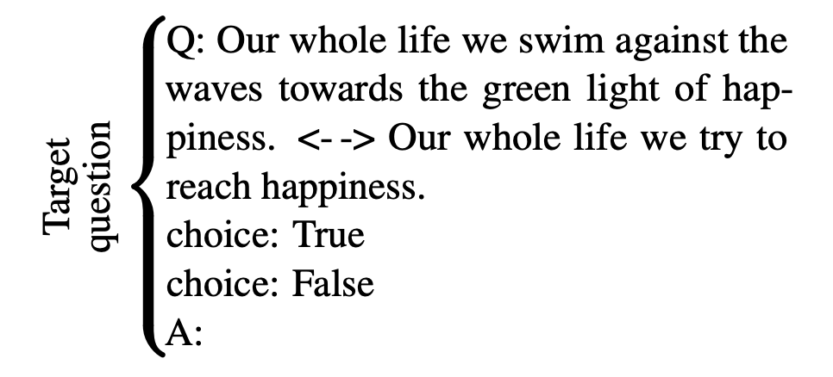
Training: Task instruction, examples + explanations
Evaluation: Target question
Notes:
Training of GANs occurs by alternating between training the generator and discriminator

Slide 5
Related Work:
In-context and prompt-based learning:
Min et al., 2022: Find that ground truth labels don’t have a large effect on model performance, and identify other aspects (label space / distribution) that drive performance
Webson and Pavlick, 2021: Find limitation in models’ ability to truly understand the meaning of their prompts
Prompting with explicit instructions
Liu et al., 2021: Prompting with explicit instructions or task descriptions helps LMs adapt to a task
Wei et al, 2022: Breaking down the steps of a reasoning process for LMs improve few-shot performance
Exploring explanations of answers
Assessing effects of auxiliary in-context information on performance
Large body of work (beyond prompting) on training/tuning with explanations
This paper particularly focuses on the effect of post-answer explanations
Notes:
Training of GANs occurs by alternating between training the generator and discriminator

Slide 6
Research Questions
Can language models benefit from explanations when learning from examples in-context?
Do few-shot explanations help the model to “understand” the task better? Do explanations of answers improve few-shot task performance?
More generally, what kind of in-context learning abilities do LMs exhibit?

Slide 7
Contributions and Main Findings
Annotate 40 challenging tasks with explanations of examples
Evaluate the particular effect of post-answer explanations (contrasted to previous work such as Wei et al. who provide chains of reasoning before the answer)
Findings:
Explanations of examples improve the performance of LLMs when compared to matched control conditions
Explanations tuned using a small validation set have even larger performance benefits
Notes:
2nd point: this is a surprising result, that we can separate semantic features with linear hyperplanes

Slide 8
Presentation Roadmap
Introduction
Method
Experiments
Discussion

Slide 9
Methods: Data and Model
Data: Selected a set of 40 challenging tasks from the BIG-Bench dataset
Task examples:
Inferring goals from actions
Reasoning about mathematical induction
Reasoning about causality
Inferring assumptions behind a statement
Model: set of decoder-only Transformer language models
Evaluated a set of models with same context window and trained on the same dataset

Slide 10
Methods: Explanation Annotation
An author annotated 15 examples with human explanations
Restricted to multiple choice tasks
Conducted comparison to control explanations to account for confounding factors
Scrambled explanations
True non-explanations
Permuted explanations
Explanation fine-tuning
Selected examples to build a 5-shot prompt greedily, to evaluate the benefit of selecting the best examples
Hand-tuned explanations to better understand the potential benefits of more optimal “expert” explanations
Tuning performed on small validation set, but tested on larger set of task examples

Slide 11
Methods: Evaluation
Modeled dependencies of results using hierarchical logistic regression
Nested dependencies and heterogeneous structure
Factors to take into account:
Task difficulty
Shared content between prompts
Model each unique effect at each level of the hierarchy
Estimates the unique added contribution of a prompt component (eg: few-shot example, explanation, etc) to the performance

Slide 12
Presentation Roadmap
Introduction
Method
Experiments
Discussion
Walkthrough
Potential Impacts
Nuances

Slide 13
Benefit of Adding Explanations
Look at 2 out of 15 prompts drawn from the 40 tasks
analytic_entailment
odd_one_out
physical_intuition
unit_interpretation/lv2
riddle_sense
arithmetic/3_digit_division
crass_ai
phrase_relatedness
penguins_in_a_table
mathematical_induction
arithmetic/3_digit_subtraction
cs_algorithms/valid_parentheses
goal_step_wikihow/goal_inference
play_dialog_same_or_different
cause_and_effect/two_sentences
english_proverbs
identify_odd_metaphor
presuppositions_as_nl
physics
arithmetic/2_digit_multiplication
empirical_judgments
goal_step_wikihow/step_inference
truthful_qa
implicatures
disambiguation_qa
epistemic_reasoning
irony_identification
nonsense_words_grammar
navigate
logical_args
common_morpheme
color/rgb
evaluating_information_essentiality
logical_deduction/three_objects
metaphor_boolean
crash_blossom
fantasy_reasoning
figure_of_speech_detection
logic_grid_puzzle

Slide 14
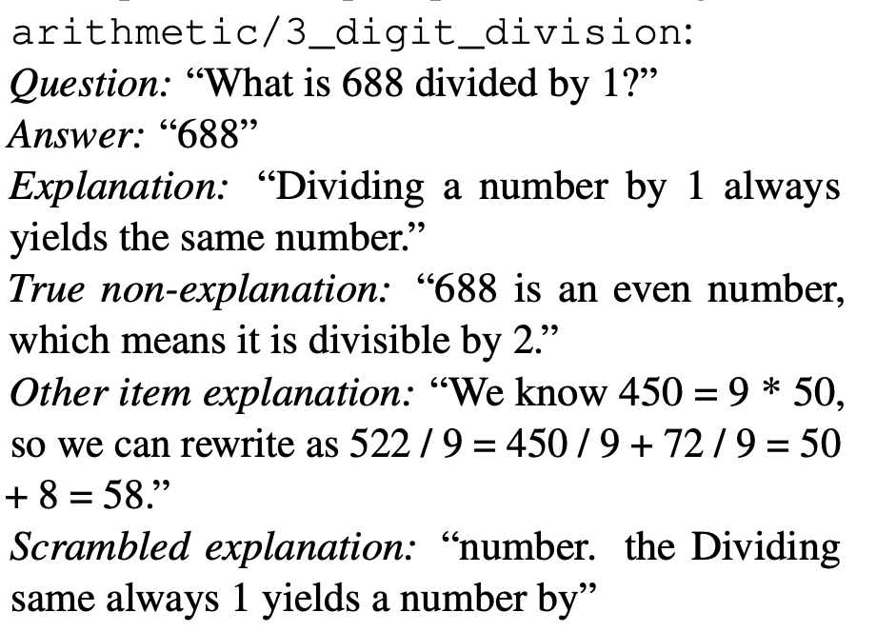
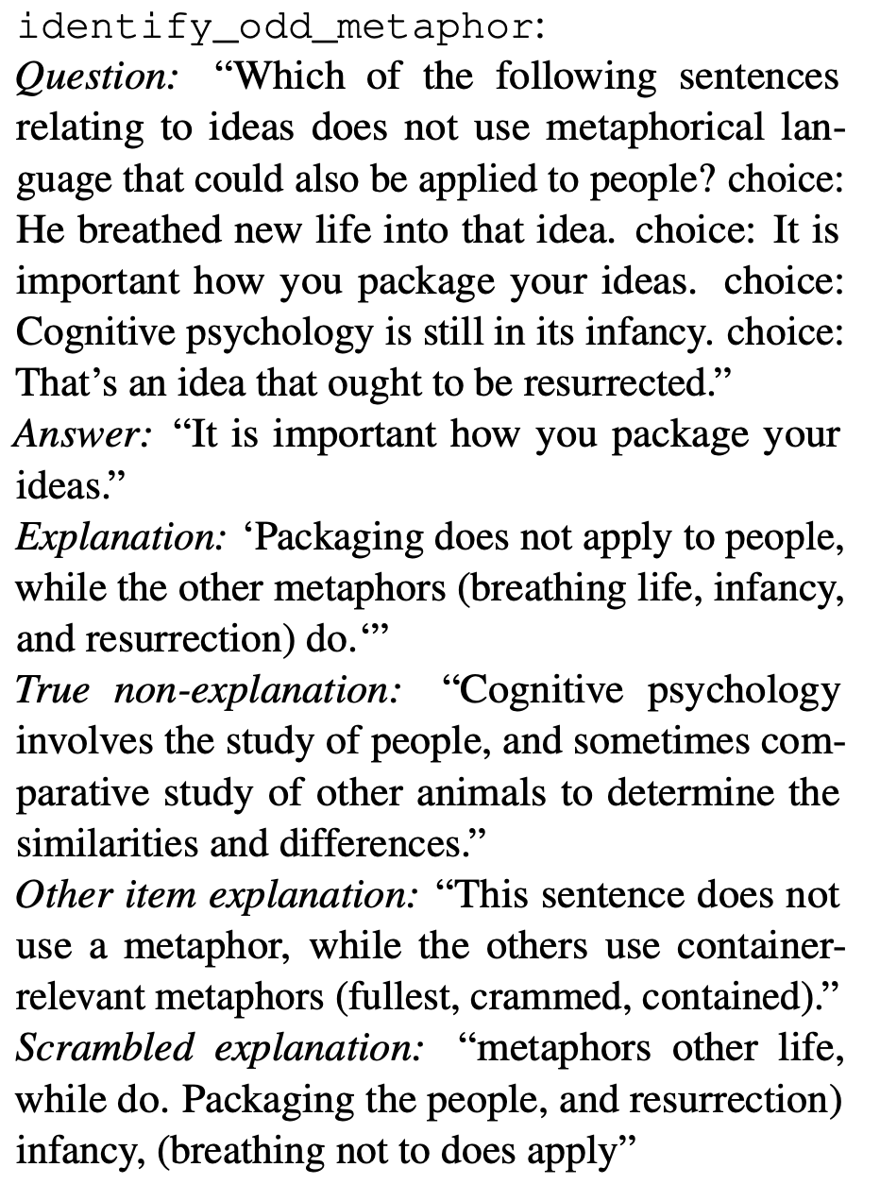
Examples Alone (no explanations)
(choices omitted for brevity)

Slide 15
Answer Likelihoods
(choices omitted for brevity)
Each experiment evaluates the relative probability of this sequence of tokens relative to all sequences in the multiple choice answers (not all possible sequences of tokens) i.e., model’s likelihood of each answer option after conditioning on the prompt and question

Slide 16
Adding Explanations

Slide 17
Adding Explanations

Slide 18
Adding Explanations
Does the likelihood ratio of the correct answer increase for the next question, when explanations are added to previous examples?

Slide 19
How much do explanations help?
Is it the explanation itself or something else (relevant words, syntactic structure, …)
vs 3 Control Conditions
Control Experiments
True Non-Explanation
Other Item Explanation
Scrambled Explanation

Slide 20
How much do explanations help?
Is it the explanation itself or something else (relevant words, syntactic structure, …)
Control Experiment 1
Relevant but non-explanatory

Slide 21
How much do explanations help?
Is it the explanation itself or something else (relevant words, syntactic structure, …)
Control Experiment 2
Randomly chosen from other examples in the prompt dataset

Slide 22
How much do explanations help?
Is it the explanation itself or something else (relevant words, syntactic structure, …)
Control Experiment 3

Slide 23
How much do explanations help?
Is it the explanation itself or something else (relevant words, syntactic structure, …)
These are untuned explanations:
Annotated by hand, without looking at LM probabilities

Slide 24
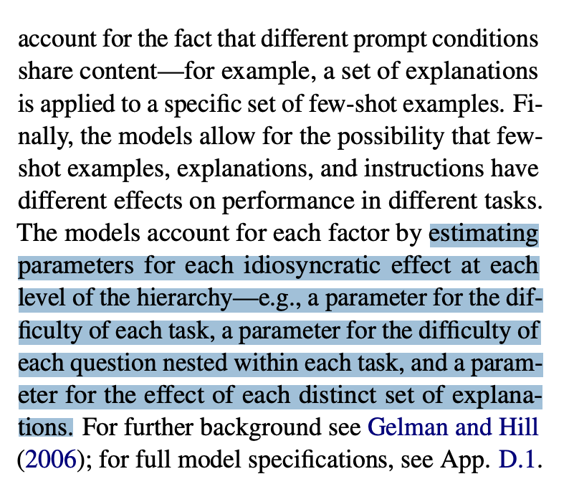

Slide 25
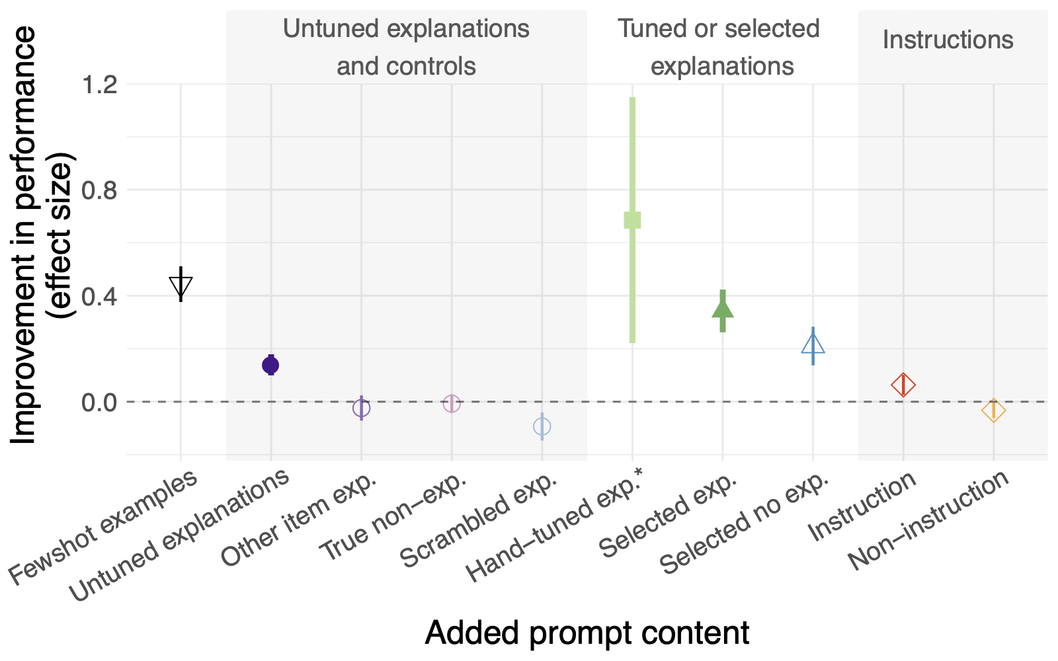
Effect Size
Hierarchical Regression: quantify unique added contribution (on Gopher-280B)

Slide 26
Effect Size
Zero-Shot vs Examples

Slide 27
Effect Size
Explanations
~ ⅓ effect size vs examples

Slide 28
Effect Size
Selection
Greedily choose the best k-shot chain of prompts to maximize likelihood of remaining (n-k) examples, up to k=5
Only 15 examples per task:
5-shot prompt selection
10 validation examples

Slide 29
Effect Size
Comparable effect size to examples alone Selection is useful!

Slide 30
Effect Size
Hand-tuning
Manually reword explanation text to boost acc on validation set (10 examples/task)

Slide 31
Effect Size
Wide CI?
Only 5/40 tasks were hand-tuned

Slide 32
Effect Size
Instructions
Small benefit

Slide 33
Presentation Roadmap
Introduction
Method
Experiments
Discussion
Walkthrough
Potential Impacts
Nuances

Slide 34
Potential impacts for LLM applications
Adding untuned few-shot explanations slightly outperforms examples alone
Selection and rewriting using a validation set boosts gains as much as examples
In-context explanations vs finetuning LLM weights on a task
Explanations are quicker + easier to deploy
But has a fixed “budget” → total prompt length
Can the gap be closed?
What is the “budget” for in-context learning?
Gopher:
2048 tokens
GPT-4-32k
~50pgs of text
Source: https://openai.com/research/gpt-4

Slide 35
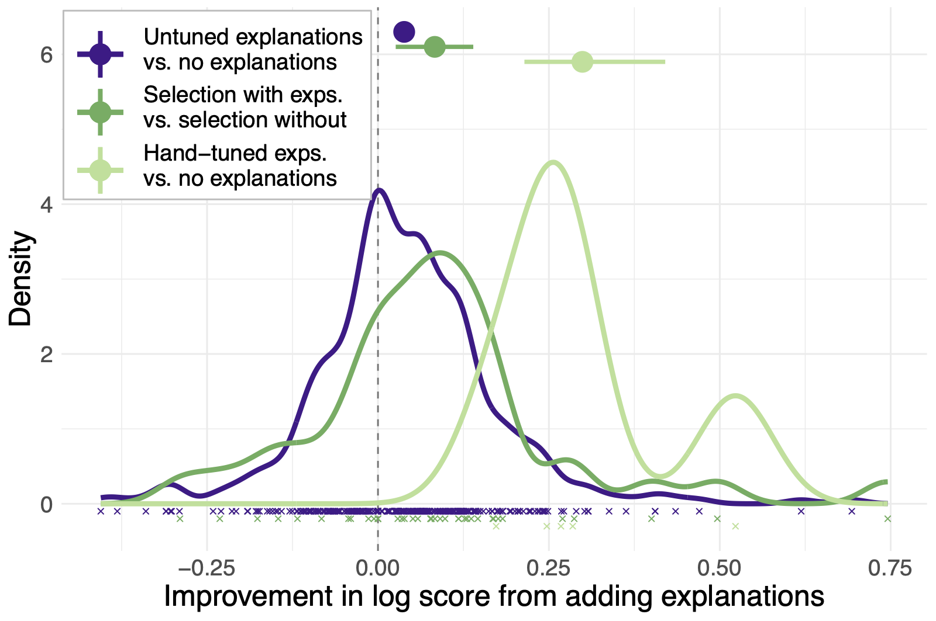
Selection vs untuned explanations
Untuned explanations are slightly beneficial on average

Slide 36
Selection vs untuned explanations
But many instances where untuned explanations hurt accuracy

Slide 37
Selection vs untuned explanations
Benefit of selection is clearer
Not enough data on hand-tuning to be persuasive?

Slide 38
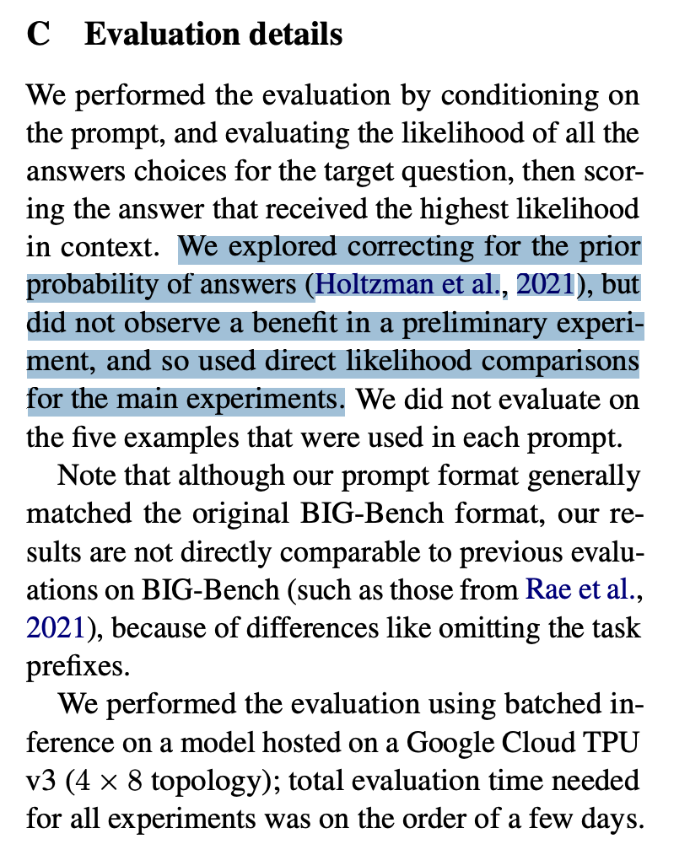

Slide 39
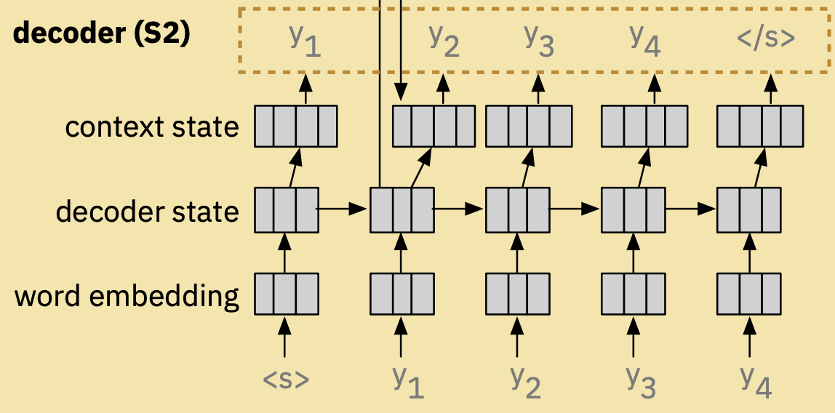
Transformer Decoder
Figure Credit: [1804.09299] Seq2Seq-Vis: A Visual Debugging Tool for Sequence-to-Sequence Models

Slide 40
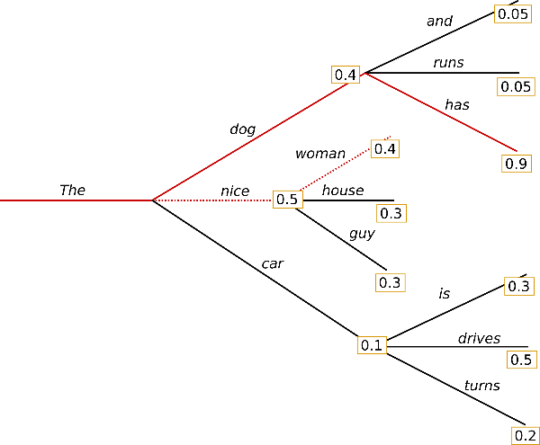
LLM Output Probabilities
Figure: https://huggingface.co/blog/how-to-generate

Slide 41
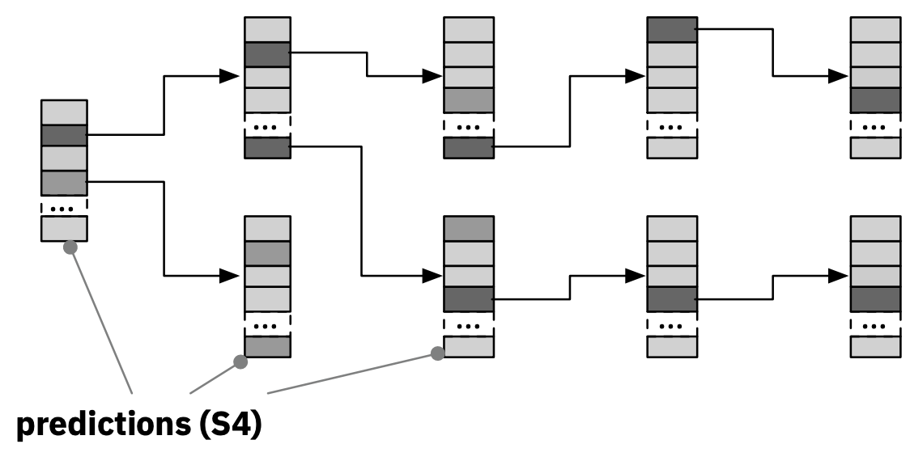
Beam Search
Figure Credit: [1804.09299] Seq2Seq-Vis: A Visual Debugging Tool for Sequence-to-Sequence Models
32K SentencePiece Tokens

Slide 42
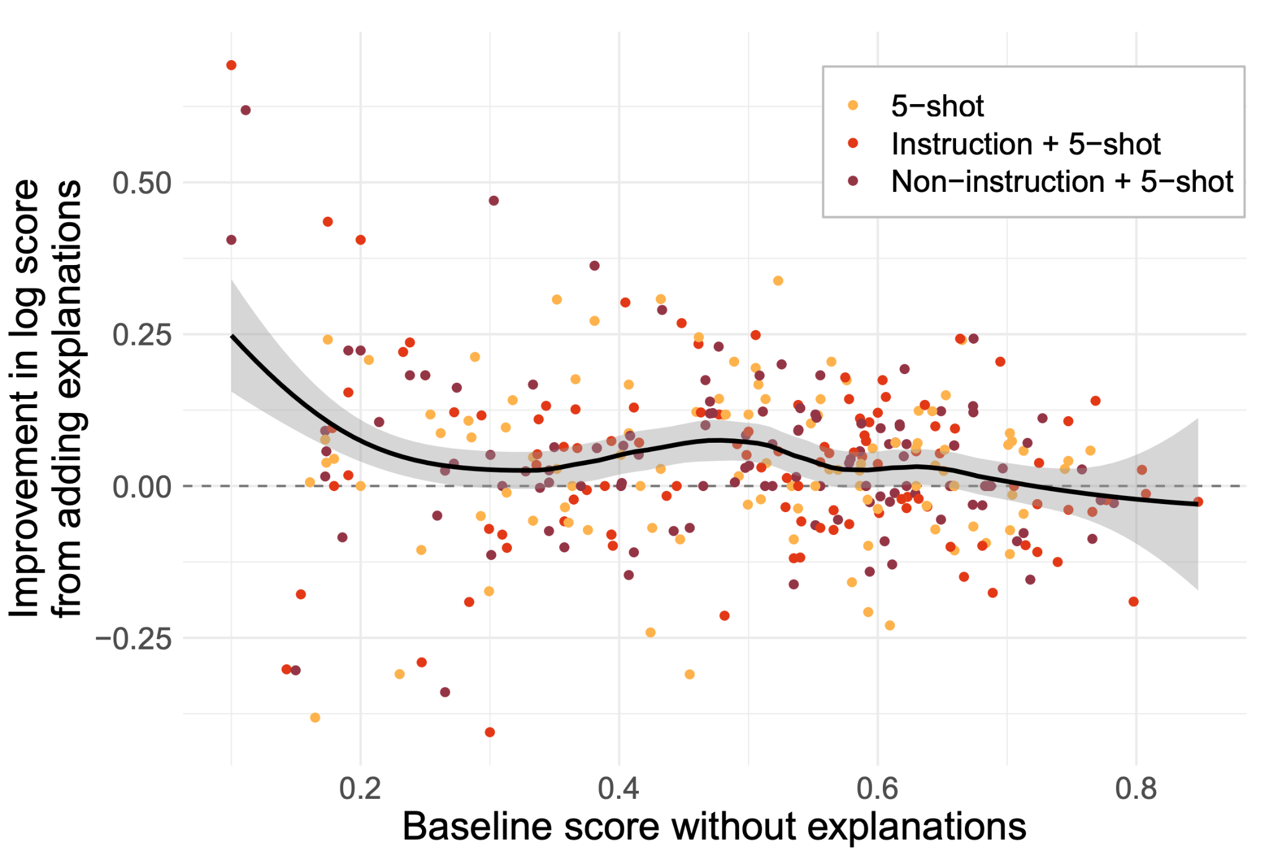
When do explanations help?
Addition of explanations vs model’s prior confidence with examples alone
Baseline: without explanations (baseline is not zero-shot)

Slide 43
When do explanations help?
The model’s uncertain - explanations help
The model’s already correct without explanations - do explanations hurt?

Slide 44
When do explanations help?
The model’s uncertain - explanations help
The model’s already correct without explanations - do explanations hurt?
Notes:
“Figure 6: The improvement given by explanations, plotted relative to the baseline score of the same prompt
without explanations. The anti-correlation between initial score and improvement would be expected from
floor/ceiling effects/regression to the mean. However,
there is also an interesting hint of greater improvements
at moderate scores. (Curve is LOESS smoothing with
a window of 50% of the data, shaded region is standard
error.)”

Slide 45
When do explanations help?
Explanations usually help: higher density regardless of baseline confidence
Notes:
“Figure 6: The improvement given by explanations, plotted relative to the baseline score of the same prompt
without explanations. The anti-correlation between initial score and improvement would be expected from
floor/ceiling effects/regression to the mean. However,
there is also an interesting hint of greater improvements
at moderate scores. (Curve is LOESS smoothing with
a window of 50% of the data, shaded region is standard
error.)”

Slide 46
When do explanations help?
But not always: scores also drop with explanations, but uniformly(ish)
Notes:
“Figure 6: The improvement given by explanations, plotted relative to the baseline score of the same prompt
without explanations. The anti-correlation between initial score and improvement would be expected from
floor/ceiling effects/regression to the mean. However,
there is also an interesting hint of greater improvements
at moderate scores. (Curve is LOESS smoothing with
a window of 50% of the data, shaded region is standard
error.)”

Slide 47
When do explanations help?
Larger boost at moderate scores?
“Zone of proximal effect?” (what a learner can do on the cusp of their prior capabilities, with/without teacher assistance)
Notes:
“Figure 6: The improvement given by explanations, plotted relative to the baseline score of the same prompt
without explanations. The anti-correlation between initial score and improvement would be expected from
floor/ceiling effects/regression to the mean. However,
there is also an interesting hint of greater improvements
at moderate scores. (Curve is LOESS smoothing with
a window of 50% of the data, shaded region is standard
error.)”

Slide 48
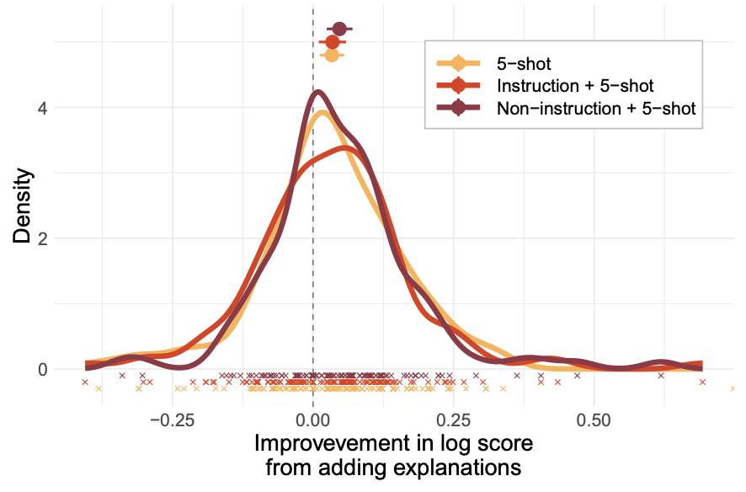
Does adding instructions help?
i.e, 5 examples + explanations
i.e, 5 examples + explanations + task instruction

Slide 49
Does adding instructions help?
Non-Instruction Control Experiments: A “neutral” description added to the prompt not about the task

Slide 50
Does adding instructions help?
Means + 95% CI

Slide 51
Does adding instructions help?
Means + 95% CI
Not appreciably different:
So are explanations equivalent to instructions?

Slide 52
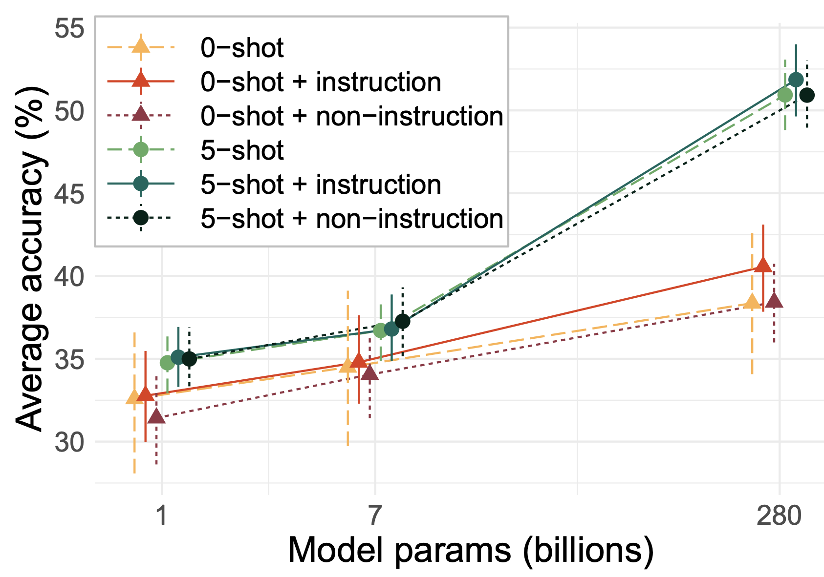
Do instructions alone help? (zero-shot)
With examples: a little, at larger model sizes?
Without examples: more beneficial

Slide 53
Do instructions alone help? (zero-shot)
Earlier work (Reynolds ‘21): instructions are more helpful than examples
Here: effect from instructions is smaller than from examples
Contradiction? Speculation that instructions were heavily tuned (i.e., not zero-shot)

Slide 54
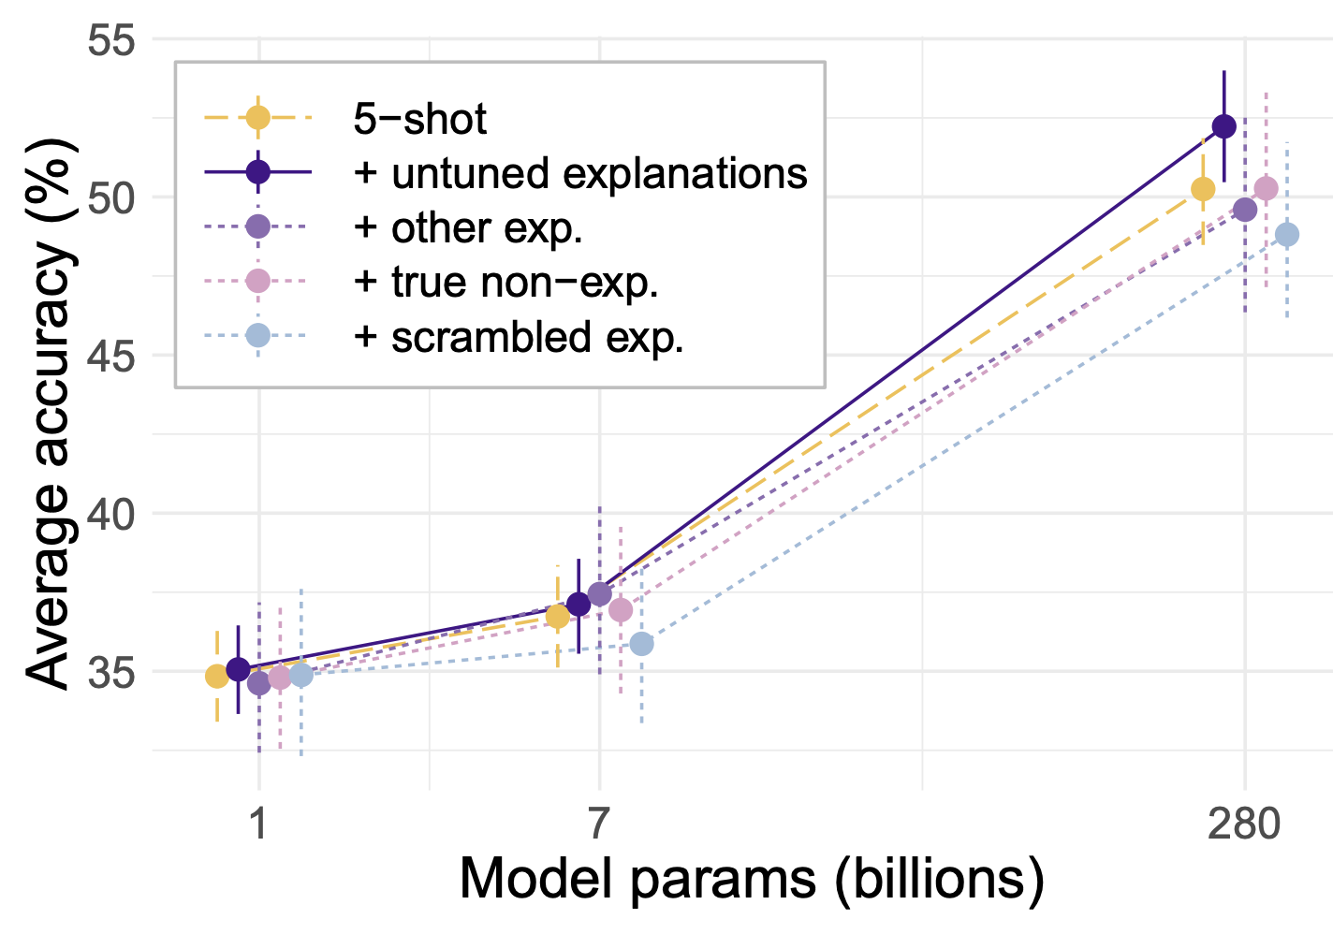
When do explanations help?

Slide 55
When do explanations help?
Explanations modestly but significantly boost accuracy over controls for the largest model only (Gopher-280B)
But not for others
Consistent w/prior work on scaling:
Brown ‘20: sharp transition for arithmetic
Wei ‘21: only large LMs generalize

Slide 56
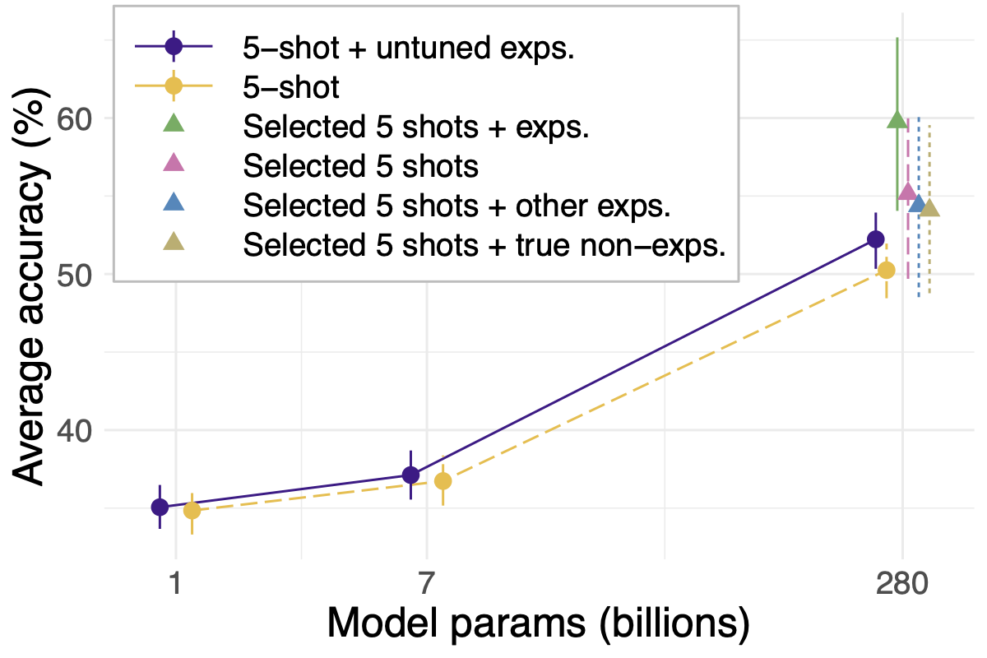
Is Scale Necessary?
Untuned explanations only help modestly for the largest model
Selection emerges from the pack
But no benefits @ 1B, 7B
Consistent w/prior work on scaling:
Brown ‘20: sharp transition for arithmetic
Wei ‘21: only large LMs generalize

Slide 57
Task Specific Improvements
Does improvement provided by explanations differ between types of tasks?

Slide 58
Task Diversity
analytic_entailment
odd_one_out
physical_intuition
unit_interpretation/lv2
riddle_sense
arithmetic/3_digit_division
crass_ai
phrase_relatedness
penguins_in_a_table
mathematical_induction
arithmetic/3_digit_subtraction
cs_algorithms/valid_parentheses
goal_step_wikihow/goal_inference
play_dialog_same_or_different
cause_and_effect/two_sentences
english_proverbs
identify_odd_metaphor
presuppositions_as_nl
physics
arithmetic/2_digit_multiplication
empirical_judgments
goal_step_wikihow/step_inference
truthful_qa
implicatures
disambiguation_qa
epistemic_reasoning
irony_identification
nonsense_words_grammar
navigate
logical_args
common_morpheme
color/rgb
evaluating_information_essentiality
logical_deduction/three_objects
metaphor_boolean
crash_blossom
fantasy_reasoning
figure_of_speech_detection
logic_grid_puzzle

Slide 59
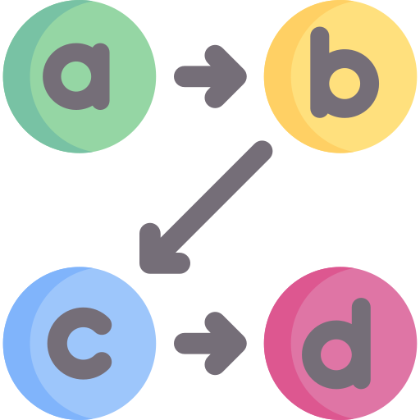
Clustering Tasks into Categories
Casual
Computer Science
Logic
Negation
OOD
Common Sense
Linguistic
Mathematics
None

Slide 60
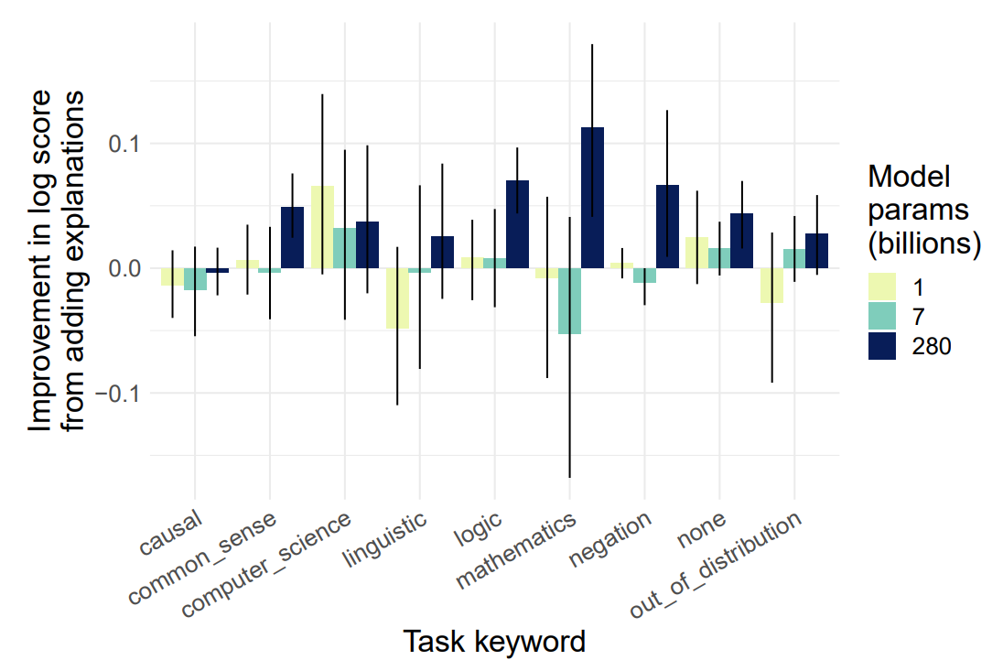
Not all Tasks are Created Equal

Slide 61
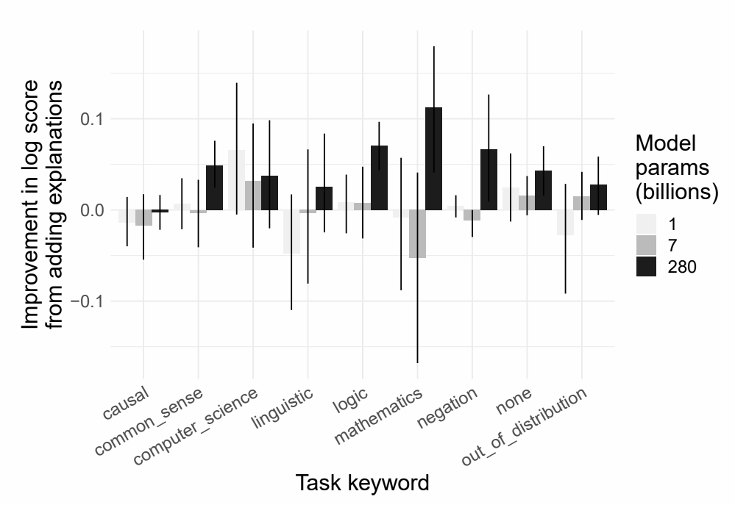
Not all Tasks are Created Equal
Semantics of explanations for tasks about Logic, Mathematics, Negation might be better suited for LM

Slide 62
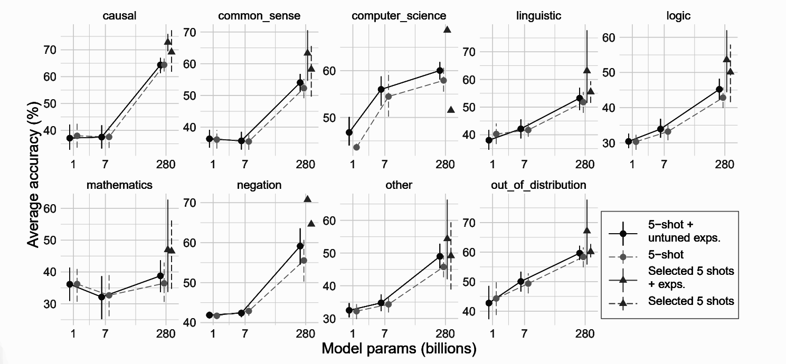
Not all Tasks are Created Equal

Slide 63
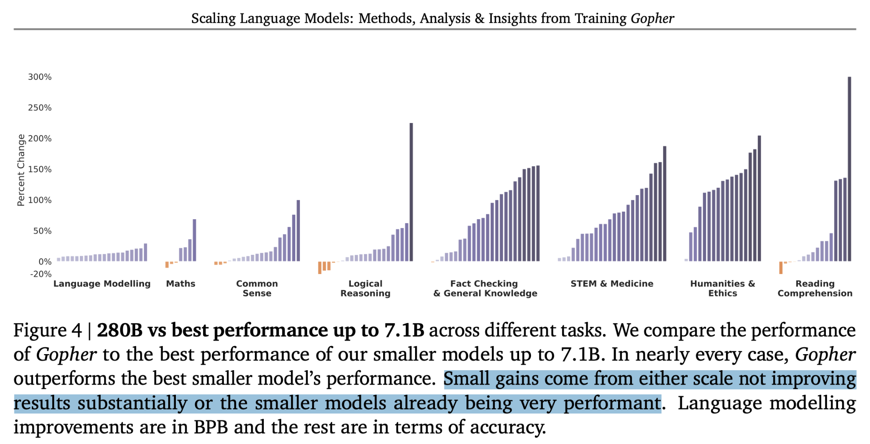
Gopher 280B vs <= 7.1B
Source: https://arxiv.org/abs/2112.11446

Slide 64
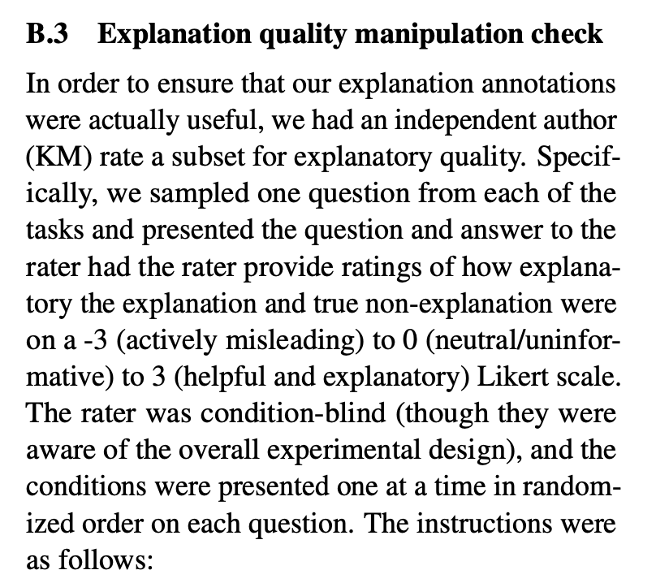

Slide 65
Presentation Roadmap
Introduction
Method
Experiments
Discussion

Slide 66
Discussion
Can explanations improve few-shot learning?
Why are post-answer explanations interesting?
What do their results imply about LMs’ abilities for in-context learning?
How do explanations relate to instructions?
How does their work relate to human language processing?
Notes:
Training of GANs occurs by alternating between training the generator and discriminator

Slide 67
Discussion
Can explanations improve few-shot learning?
Why are post-answer explanations interesting?
What do their results imply about LMs’ abilities for in-context learning?
How do explanations relate to instructions?
How does their work relate to human language processing?
Notes:
Training of GANs occurs by alternating between training the generator and discriminator

Slide 68
Can explanations improve few-shot learning?
Scale
Quality
Notes:
Training of GANs occurs by alternating between training the generator and discriminator

Slide 69
Discussion
Can explanations improve few-shot learning?
Why are post-answer explanations interesting?
What do their results imply about LMs’ abilities for in-context learning?
How do explanations relate to instructions?
How does their work relate to human language processing?
Notes:
Training of GANs occurs by alternating between training the generator and discriminator

Slide 70
Why are post-answer explanations interesting?
Holistic vs Chain-of-Reasoning
Test Time Implications
Notes:
Training of GANs occurs by alternating between training the generator and discriminator

Slide 71
Discussion
Can explanations improve few-shot learning?
Why are post-answer explanations interesting?
What do their results imply about LMs’ abilities for in-context learning?
How do explanations relate to instructions?
How does their work relate to human language processing?
Notes:
Training of GANs occurs by alternating between training the generator and discriminator

Slide 72
What do their results imply about LMs’ abilities for in-context learning?
Example & Explanation Relationships
Learning vs Recalling
Notes:
Training of GANs occurs by alternating between training the generator and discriminator

Slide 73
Discussion
Can explanations improve few-shot learning?
Why are post-answer explanations interesting?
What do their results imply about LMs’ abilities for in-context learning?
How do explanations relate to instructions?
How does their work relate to human language processing?
Notes:
Training of GANs occurs by alternating between training the generator and discriminator

Slide 74
How do explanations relate to instructions?
Instructions Improvement in Prior Work was Successful
Instruction & Explanations Complementary
Notes:
Training of GANs occurs by alternating between training the generator and discriminator

Slide 75
Discussion
Can explanations improve few-shot learning?
Why are post-answer explanations interesting?
What do their results imply about LMs’ abilities for in-context learning?
How do explanations relate to instructions?
How does their work relate to human language processing?
Notes:
Training of GANs occurs by alternating between training the generator and discriminator

Slide 76
How does their work relate to human language processing?
Humans LMs
No Broader Context
Notes:
Training of GANs occurs by alternating between training the generator and discriminator

Slide 77
Class Discussion
Is the dataset large (~600 samples)/diverse (40 tasks) enough to support their conclusions?
Is the degree of improvement offered by explanations significant?
How does this compare to other in-context learning methods?
Chain-of-thought [Wei]
Soft prompts (changing the embedding of the prompt) [Leister]
Finetuning + Distillation (Alpaca) [Taori]
How could explanations benefit smaller models and not only large models?
Notes:
Training of GANs occurs by alternating between training the generator and discriminator

Slide 78
Class Discussion
What are the benefits of their research methods?
What are the benefits and drawbacks of the datasets used?
Is the degree of improvement offered by explanations significant?
How scalable is explanation annotations?
How could explanations benefit smaller models and not only large models?
Notes:
Training of GANs occurs by alternating between training the generator and discriminator

Slide 79
Discussion
Large models benefit even from untuned explanations
Post-answer explanations are interesting because they can improve few-shot learning
This study focused on providing post-answer explanations rather than chains of reasoning before the answer, in contrast to some related works
Results suggest that post-answer explanations can have a positive impact on few-shot learning, in contrast to Wei et al. (2022) who did not observe a benefit
Pre- and post-answer modes of explanation have different implications at test-time and different scientific implications about the model's in-context inferences
Post-answer explanations do not affect the evaluation pipeline at test time, while pre-answer chains-of-reasoning do
Pre-answer reasoning and post-answer explanations might have complementary, combinable benefits for optimal performance
Zelikman et al. (2022) used post-answer-hint "rationalizations" as part of their bootstrapped training procedure
Pre-answer chains of reasoning allow the model to output a reasoning process and process the problem step-by-step before answering, while post-answer explanations can only shape the reasoning processes abstractly, by changing task inference
The effect of explanations is due to changes in how the model is processing the question and possible answers
The benefits of explanations result from fairly sophisticated higher-order inferences during in-context learning.
Notes:
Training of GANs occurs by alternating between training the generator and discriminator

