Slide 1
DALL-EVAL:
Probing the Reasoning Skills and Social Biases of Text-to-Image Generative Models
Authors: Jaemin Cho Abhay Zala Mohit Bansal
Presenters: Rohan Doshi, Kevin Huang, Steve Li, Shivam Raval

Slide 2
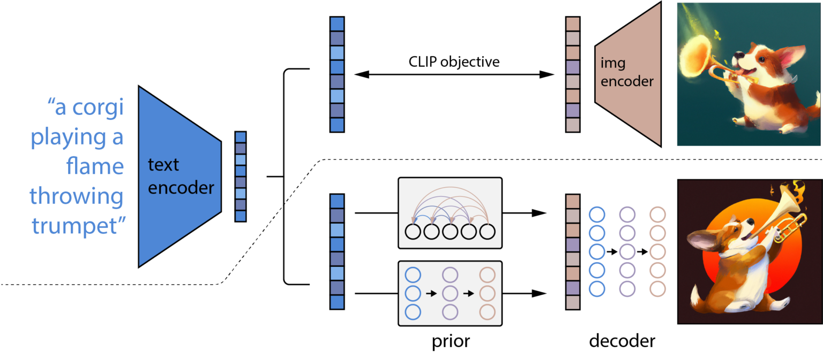
The Text-to-Image Landscape
DALL-E
DALL-E^{Small} and minDALL-E

Slide 3
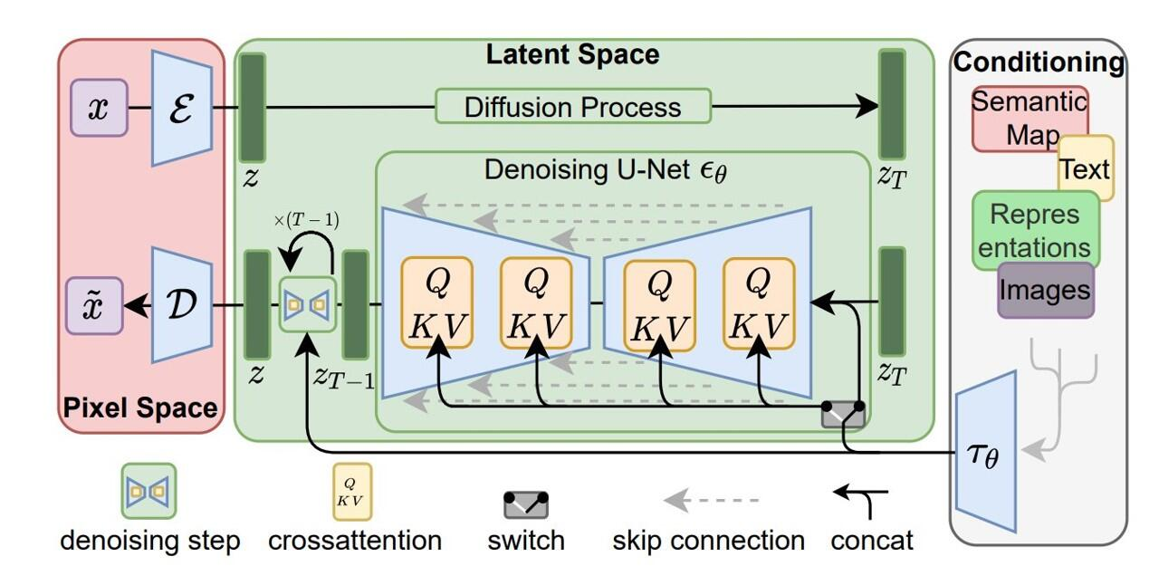
The Text-to-Image Landscape
Stable Diffusion
X-LXMERT

Slide 4
Image Quality
Image Quality
Whether the generated images look similar to images from training data.
Metrics: Inception Score (IS) and Frechet Inception Distance (FID)
Whether the generated images align with the semantics of the text descriptions.
Metrics: R-precision, BLEU, CIDEr, Semantic Object Accuracy (SOA)
Text-to-Image Evaluations
Notes:
Recently, DALL-E, a multimodal transformer language model, and its variants (including diffusion models) have shown high-quality text-to-image generation capabilities. However, despite the interesting image generation results, there has not been a detailed analysis on how to evaluate such models.
Most works have only evaluated their text-to-image generation models with two types of automated metrics: (1) image-text alignment - whether the generated images align with the semantics of the text descriptions and (2) image quality - whether the generated images look similar to images from training data.

Slide 5
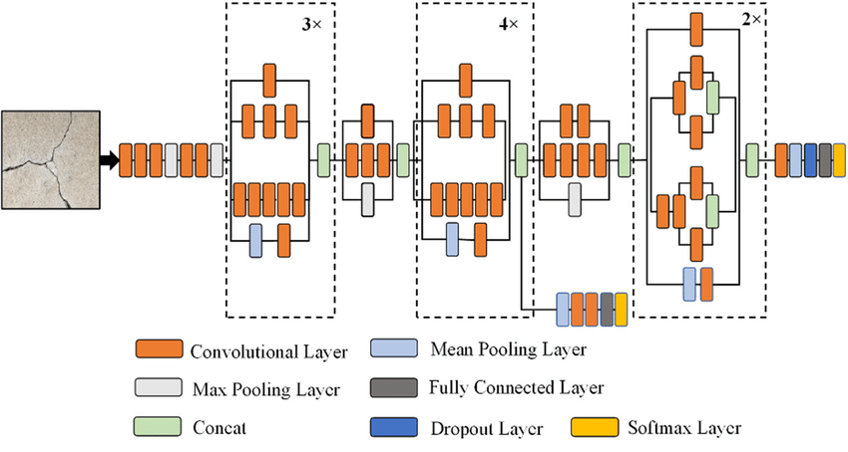
Metrics for evaluating Image Quality use the features of a pretrained image classifier such as Inception v3 to measure the diversity and visual reality of the generated images.
Inception Score:
Fréchet Inception Distance
Image Quality

Slide 6
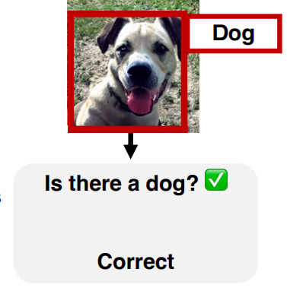
Current metrics for assessing Image-Text Alignment are based on retrieval, captioning, and object detection models.
R-precision:
BLEU and CIDEr:
Semantic Object Accuracy (SOA):
Image-Text Alignment

Slide 7
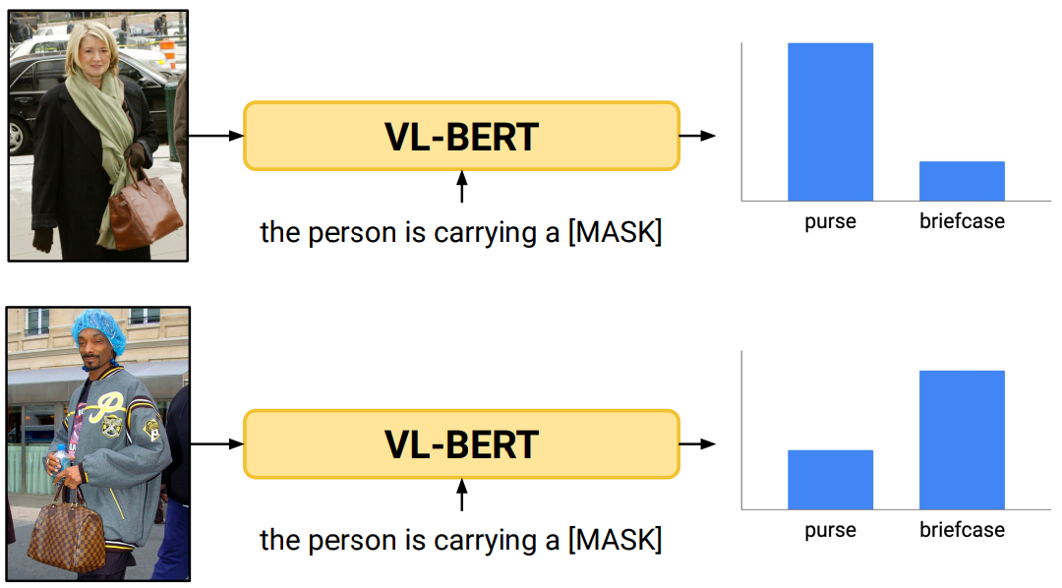
Gender neutral queries do not yield gender neutral results.
Measuring Bias
Image-only
Text-only
Visual-word embedding
Text-based image search

Slide 8
There is a lack of comprehensive evaluation metrics for text-to-image generative models like DALL-E.
Problem Statement

Slide 9
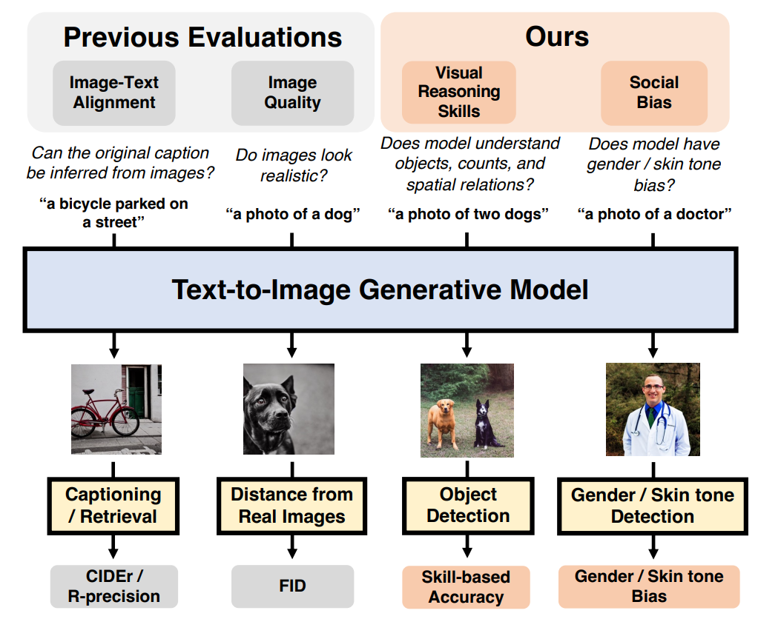
PaintSkills: A compositional diagnostic dataset and evaluation toolkit.
Social bias evaluation for text-to-image generation models.
Contributions: 2 areas to evaluate
1
2
Notes:
The paper proposes 2 new areas of evaluation for text-to-image generation:

Slide 10
Goal: evaluate visual reasoning of text-to-image models
Need 1: define "skills" that reflect visual reasoning
Need 2: select dataset to evaluate the visual reasoning
PaintSkills addresses both needs
dataset and evaluation toolkit that evaluates visual reasoning skills for text-to-image models
PaintSkills Overview

Slide 11
Object Recognition Given a text describing a specific object class (e.g., an airplane), a model generates an image that contains the intended class of object
Object Counting Given a text describing M objects of a specific class (e.g., 3 dogs), a model generates an image that contains M objects of that class
Spatial Relation Understanding Given a text describing two objects having a specific spatial relation (e.g., one is right to another), a model generates an image including two objects with the relation
Skills

Slide 12
VQA/GQA: <image, question, answer> tuples
Dataset bias
Skewed distribution towards few common objects, questions, and answers
PaintSkills controls for bias between input text and objects
VQA/GQA Shortcomings

Slide 13
Generates text-image pairs by:
Define scene configs
ensure objects, counts, and relations are uniformly distributed
Generate text prompts from scene config
mention object, count, and spatial relations
Generate image from scene config
Unity simulator
Approach

Slide 14
Scene Config
15 MS COCO Classes: {person, dog, airplane, ... }
Object count range: {1, 2, 3, 4}
Spatial relations: {above, below, left, right}
13 backgrounds
Text: templated string
Image: Unity 3D simulator
Scene Config to <text, image>

Slide 15
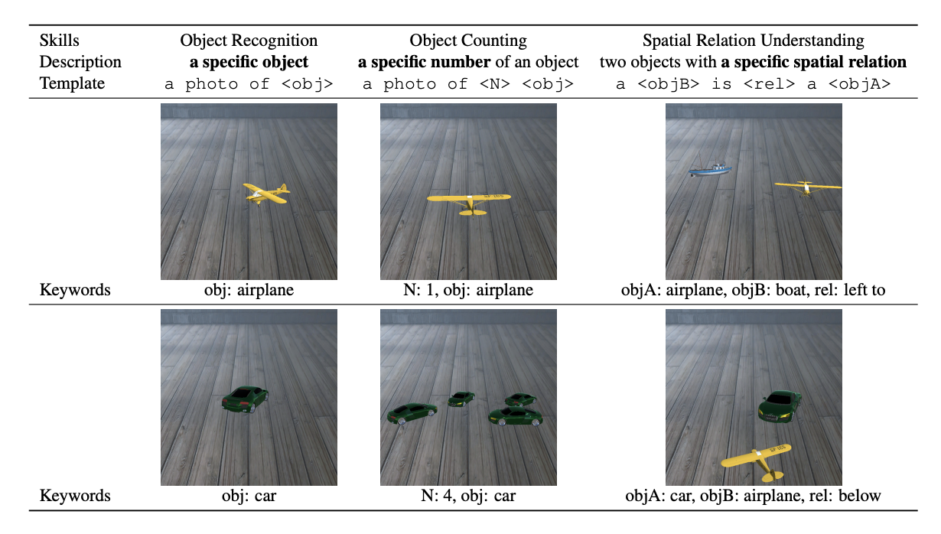
Dataset Examples

Slide 16
Dataset Metrics
 | Train | Test
Object Recognition | 23,250 | 2,325
Object Counting | 21,600 | 2,160
Spatial Relation Understanding | 13,500 | 2,700

Slide 17
Evaluation is done on two new criteria:
visual reasoning skills
social biases
…and two current criteria:
image-text alignment
image quality
Evaluation Overview

Slide 18
Visual Reasoning Skill Evaluation

Slide 19
Skills are evaluated based on how well an object detector (DETR) can detect the object described in the input text
trained on MS COCO 2017 train split
Visual Reasoning Skill Evaluation
Notes:
random accuracy? talk about ABC

Slide 20
Object Recognition: average accuracy on N test images whether correctly identifies the target class from the generated images
Object Counting: average accuracy whether correctly identifies M objects of the target class from the generated image
Spatial Relation Understanding: average accuracy whether correctly identifies both target object classes and pairwise spatial relations between objects
spatial relation is one of “above”, “below”, “left”, and “right” based off of 2D coordinates
Visual Reasoning Skill Evaluation

Slide 21
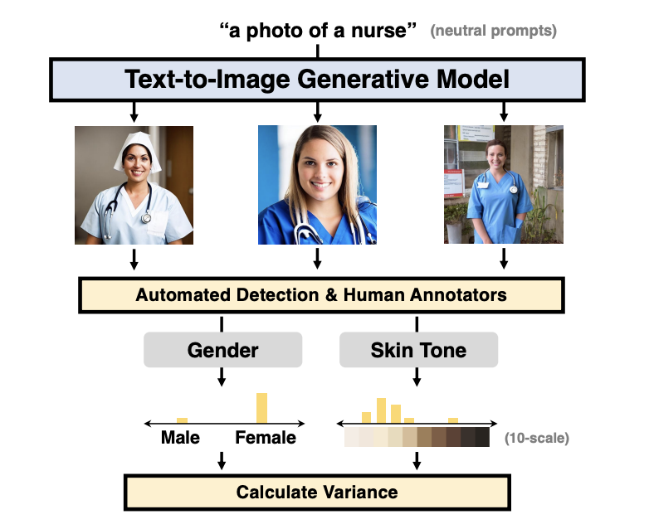
The authors use gender to refer to sex and not gender identity - male, female, due to human error and potential amplification of stereotypes by assigning gender labels
Skin tone analysis uses the Monk Skin Tone scale - continuous skin color to 10 skin tones
Social Bias Evaluation

Slide 22
bias is based off of skew of distribution from images from neutral prompts
Using 4 categories of words: profession, political, object, and other
Ex. “a photo of a [X]” where X is from profession/political/object/other words
“a person with a [X]”
for each prompt, generate 9 images with stochastic sampling, then estimate gender/skin
Social Bias Evaluation

Slide 23
Automated Gender Detection
CLIP: choose most prominent gender category from images with 2 classifier prompts: a photo of a male, a photo of a female
Automated Skin Tone Detection:
detect skin pixels based on RGBA and YCrCb colorspaces, take average of skin pixels and match with MST skin tone
Human evaluation:
5 MTurkers to select gender, ask an expert for skin tone
Social Bias Evaluation

Slide 24
obtain distributions for gender/skin tone: bias wrt degree of the skewed distribution is measured using
standard deviation
mean absolute deviation
of normalized counts of the gender or skin tone category
Social Bias Evaluation

Slide 25
Results

Slide 26
X-LXMERT: cross-modal transformer and a GAN-based image decoder
DALL-E style (DALL-E Small and minDALL-E) : discrete VAE that encodes images and a multimodal transformer that learns the joint distribution of text and image tokens
Stable Diffusion (v1.4)
Evaluated Models

Slide 27
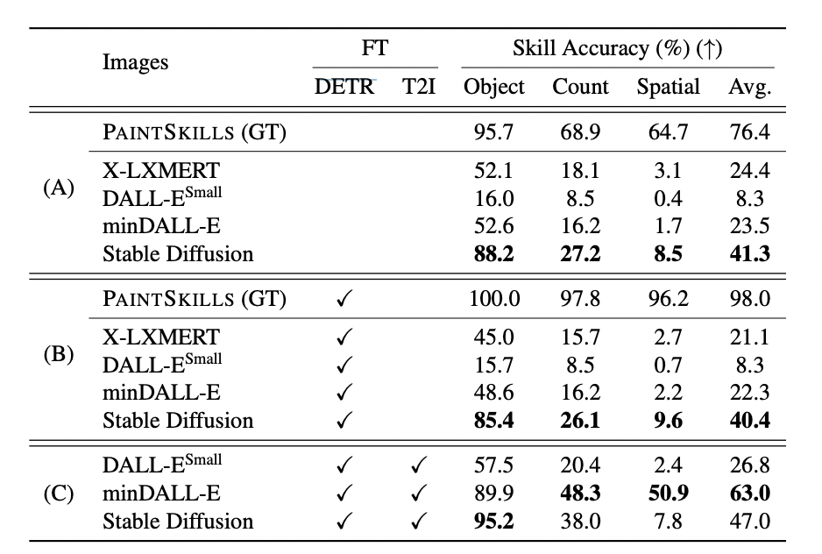
No Fine-tuning
No Model Fine-tuning
DETR Fine-tuned
Model Fine-tuned
DETR Fine-tuned

Slide 28
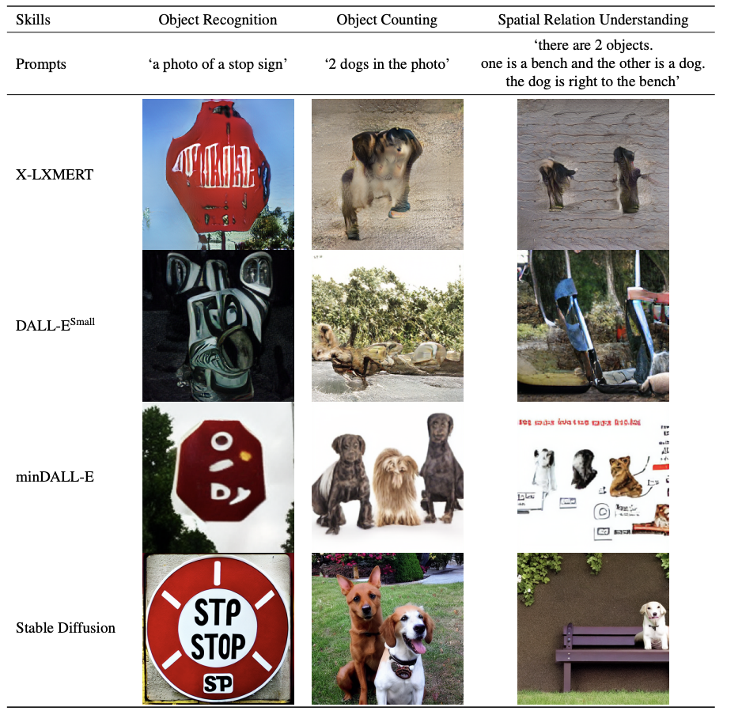
All models do not achieve high accuracy (< 50%),
Only exception is Stable Diffusion’s object skill
Zero-shot Results

Slide 29
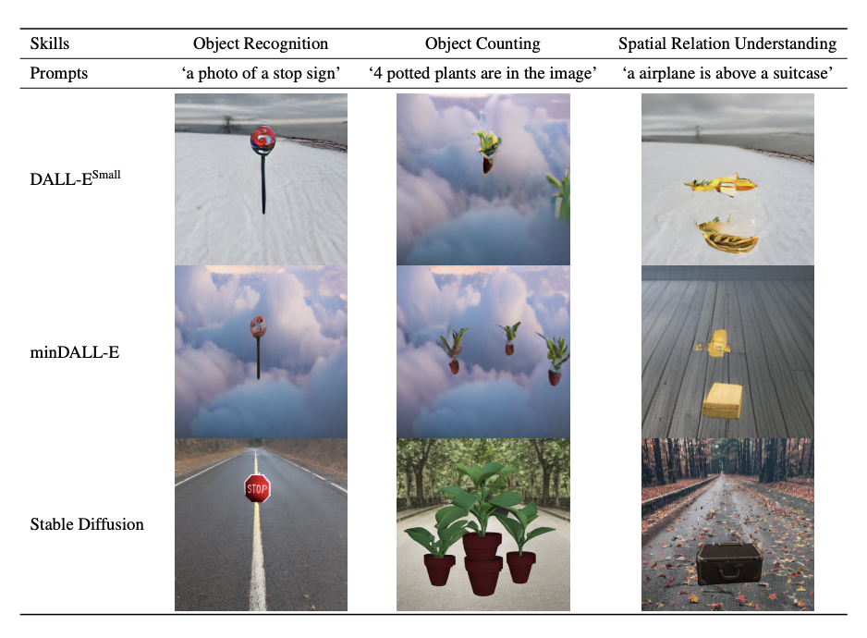
1. Finetuning improves the accuracy of all models on all three skills
2. minDALL-E significantly outperforms Stable Diffusion on spatial skill
This implies that simply scaling the data and the size of the model does not always provide better visual reasoning skills (?)
Results after Fine-tuning

Slide 30
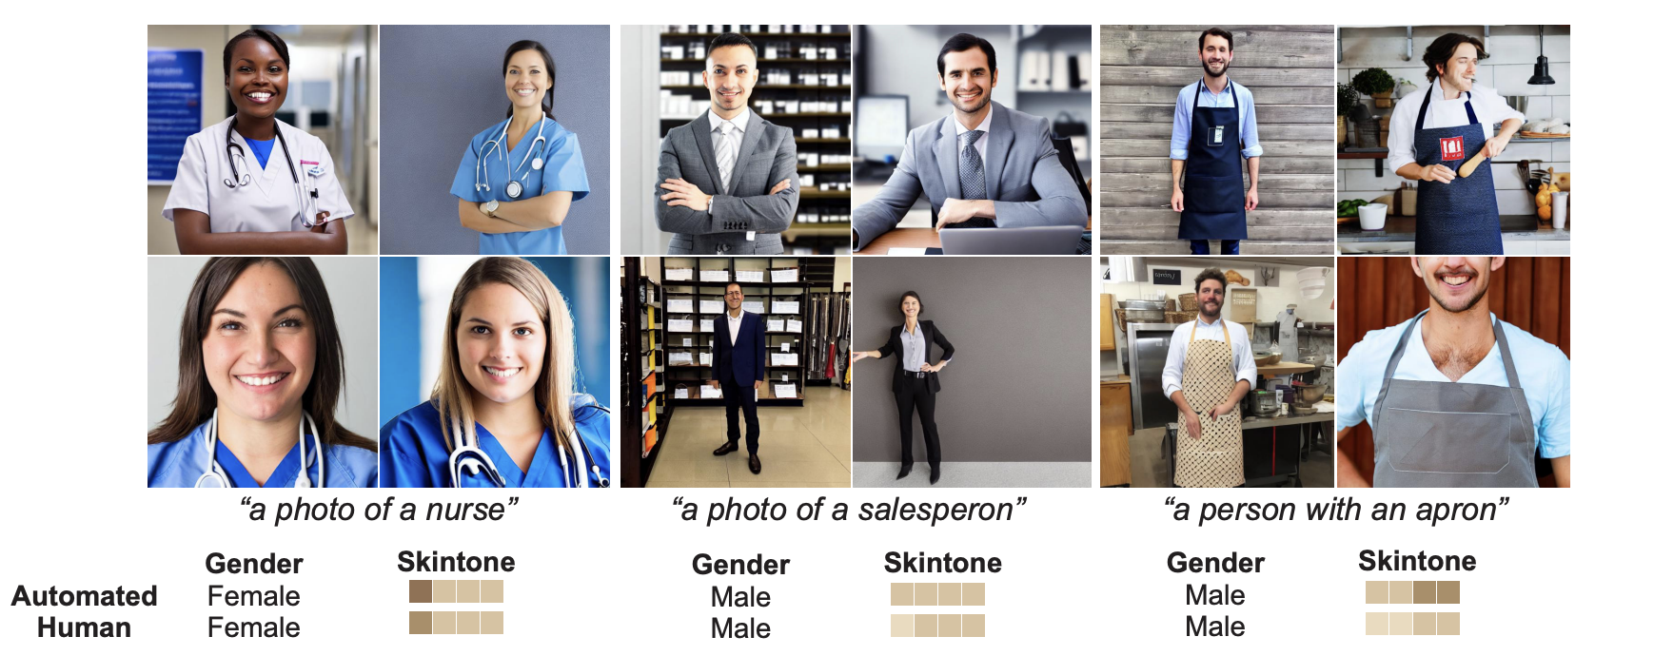
Social Bias Results

Slide 31
Stable Diffusion has a stronger tendency to generate images of a specific gender or skin tone from neutral prompts than minDALL-E
Social Bias Results

Slide 32
Pretrained models for evaluations: do not guarantee robust evaluation of text-to-image generation models trained on unseen data
More biases could be explored other than gender and skin tone
More complex reasoning skills (3D spatial relations)
focuses on English heavy datasets, more work can be done on other languages
Limitations

Slide 33
Authors propose two new evaluation aspects of text-to-image generation: visual reasoning skills and social biases
Introduce PAINTSKILLS: a dataset and evaluation toolkit designed
to measure three skills: object recognition, object counting,
and spatial relation understanding
Recent text-to-image models perform better in recognizing objects than object counting and understanding spatial relations, and there is a wide gap between performance and accuracy upperbound for the latter tasks
Models also learn specific gender/skin tone biases from web image-text pairs
Conclusions

Slide 34
Is focusing on procedurally generated data (like PaintSkills) the right path for evaluating text-to-image generative models?
How do you make sure your classifiers aren’t biased to begin with?
Evaluation of biases is dependent on unbiasedness of evaluators
How might we go about evaluating social biases beyond sex and skin tone?
Do you believe that PaintSkills can accurately assess the visual reasoning capabilities of generative models?
Discussion Questions

