Slide 1
“Why Should I Trust You?”
Explaining the Predictions of Any Classifier
Ribeiro, Singh, Guestrin (2016)
Presented by Robin Na, Paul Liu, Zelin (James) Li

Slide 2
Define Trust
Trusting a prediction: whether a user trusts sufficiently to take some action based on it
Trusting a model: whether a user trusts a model to behave in reasonable ways if deployed.

Slide 3
Define Explanation for a Prediction
Textual or visual artifacts to provide qualitative understanding of the relationship between instance’s components and the model’s prediction.
Notes:
Example gave in the text was that patient ID found to be heavily correlated with target class. (hard to identify through just predictions and raw data, but can be found using interpretation)

Slide 4
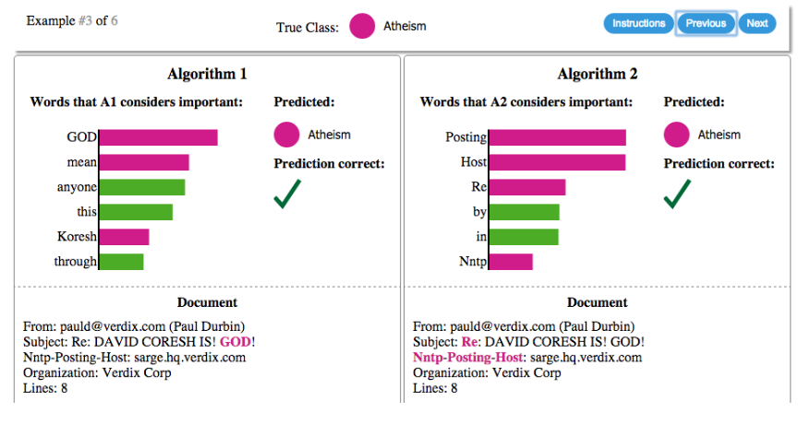
Explanations as a Means to Select Model

Slide 5
Why Do We Need Trust and Interpretability?
Sometimes models can go wrong (in a way that’s obvious to humans)!
Data leakage: patient ID being correlated with the target class
Dataset shift: training data is different than the test data
Exploiting features: users may favor recommender systems that don’t exploit on “clickbaits”

Slide 6
Desired Characteristics for Explainers
LIME as Interpretable Framework
Interpretable
Local fidelity: at least locally faithful
Model-agnostic: the ability to explain any model
Global perspective: ability to explain the model not just single prediction
Local Interpretable Model-agnostic Explanation

Slide 7
LIME as Interpretable Framework
Step 1: Define LIME Framework (Ensure both local fidelity and interpretability)
measure of unfaithfulness
interpretable model
complexity measure
an instance
model to be explained
proximity measure
to define locality
Notes:
L: locality awareness loss

Slide 8
LIME as Interpretable Framework
Step 2: Interpretable Data Representation
Text: binary vector indicating the presence or absence of a word
Image: binary vector indicating the presence or absence of a contiguous patch of similar pixels
Original Representation
Interpretable Representation

Slide 9
LIME as Interpretable Framework
Step 3: Approximate Locality-Aware Loss
Perturbed Sample (z’) Sampling Procedure:
Sample around x’ by drawing nonzero elements of x’ uniformly at random
The number of draws is also uniformly sampled
z’ basically has a faction of nonzero elements of x’
Samples are weighted by π_{x}
interpretable
representation
sampling local area
inverse
(interpretable
representation)
obtain label
Notes:
L: locality awareness loss
Obtain label for explainable model

Slide 10
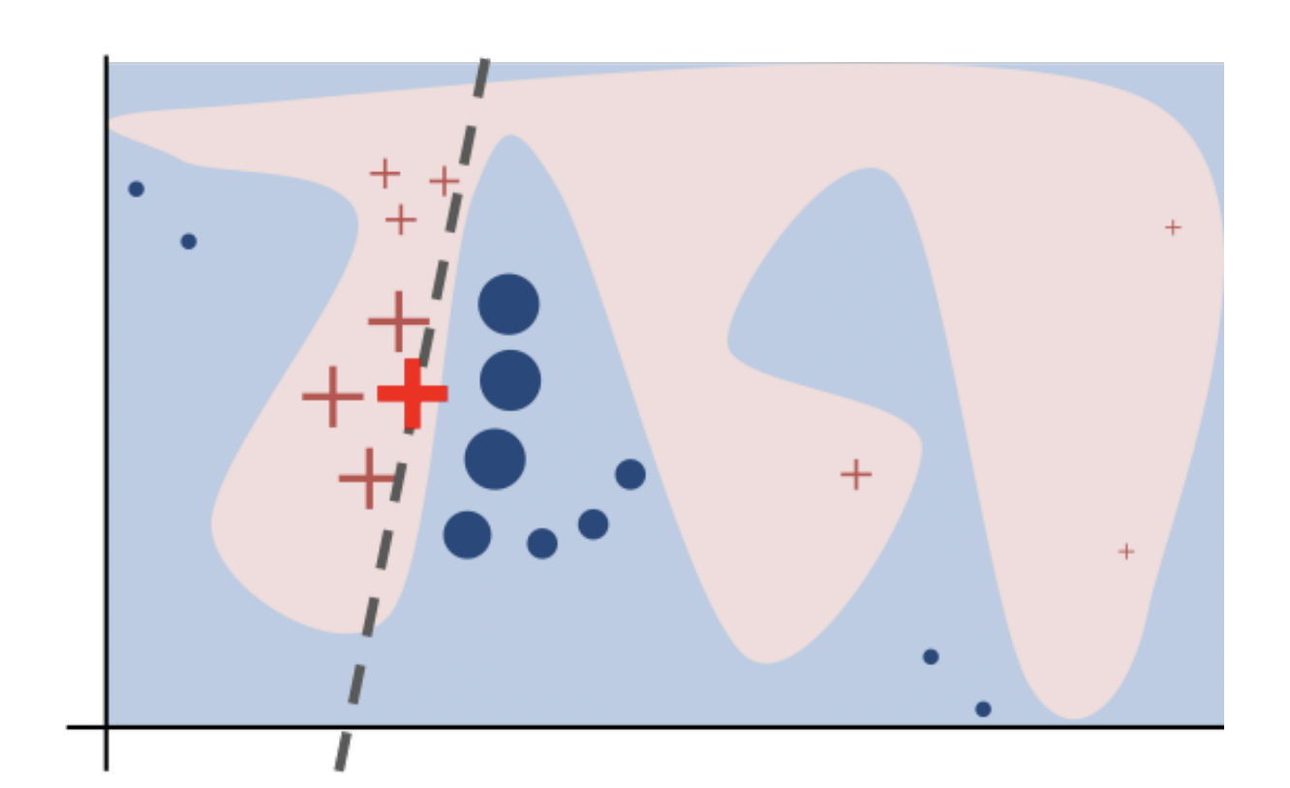
Sampling Procedure Intuition
Notes:
Toy example to present intuition for LIME. The black-box model’s complex decision function f (unknown to LIME) is represented by the blue/pink background, which cannot be approximated well by a linear model. The bold red cross is the instance being explained. LIME samples instances, gets predictions using f, and weighs them by the proximity to the instance being explained (represented here by size). The dashed line is the learned explanation that is locally (but not globally) faithful.
Locally linear assumes interpretation

Slide 11
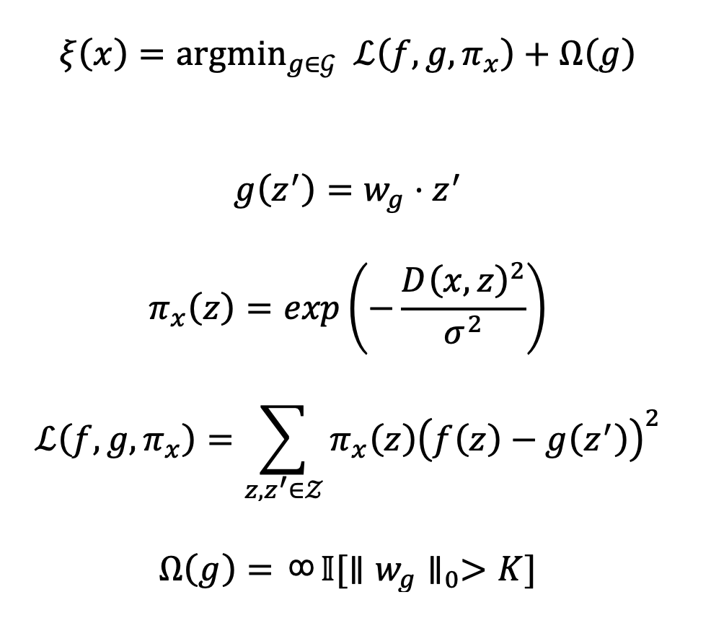
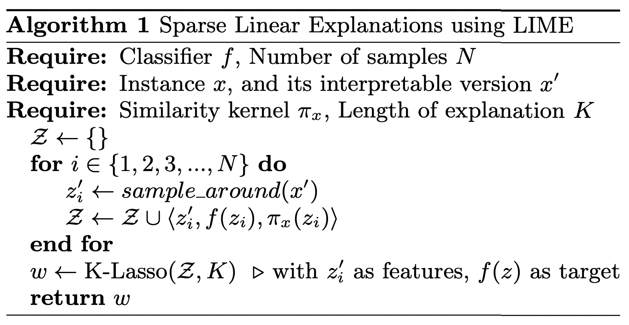
Example: Sparse Linear Explanation
Notes:
Pi is a exponential kernel function, D is a distance function (cosine for text , L2 for image)
K, in the context of text, set a limit on the number of words
K-lasso basically use Lasso to first select K features and then learn feature weight

Slide 12
Some Results
Notes:
Shows clear issue with dataset (predictions with SVM with RBF kernel)
Tradeoff between high accuracy and predictions
“Posting” appears in 22% of examples in training set and 99% of them in the class Atheism
Image is from Google’s pre-trained Inception, with K = 10

Slide 13
Gain Global Understanding of the Model
Proposal: Explain a set of individual instances
The number of instances should be small (denoted by budget B)
The pick step should account for the explanations that accompany each prediction
Should pick a diverse, representative set

Slide 14
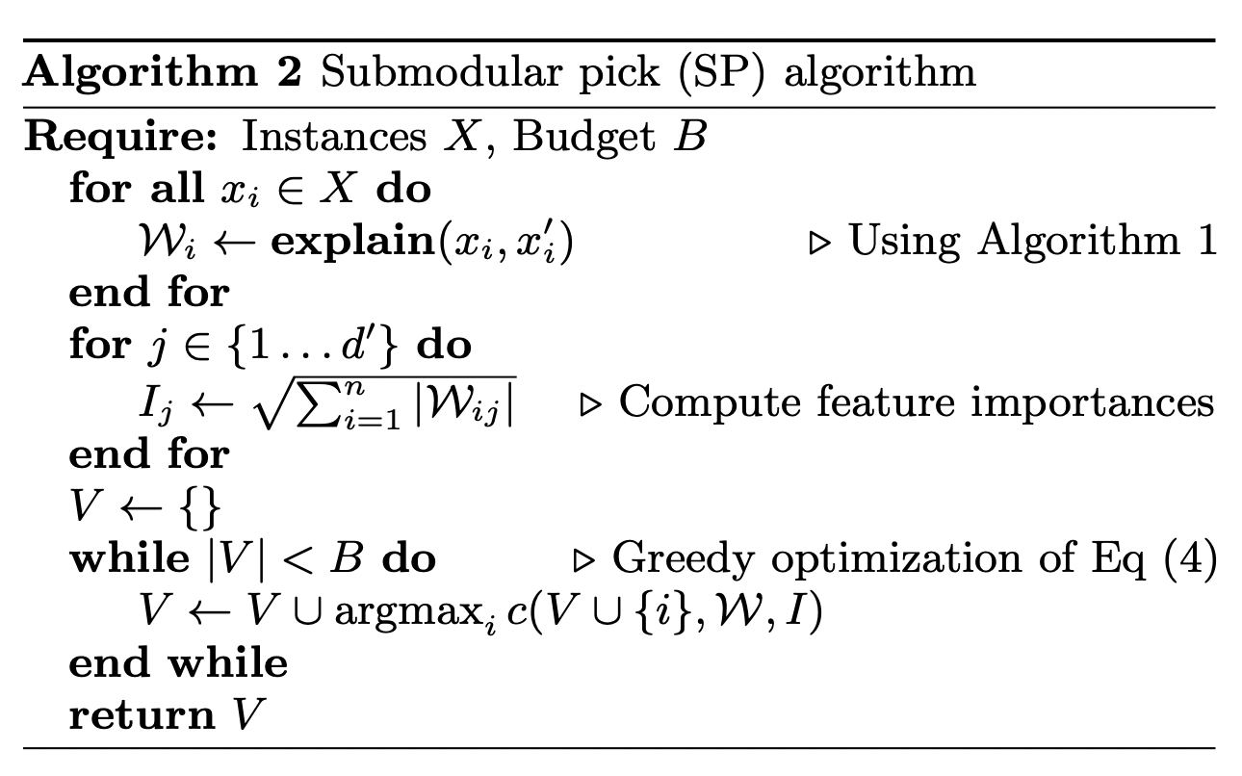
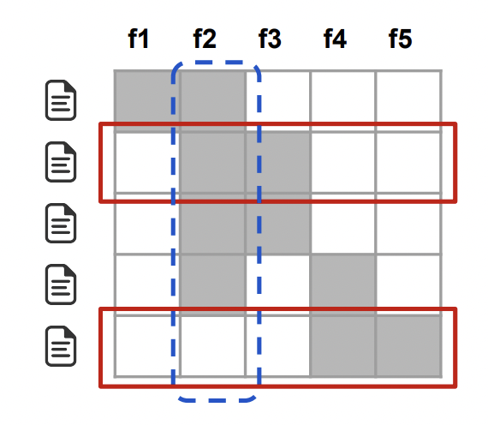
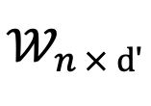
explanation matrix
a submodular problem: recall submodularity has the property of diminishing return
Notes:
Toy example W.
Rows represent instances (documents) and columns represent features (words).
Feature f2 (dotted blue) has the highest importance.
Rows 2 and 5 (in red) would be selected by the pick procedure, covering all but feature f1.

Slide 15
explanation matrix
(a submodular problem)
recall submodularity has the property of diminishing return
Notes:
Toy example W.
Rows represent instances (documents) and columns represent features (words).
Feature f2 (dotted blue) has the highest importance.
Rows 2 and 5 (in red) would be selected by the pick procedure, covering all but feature f1.

Slide 16
Simulated User Experiment
Experimental Setup
Decision Tree, Logistic Regression, Nearest Neighbors, SVM, RandomForest
Compare with parzen, greedy procedure, random procedure
Greedy Procedure: greedily remove features that contribute the most until prediction changes
Random Procedure: randomly select K features
If involve pick procedure
Submodular Pick (SP)
Random Pick (RP)

Slide 17
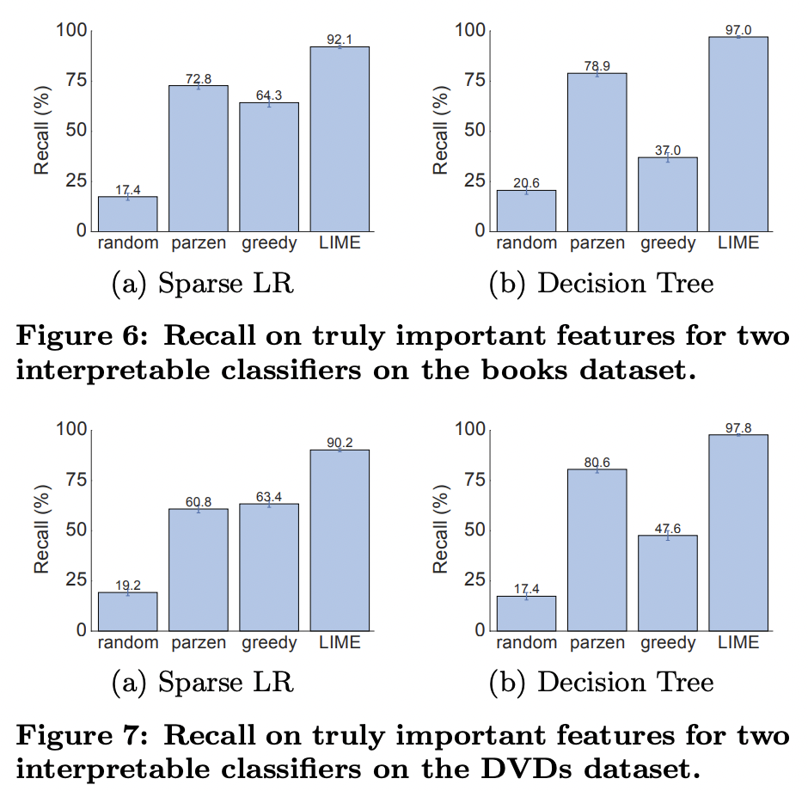
Simulated User Experiment
Are explanations faithful to the method?
Train sparse logistic regression and decision trees
Interpretable -> know gold set features
Compute average fractions of gold features covered by the explanations (over all instance)
Notes:
the gold set of features that the are considered important by these models.
For each prediction on the test set, we generate explanations and compute the fraction of these gold features that are recovered by the explanations
recall averaged over all the test instances
LIME consistently provides > 90% recall for both classifiers on both datasets, demonstrating that LIME explanations are faithful to the models.

Slide 18
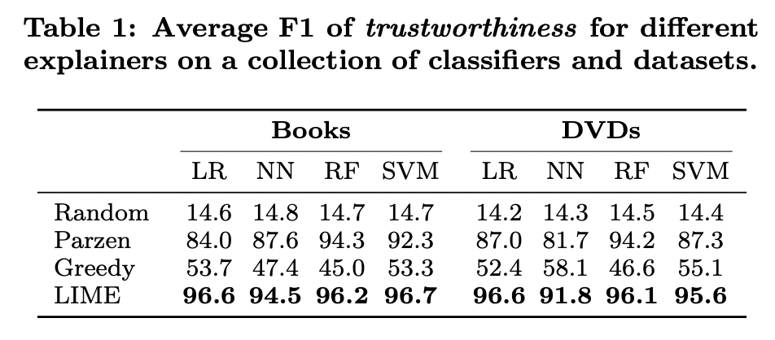
Simulated User Experiment
Should I trust this prediction?
Randomly select 25% of features to be untrustworthy
Label predictions as untrustworthy if prediction changes when all untrustworthy features are removed from the instance
For greedy and random, untrustworthy if untrustworthy features present
Notes:
Thus for each test set prediction,
we can evaluate whether the simulated user trusts it using each explanation method, and compare it to the trustworthiness labels
LIME is helpful in assessing trust in individual predictions.

Slide 19
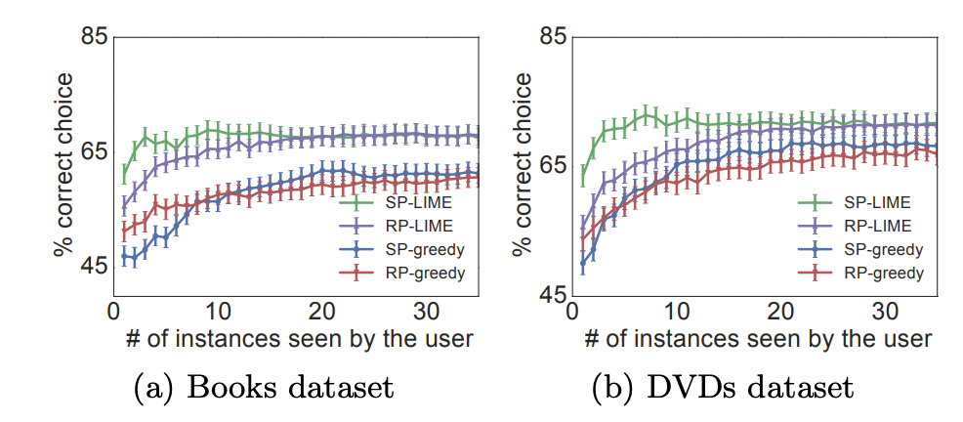
Simulated User Experiment
Can I trust this model?
Add noisy features to data to create spurious correlations within dataset
Train two random forests
Validation accuracy within 0.1% of each other
Test accuracy differs by at least 5%
Marks the noisy features as untrustworthy and follow a similar procedure as before
Notes:
simulating the case where a human has to decide between two competing models with similar accuracy on validation data
The goal of this experiment is to evaluate whether a user can identify the better classifier based on the explanations of some instances from the validation set
we select the classifier with fewer untrustworthy predictions, and compare this choice to the classifier with test accuracy

Slide 20
Evaluating with Human Subjects
Experimental Setup
Previous 20 newsgroups dataset (Problematic!)
Contain features that do not generalize
Create a new religion dataset
819 web pages in each of “Christianity” and “Atheism”
Use SVM with RBF Kernel with hyperparameters chosen by cross-validation
Notes:
three scenarios in machine learning that require trust and understanding of predictions and models
validation accuracy considerably overestimates real-world performance
In order to estimate the real world performance, we create a new religion dataset for evaluation

Slide 21
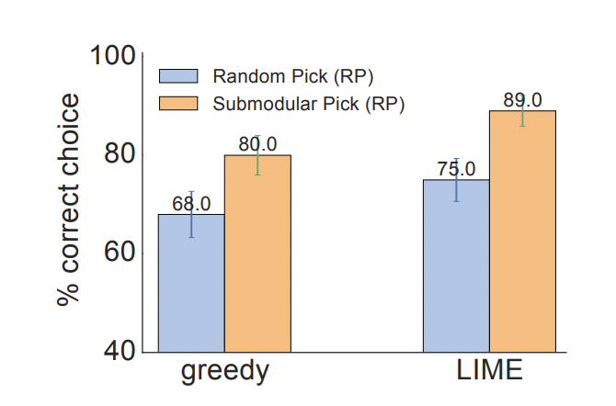
Evaluating with Human Subjects
Can users select the best classifier?
Train two SVM
one on problematic dataset, and the other on “cleaned” dataset
Recruit human to select which algorithm will perform best
Notes:
whether explanations can help users decide which classifier generalizes better
where many of the features that do not generalize have been manually removed
Original classifier scores 57.3% accuracy, “cleaned” achieves 69% on original dataset. Test accuracy is 94% and 88.6%, respectively
Greedy or LIME for explanations; SP or RP to select the 6 instances

Slide 22
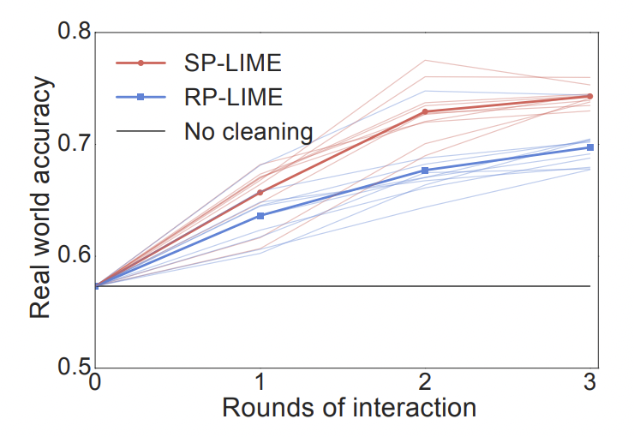
Evaluating with Human Subjects
Can non-experts improve a classifier?
Human marks which words should be removed after seeing B = 10 instances and K = 10 words in explanation.
10 subjects -> train 10 classifiers
5 more users
50 classifiers
5 more users
250 classifiers
Notes:
We start the experiment with 10 human subjects. After they mark words for deletion, we train 10 different classifiers, one for each subject (with the corresponding words removed).
Then, the explanations for each classifier are then presented to a set of 5 users in a new round of interaction, which results in 50 new classifiers.
We do a final round, after which we have 250 classifiers, each with a path of interaction tracing back to the first 10 subjects
Each shaded line represents the average accuracy of subjects in a path starting from one of the initial 10 subjects. Each solid line represents the average across all paths per round of interaction.
This evaluation is an example of how explanations make it easy to improve an untrustworthy classifier – in this case easy enough that machine learning knowledge is not required
Each subject took an average of 3.6 minutes per round of cleaning, resulting in just under 11 minutes to produce a classifier that generalizes much better to real world data. Each path had on average 200 words removed with SP, and 157 with RP, indicating that incorporating coverage of important features is useful for feature engineering. Further, out of an average of 200 words selected with SP, 174 were selected by at least half of the users, while 68 by all the users.

Slide 23
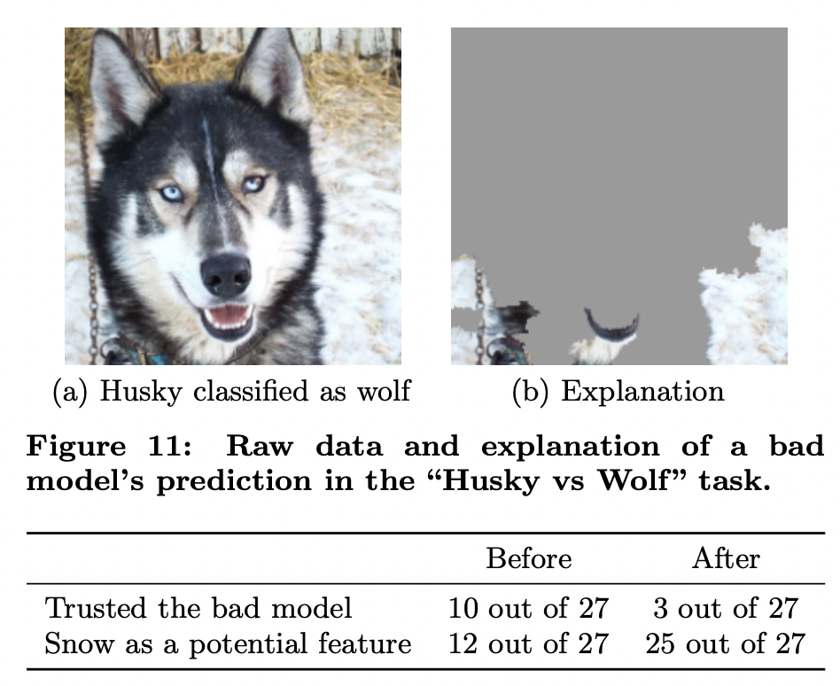
Evaluating with Human Subjects
Do explanations lead to insights?
Find pictures such that classifier predicts “wolf” if there is snow, and “husky” otherwise.
Ask subjects (grad students) questions
Do they trust model to work well in real world
Why?
How do they think the model distinguishes
Showed explanations and asked again
Notes:
Since this task requires some familiarity with the notion of spurious correlations and generalization, the set of subjects for this experiment were graduate students who have taken at least one graduate machine learning course
Before observing the explanations, more than a third trusted the classifier, and a little less than half mentioned the snow pattern as something the neural network was using – although all speculated on other patterns. After examining the explanations, however, almost all of the subjects identified the correct insight, with much more certainty that it was a determining factor

Slide 24
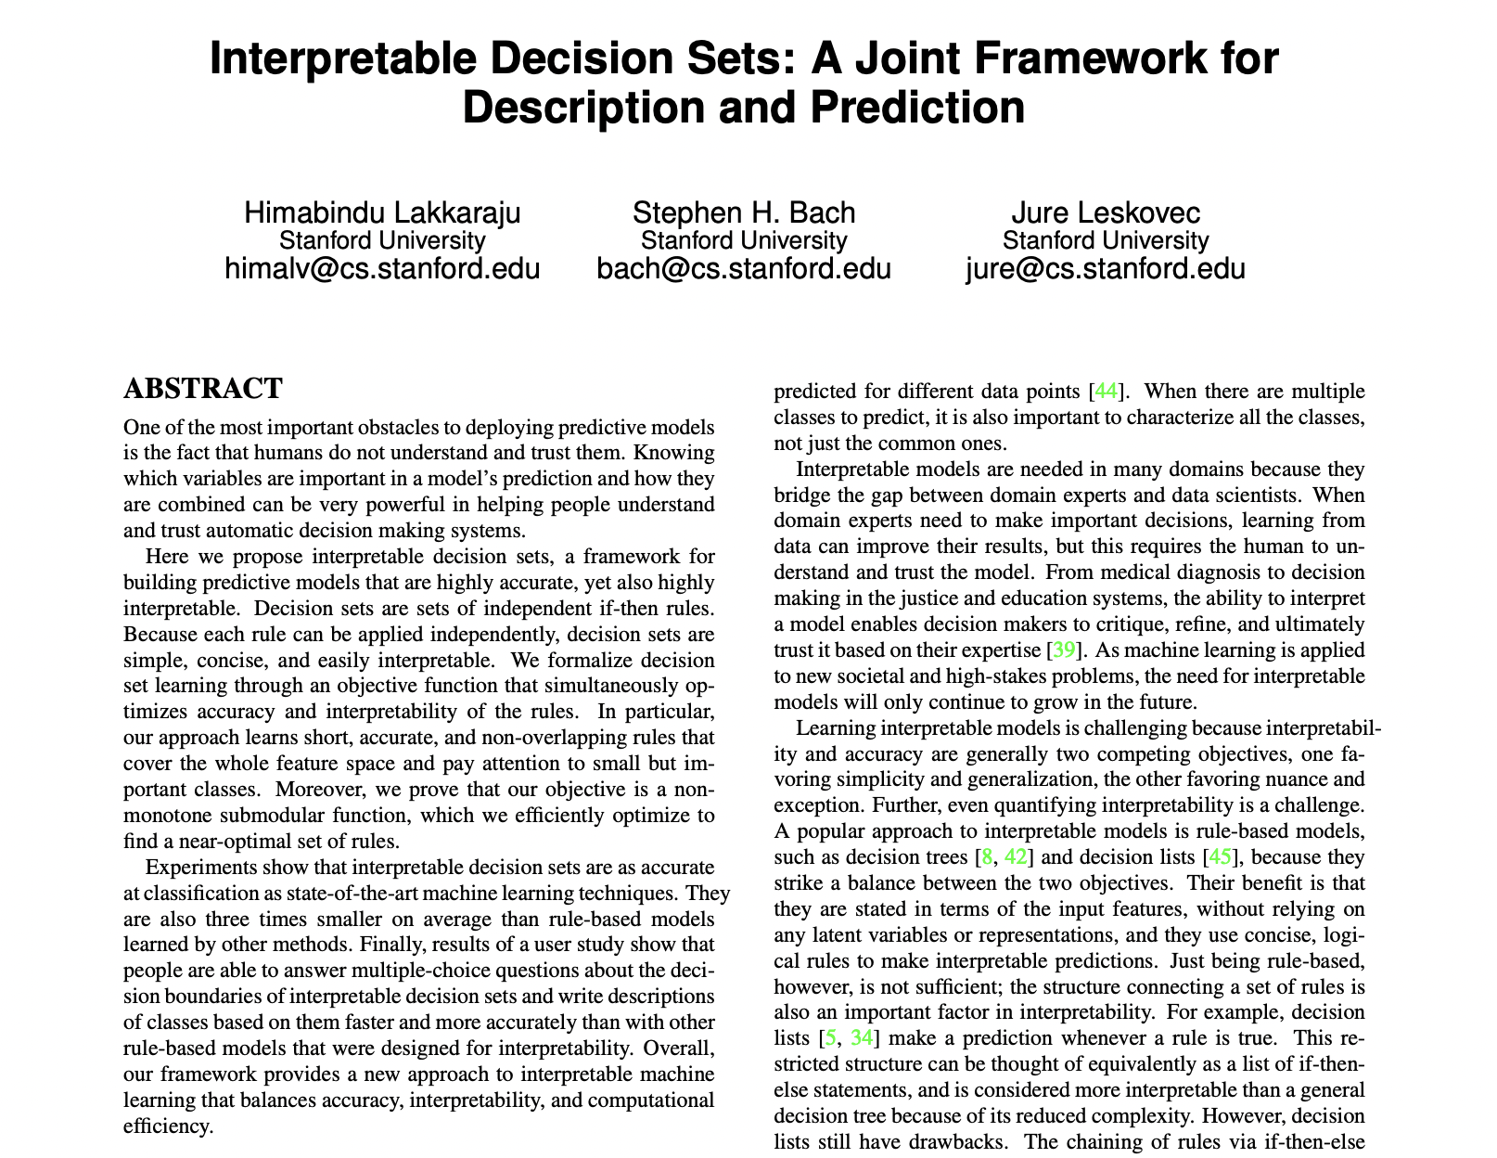
Related Work
Inherently interpretable models
Trees, lists, sets, (generalized) linear models and additive models
LIME: one of the first significant papers for post-hoc, model-agnostic analysis

Slide 25
Related Work
Extracting descriptive features
Approximating the model globally through gradient methods is a challenge → Local fidelity

Slide 26
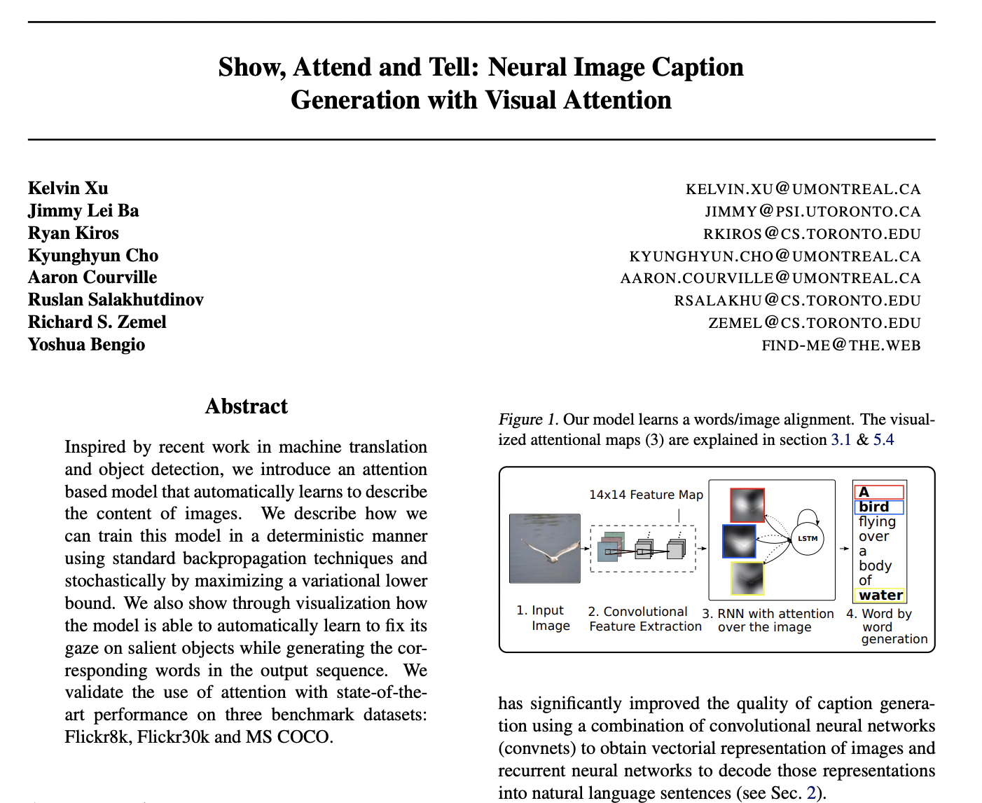
Related Work
Interpretable description of images
LIME aims for a more model-agnostic approach

Slide 27
Limitations and Future Work
Expected to work on feature spaces that are not too complex
Can similar ideas be applied to sequential decision making (e.g., RL)?
User experiment: results could depend on how the study notified the definition of “trustworthiness” to participants
A principled way for the algorithm to automatically improve based on its explanation (without humans having to modify the data or algorithm manually)

