Slide 1
SmoothGrad: removing noise
by adding noise
Authors: Daniel Smilkov, Nikhil Thorat, Been Kim,
Fernanda Viégas, Martin Wattenberg
Presented by: Vignav Ramesh, Zelin (James) Li, Paul Liu

Slide 2
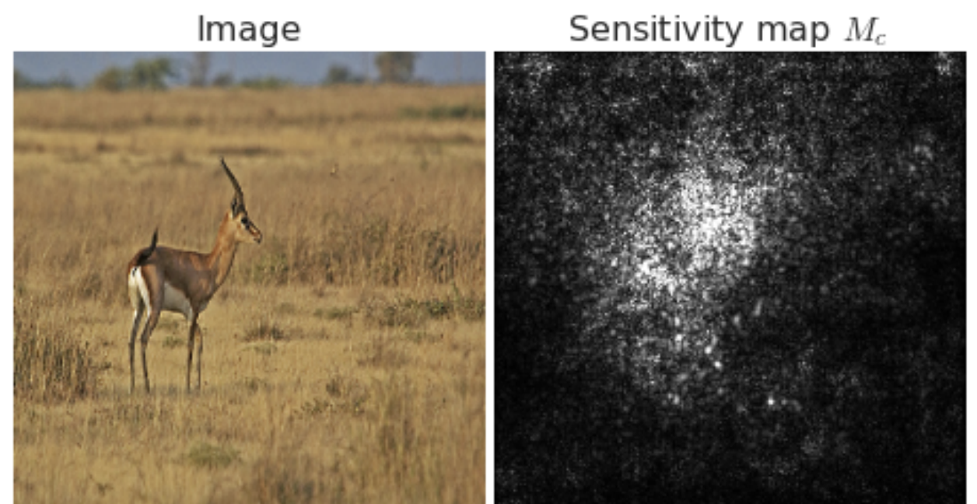
Motivation
We want post-hoc explanations of image classifiers
Solution: Sensitivity maps (a.k.a. saliency maps, pixel attribution maps)
Visual interpretation of gradient of class activation function w.r.t input image
Structured as grayscale image w/ dimension same as input image
Brightness of pixel ∝ importance to classification decision
Notes:
Explaining a classification decision can shed light on underlying system mechanisms, help debug/enhance them
And keep in mind that these gradients are usually calculated with respect to individual class labels, so we can generate a different sensitivity map for each possible label of the image.

Slide 3
Background: Gradients as Sensitivity Maps
N: network that classifies images into one class from set C
Given input image x, N typically computes class activation function S_{c} for each c ∈ C
Final classification is
Sensitivity map given by
Intuition: M_{c} represents how much difference a tiny change in each pixel of x would make to the classification score for class c

Slide 4
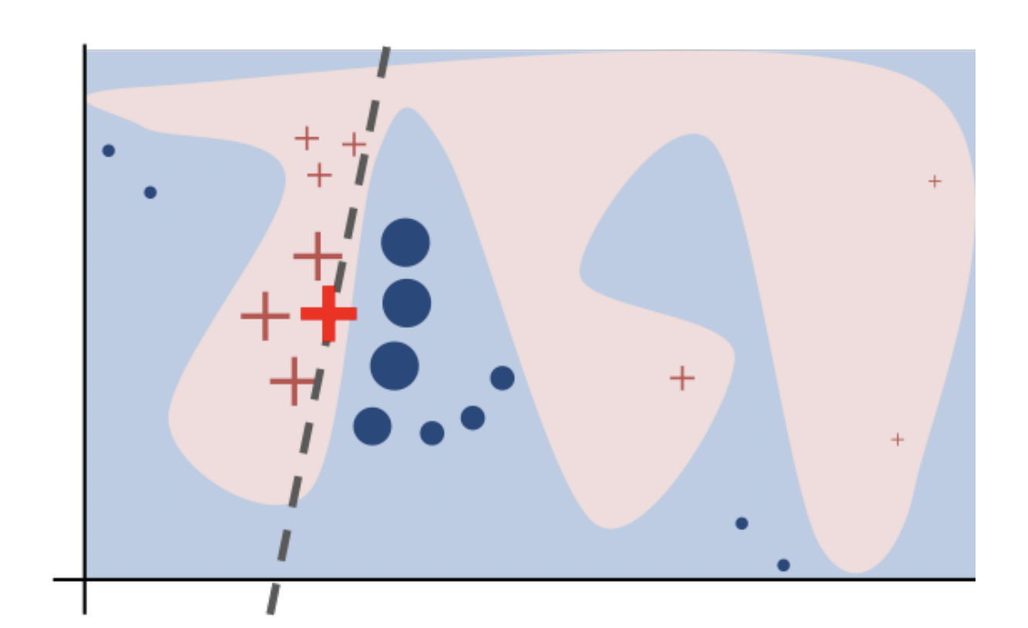
Related Work: Perturbation Methods
Key idea: generate a perturbed dataset to fit an explainable model
LIME
KernelSHAP

Slide 5
Related Work: Backpropagation
Output
Key idea: backpropagate importance through the network
Vanilla gradients
Layerwise relevance propagation (Bach et al.)
Integrated gradients (Sundararajan et al.)
DeepLIFT (Shrikumar et al.)
Deconvolution (Zeiler & Fergus, 2014)
Guided Backpropagation (Springenberg et al, 2014)
…
…
…
…
Yellow = inputs
Notes:
In these approaches, the idea is that, based on the relationship between the output and the neurons in the layer below, you assign contribution scores [ANIMATE] or importance scores to those neurons according to how much they affect the output. You then repeat this process, backing [ANIMATE] down through [ANIMATE] the layers [ANIMATE] until you reach the input. So in a single backward pass, you get importance scores for all parts of your input.
There are several approaches that fall into this category, and one is simply calculating the gradient of the class activation function with respect to the input, like we just talked about a few slides before. But a key limitation of calculating vanilla gradients boils down to the fact that gradients are inherently a local description of model behavior! [Saturation demo] So layerwise relevance propagation, integrated gradients, and deeplift were developed to address this issue, by modifying the gradient calculation process to estimate the global importance of each pixel, rather than local sensitivity.
Deconvolution and Guided Backpropagation techniques, which modify the gradients of ReLU functions by discarding negative values during the backpropagation calculation. The intention is to perform a type of “deconvolution” which will more clearly show features that triggered activations of high-level units.
_____
INTUITION: Idea: neurons act like detectors of particular image features • We are only interested in what image features the neuron detects, not in what kind of stuff it doesn’t detect • So when propagating the gradient, we set all the negative gradients to 0 • We don’t care if a pixel “suppresses” a neuron somewhere along the part to our neuron

Slide 6
Limitations of Sensitivity Maps
Visually noisy
Often highlight pixels that–to a human eye–seem randomly selected
a priori, we cannot know if this noise reflects an underlying truth about how networks perform classification, or is due to more superficial factors
The SmoothGrad paper answers this question - we’ll get to this soon!
Notes:
Note that all these methods - from vanilla gradients to DeepLift, still succumb to a key limitation: they produce visually noisy sensitivity maps.

Slide 7
Theory Behind SmoothGrad: Noisy Gradients
Key idea behind SmoothGrad: noisy maps are due to noisy gradients
Derivative of S_{c} may fluctuate sharply at small scales
Apparent noise one sees in a sensitivity map may be due to essentially meaningless local variations in partial derivatives
Notes:
This makes intuitive sense - typical networks use ReLU activations so the class activation map S sub c generally isn’t even continuously differentiable !

Slide 8
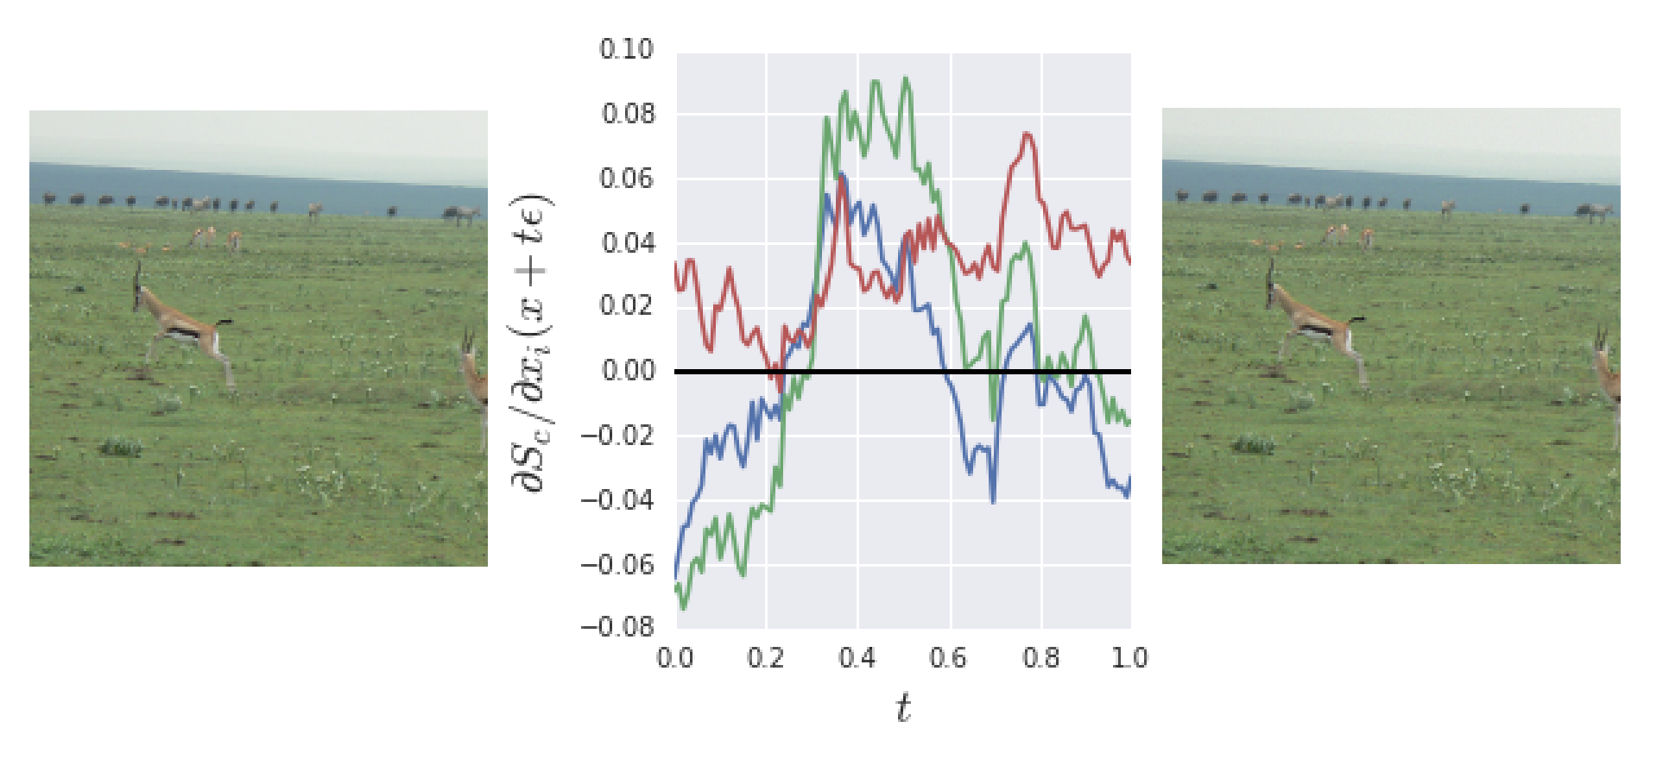
Noisy Gradients (cont’d)
Given these rapid fluctuations, gradient of S_{c} at any given point will be less meaningful than a local average of gradient values.
Notes:
Here, we see a plot showing essentially the partial derivative of S sub c with respect to the RGB values of a single pixel as one slowly moves away from a baseline image x (left plot) to a modified version of the image with Gaussian noise added. It’s easy to see that even though the final image is indistinguishable to a human from the origin image x, there are rapid fluctuations in the gradient of S sub c. Given these fluctuations, the gradient of S sub c at any given point will be less meaningful than a local average of gradient values
after bullet point, say: And THIS is the motivation behind the core idea of SmoothGrad.
``` as a fraction of the maximum entry in the gradient vector, maxi ∂Sc ∂xi (t), (middle plot)

Slide 9
SmoothGrad: Intuition
Recall that noisy maps are due to noisy gradients
Simple solution:
take an image of interest
sample similar images by adding Gaussian noise to the image
take the average of the resulting sensitivity maps for each sampled image
This smoothes the gradient
Notes:
Specifically, we base visualizations not directly on the gradient of the class activation map w.r.t. input image, but on a local average of the gradient for images with added Gaussian noise
emoving noise in gradients
visualizations not directly on the gradient
but on a local average of the gradient for images with Gaussian noise
Equivalent to a smoothing of the gradient with a Gaussian kernel

Slide 10
SmoothGrad: Algorithm
Take random samples in a neighborhood of an input x with added noise
Average the resulting sensitivity maps.
n is the number of samples, and Ɲ(0, σ²) represents Gaussian noise with standard deviation σ.
Notes:
Directly computing such a local average in a high-dimensional input space is intractable, but we can compute a simple stochastic approximation. In particular, we can

Slide 11
Experimental Setup
Performed SmoothGrad on visualizations of two neural networks:
Inception v3 model by Google that was trained on the ILSVRC-2013 dataset
Convolutional MNIST model based on the TensorFlow tutorial

Slide 12
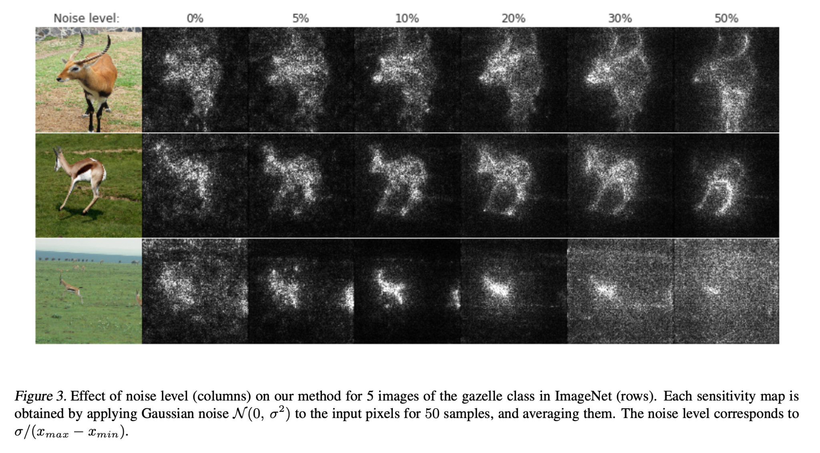
Choosing Hyperparameters (𝜎: std. dev.)
𝜎 : the standard deviation of the Gaussian noise
Notes:
10%-20% noise seems to balance the sharpness of the sensitivity map and maintain the structure of the original image
this range of noise gives generally good results
ideal noise level depends on the input

Slide 13
Choosing Hyperparameters (n: sample size)
Notes:
the larger the n is, the better the results are
little change for n > 50, i.e. diminishing return

Slide 14
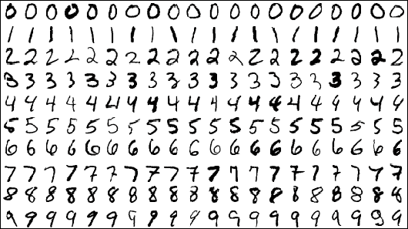
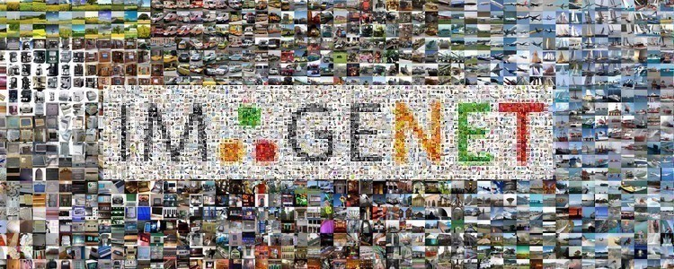
Qualitative Results: Visualization Techniques
Absolute Value of Gradients
depends on the characteristics of dataset
Notes:
Absolute Value: The utility of taking the absolute values or not depends on the characteristics of the dataset of interest.
For example, when the object of interest has the same color across the classes (MNIST digits), the positive gradients indicate positive signal to the class.
On the other hand, for ImageNet dataset, we have found that taking the absolute value of the gradient produced clearer pictures. possible explanation: context dependent: many image recognition tasks are invariant under color and illumination changes.
Capping: capping or else whole image is black
These outlying values have the potential to throw off color scales completely.

Slide 15
Qualitative Results: Visualization Techniques
Absolute Value of Gradients
depends on the characteristics of dataset
Capping outlying values
presence of few pixels that have much higher gradients than the average
capping to 99 percentile
Multiplying maps with images
produce simpler & sharper images (Shrikumar et al., 2017; Sundararajan et al., 2017)
Downside: Pixels with values of 0 will never show up on the sensitivity map.
Upside: when viewing the importance of the feature as contribution to the image
Notes:
Absolute Value: The utility of taking the absolute values of gradients or not depends on the characteristics of the dataset of interest.
For example, when the object of interest has the same color across the classes (e.g., digits are always white in MNIST digits (LeCun et al., 2010)), the positive gradients indicate positive signal to the class. On the other hand, for ImageNet dataset (Russakovsky et al., 2015), we have found that taking the absolute value of the gradient produced clearer pictures. possible explanation: context dependent: many image recognition tasks are invariant under color and illumination changes.
Capping: capping or else whole image is black
These outlying values have the potential to throw off color scales completely.

Slide 16
Qualitative Results: Visual Coherence
Definition (Visual Coherence): Highlights are only on the object of interest, not the background
Comparison with three gradient-based methods
Vanilla gradient
Integrated Gradients
Guided BackProp

Slide 17
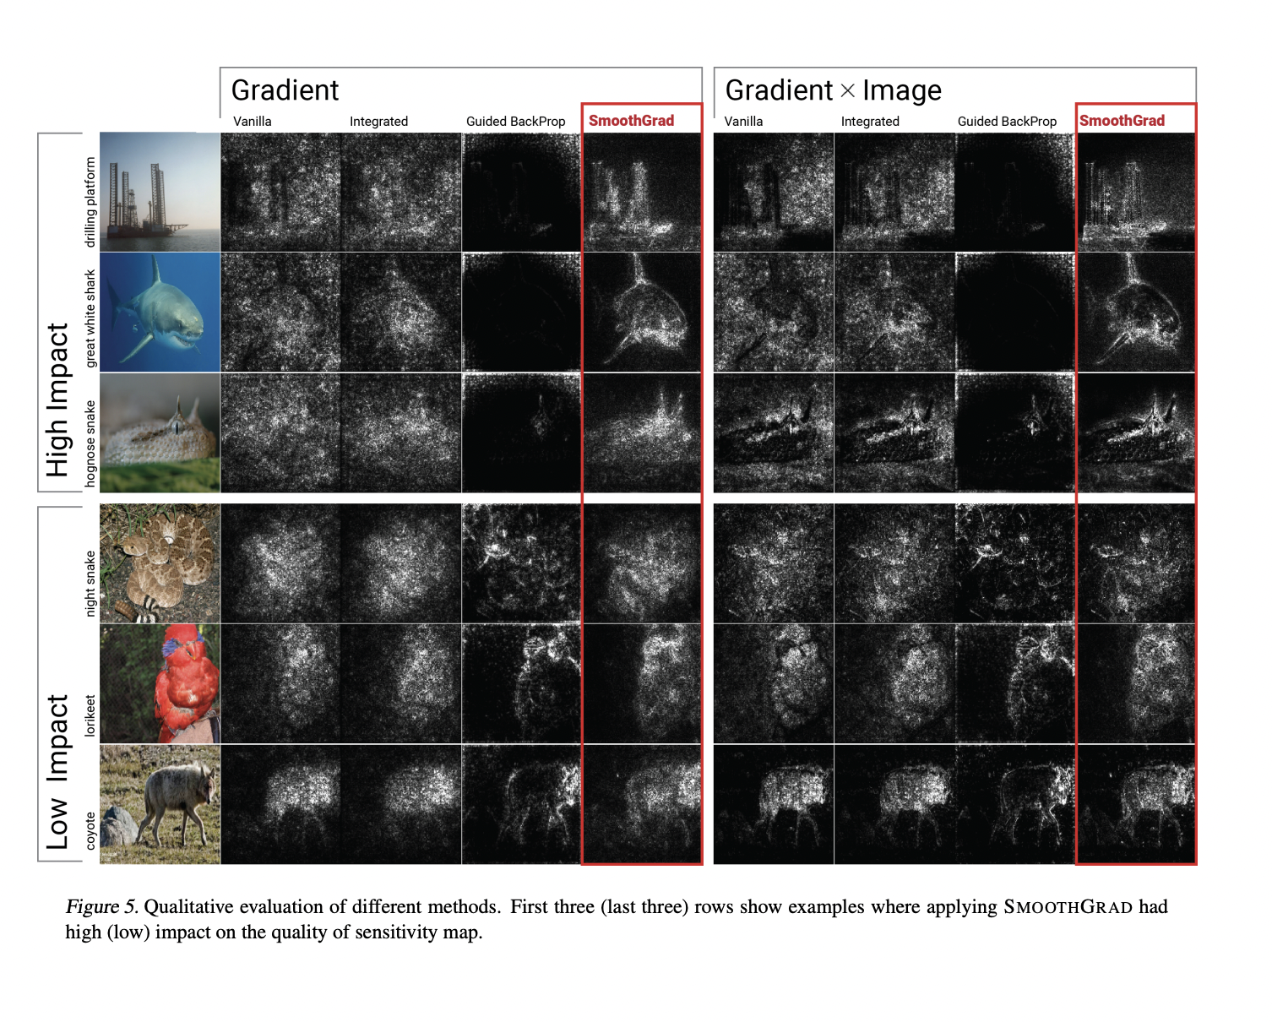
Notes:
Results:
More visually coherent maps than IG and VG
GBP has the most sharp images for last three rows
SmoothGrad outperforms GBP for images with uniform background

Slide 18
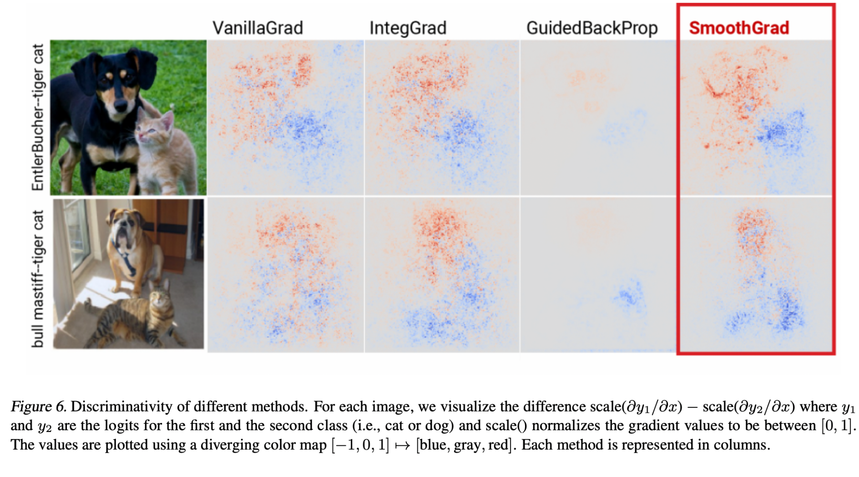
Qualitative Results: Discriminativity
Definition (Discriminativity):
the ability to explain / distinguish separate objects without confusion
Notes:
an image with both a monkey and a spoon, one would expect an explanation for a monkey classification to be concentrated on the monkey rather than the spoon, and vice versa
To visually show discriminativity, we compute the sensitivity maps M1(x) and M2(x) for both classes, scale both to [0, 1], and calculate the difference M1(x) − M2(x). We then plot the values on a diverging color map [−1, 0, 1] → [blue, gray, red]
SmoothGrad shows better discriminativity over the three methods
Open problem:
Which properties affect the discriminativity of a given methods
e.g. Why GBP shoe the worst discriminativity

Slide 19
Qualitative Results: Discriminativity
Open Problem
Which properties affect the discriminativity of a given methods?
Why did GBP show the worst performance?
Notes:
an image with both a monkey and a spoon, one would expect an explanation for a monkey classification to be concentrated on the monkey rather than the spoon, and vice versa
SmoothGrad shows better discriminativity over the three methods
Open problem:
Which properties affect the discriminativity of a given methods
e.g. Why GBP shoe the worst discriminativity

Slide 20
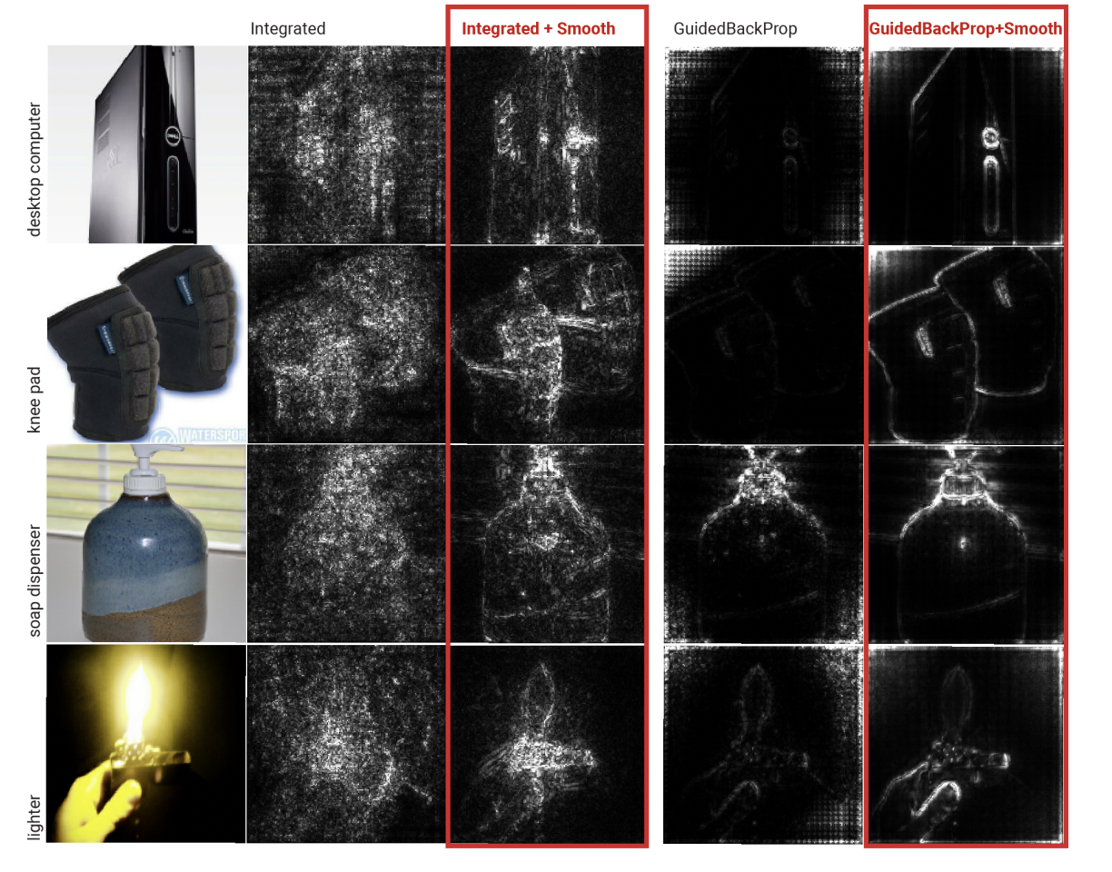
Combining with Other Methods
The same smoothing procedure can be used to augment any gradient-based method.
Notes:
SmoothGrad : smoothing the vanilla gradient method using a simple procedure: averaging the vanilla sensitivity maps of n noisy images.
Example: apply SmoothGrad in combination with IG and GBP
improves the visual coherence of sensitivity maps for both methods.

Slide 21
Limitations / Discussion
Completely qualitative results, can we get quantitative metrics?
Noisy sensitivity maps are due to noisy gradients
Is this true?
Future work: look for further evidence and theoretical arguments
Does SmoothGrad generalize to other networks & tasks?
How do we tradeoff between making picture pretty and being faithful to the model? Do you think SmoothGrad handled this tradeoff well?
Notes:
discuss those here + ask audience what their thoughts are
give our proposed solutions?
To measure spatial coherence of sensitivity maps, one might use existing databases of image segmentations. Systematic measurements of discriminativity could also be valuable
Also recall the discriminativity open problem: what properties affect the discriminativity of a given method

Slide 22
Thank you!
Questions?

