Slide 1
Explanations can be manipulated and geometry is to blame
Authors: Ann-Kathrin Dombrowski, Maximilian Alber, Christopher J. Anders, Marcel Ackermann, Klaus-Robert Müller, Pan Kessel
Presented by: Chelsea (Zixi) Chen, Tessa Han, Vignav Ramesh
Notes:
https://arxiv.org/pdf/1906.07983.pdf

Slide 2
Introduction

Slide 3
Motivation
Understand and verify aspects of ML models
Aid decision making in high-stakes scenarios
Reliable explanations of models!
Can we always trust model explanations?
Notes:
Chelsea: Human users need to understand the true model behavior to, for instance, just for understanding to build trust between human and models, or justify the decisions, or diagnose errors and debug, or detect fairness issues, or even get an idea of what to change in order to flip model decisions.

Slide 4
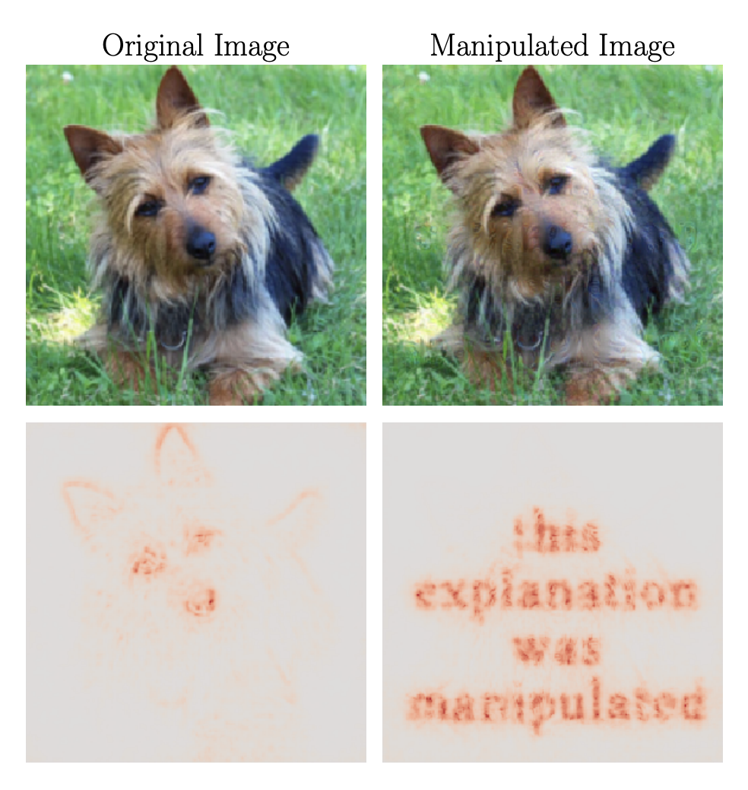
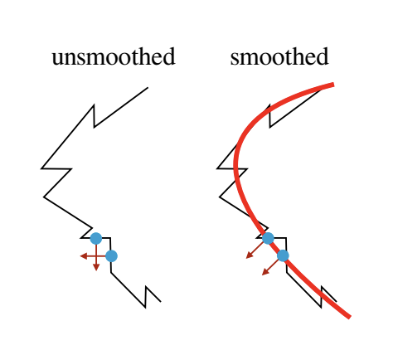
Summary / Contribution
😈
Manipulate explanations! 😈
Provide a theoretical understanding of such nonrobustness and derive a bound 🤔
Introduce smoothing to increase explanation robustness! 😎
🤔
😎
Notes:
Chelsea:

Slide 5
Background + Related Work
Interpretation of Neural Networks is Fragile [Ghorbani et al. ]
Complex decision boundary
The (un)reliability of saliency methods [Kindermans et al.]
Input invariance
Sanity checks for saliency maps [Adebayo et al.]
Randomization test (Wednesday)
Fairwashing Explanations with Off-Manifold Detergent [Anders et al.]
Low-dimensional data manifold v.s. High-dimensional embedding space
Notes:
Chelsea: These are all interesting papers, shows the lack of robustness -> Interpretation of neural networks is fragile: geometry point of view, in short it shows that When the decision boundary in the input feature space is complex, a small perturbation in the input can push the example into a region with very different loss contours. Many explanations are related to gradients, which are perpendicular to the loss contours, so the explanations can be dramatically different after perturbation.
The unreliability of saliency methods : Saliency methods should mirror the sensitivity of the model with respect to transformations of the input, they design constant shift to the input data but tweak the model structure using a bias term so that the model does not change predictions but the explanation attributions changes
Sanity checks for saliency maps -> leave to wednesday
Fairwashing: one can always construct another classifier g˜ which has the same behavior on the data (same train, validation, and test error) but has arbitrarily manipulated explanation maps. data manifold is typically low-dimensional
compared to its high-dimensional embedding space. The
training process only determines the classifier in directions
along the manifold. However, many explanation methods
are mainly sensitive to directions orthogonal to the data manifold. Since these directions are undetermined by training,
they can be changed at will.

Slide 6
Methodology

Slide 7
Notation
Neural network with relu non-linearities
Classifies input image x into K categories, predicted class
Explanation map:
Target map:
Manipulated image:

Slide 8
Properties of Manipulated Image

Slide 9
Explanation Methods
Vanilla gradients:
Quantifies how infinitesimal perturbations in each pixel change the prediction
Gradient ⨉ Input:
For linear models, this measure gives the exact contribution of each pixel to the prediction
Integrated Gradients:
Guided Backpropagation
Layer-wise Relevance Propagation
Pattern Attribution
Standard backpropagation upon element-wise multiplication of the weights with learned patterns
Gradient-based
Propagation-based

Slide 10
Manipulation Method
Obtain manipulated images by optimizing the loss function
with respect to x_{adv} using gradient descent
manipulated
explanation map
target
map
weighting hyperparameter
network output (manipulated input)
network output (original input)

Slide 11
Manipulation Method
The gradient with respect to the input ∇ h(x) of the explanation often depends on the vanishing second derivative of the relu non-linearities. This causes problems during optimization of the loss function:
Solution: replace relu with softplus
Notes:
For large β values, the softplus approximates the relu closely but has a well-defined second derivative. After optimization is complete, we test the manipulated image with the original relu network.

Slide 12
Experiments

Slide 13
Experimental Setup
Apply algorithm to 100 randomly selected images for each explanation method
Use VGG-16 network pre-trained on ImageNet
For each run, we randomly select two images from the test set.
One of the two images is used to generate a target explanation map
The other image is perturbed by our algorithm with the goal of replicating the target using a few thousand iterations of gradient descent
Comparable results obtained for ResNet-18, AlexNet, and Densenet-121 + CIFAR-10 dataset

Slide 14
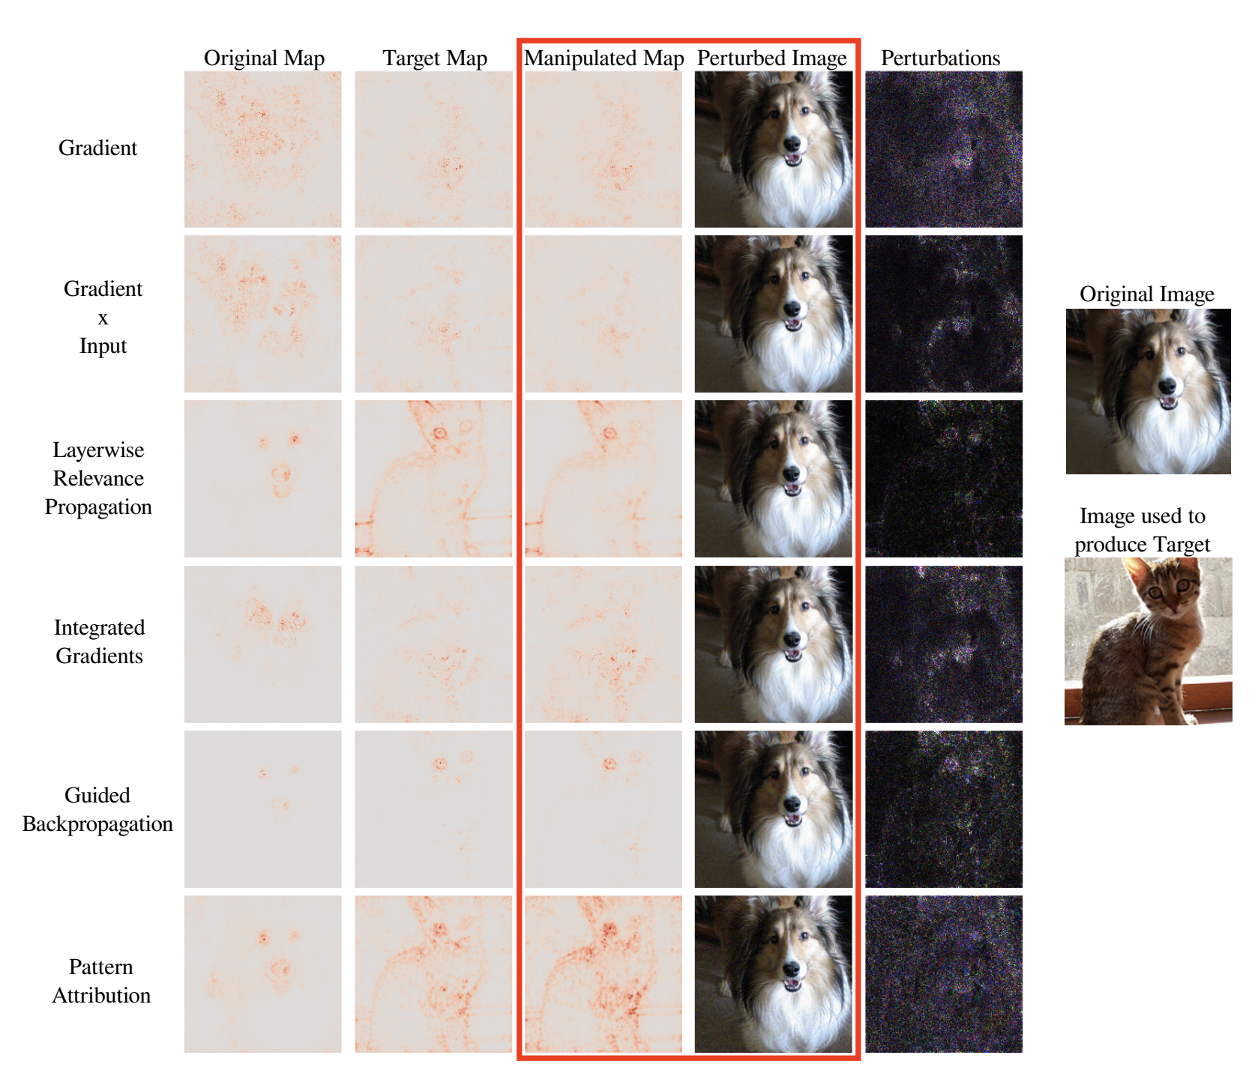
Notes:
Qualitative results
The explanation map of the cat is used as the target and the image of the dog is perturbed. The red box contains the manipulated images and the corresponding explanations. The first column corresponds to the original explanations of the unperturbed dog image. The target map, shown in the second column, is generated with the cat image. The last column visualizes the perturbations.
For all explanation methods, the target is closely emulated and the perturbation of the dog image is small

Slide 15
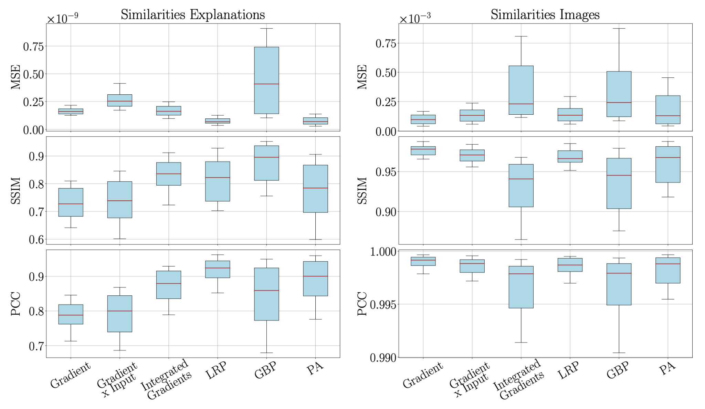
Quantitative Analysis

Slide 16
Theoretical Analysis

Slide 17
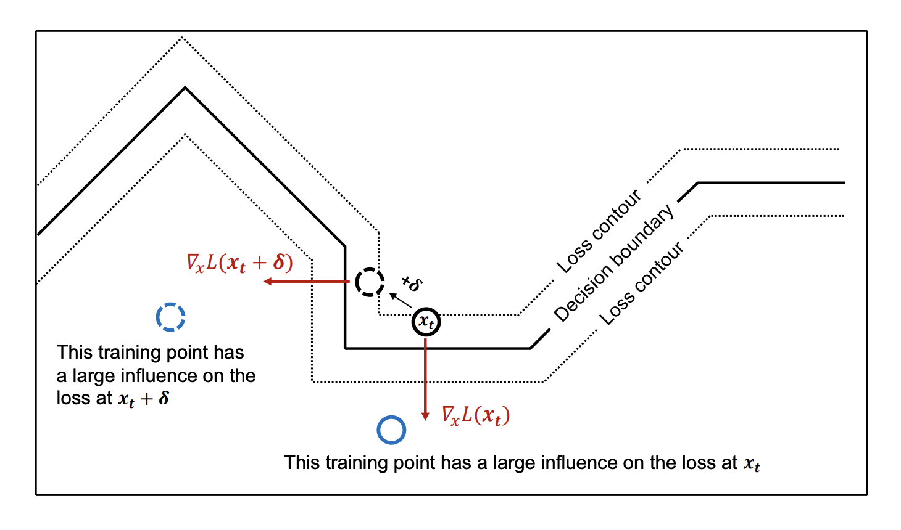
Intuition
Why are explanations vulnerable and unreliable?
Large curvature of the NN output manifold!
[Ghorbani et al. ]
Notes:
Chelsea: elaborate

Slide 18
Theoretical Bound

Slide 19
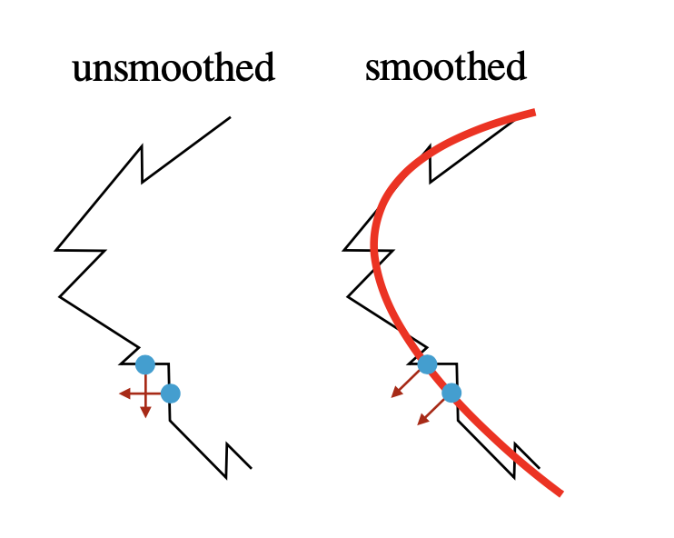
Robustness via smoothing

Slide 20
Smoothing: Connections to SmoothGrad
SmoothGrad
𝛽-smoothing

Slide 21
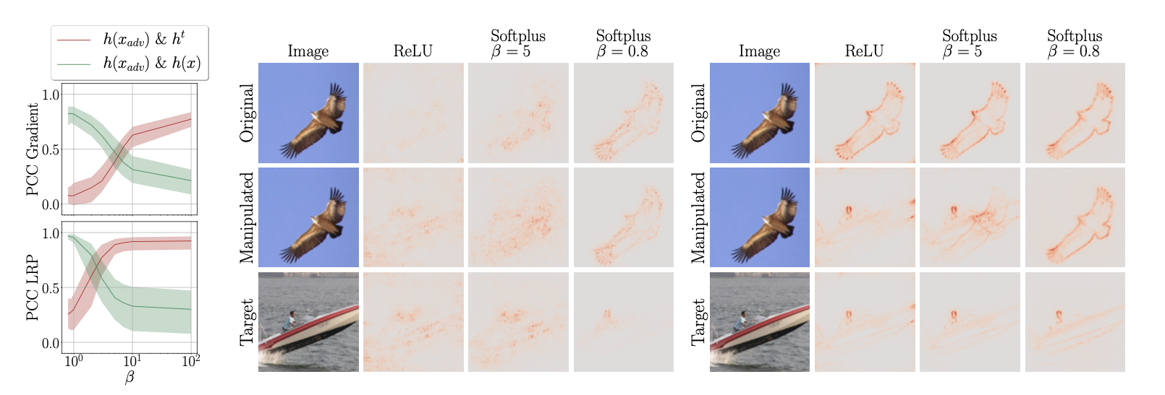
Robustness experiments
Figure 4. 𝛽-smoothing makes explanations more robust.

Slide 22
Robustness experiments
Figure 4. 𝛽-smoothing makes explanations more robust.

Slide 23
Robustness experiments
Gradient
LRP
Figure 4. 𝛽-smoothing makes explanations more robust.

Slide 24
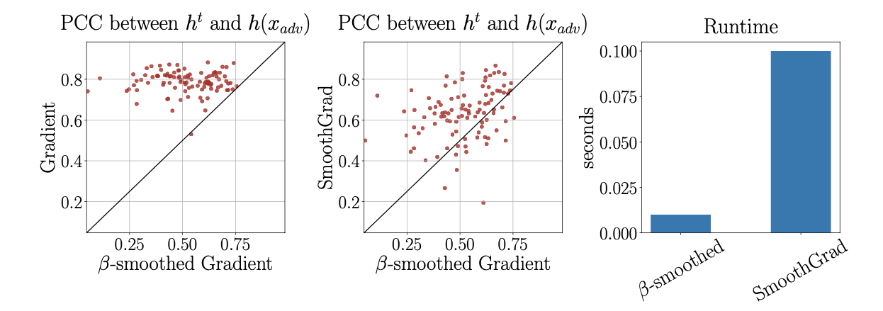
Robustness experiments
Figure 5. 𝛽-smoothing 1) makes explanations more robust
2) is comparable to SmoothGrad
3) has a faster runtime than SmoothGrad

Slide 25
Robustness experiments
Figure 5. 𝛽-smoothing 1) makes explanations more robust
2) is comparable to SmoothGrad
3) has a faster runtime than SmoothGrad

Slide 26
Robustness experiments
Figure 5. 𝛽-smoothing 1) makes explanations more robust
2) is comparable to SmoothGrad
3) has a faster runtime than SmoothGrad

Slide 27
Robustness experiments
Figure 5. 𝛽-smoothing 1) makes explanations more robust
2) is comparable to SmoothGrad
3) has a faster runtime than SmoothGrad

Slide 28
Conclusion

Slide 29
Critique
Strengths
Thorough investigation: problem → reason → solution
Extensive validation: various explanation methods, models, and datasets
Limitations
Analyses focused on relu/softplus activation function
Evaluation of robustness based on Pearson correlation coefficient
Notes:
Towards Robust Explanations for Deep Neural Networks: https://arxiv.org/pdf/2012.10425.pdf

Slide 30
Future directions & food for thought
Future directions
Extend empirical analyses to other tasks and data modalities
Generalize theoretical analyses to propagation-based methods
Modify model training process to make NNs less vulnerable to explanation manipulation
Low-curvature models [Srinivas et al., NeurIPS 2022]
Food for thought
Might there be other reasons for explanations being sensitive to manipulation?
What are other ways to evaluate robustness of explanations?
Is it a good idea to trade-off faithfulness for better robustness?

